Slide 1
Email for Everyone: Creating Accessible Digital Marketing Assets
Cara Weese CRM & Marketing Automation Strategist, Sercante
Katy Hege Front-end Developer, Sercante

Slide 2
Cara Weese
Katy Hege
CRM & Marketing Automation Strategist, Sercante
Front-end Developer, Sercante

Slide 3
Goal
In this session, I will share with you the top resources and items to check off your to-do list when enacting the ADA guidelines in your digital marketing to achieve email accessibility.

Slide 4
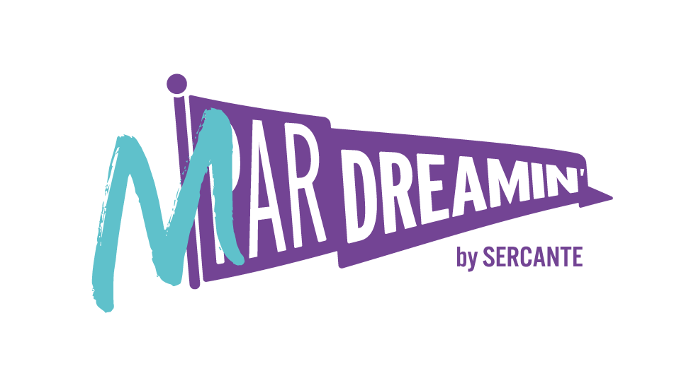
Special Thanks To Our Sponsors
Title
Platinum
Gold
Silver

Slide 5
Why Accessibility Matters

Slide 6
Why does accessibility matter?
Worldwide Stats
More than 1 billion people have a disability (15% of the world’s population)
36 million of the world’s workforce are disabled
In the United States, 1 in 4 adults have some type of disability
Functional Disability Types
Mobility
Cognition
Independent Living
Hearing
Vision
Self-Care
Notes:
Mobility: serious difficulty walking or climbing stairs
Tell personal story; Why accessibility matters to me.

Slide 7
Why does accessibility matter?
43 million of those struggling with a disability live with visual impairments and use assistance when online, including computers, tablets, and phones.
Accessibility Devices
Screen Readers
Magnifiers
Navigation Assistants
Notes:
Screen Readers: software that allows users to read text with a speech synthesizer or braille display
Magnifiers: tools that increase the text size for the reader
Navigation Assistants: systems that guide users via sound commands
As a marketer, it is important for us to take these into consideration when creating our digital marketing content, such as your website, landing pages, emails, social posts, and any other digital content. Overall, companies who practice digital marketing accessibility experience fewer lawsuits, an increased customer base, and an improved sense of brand loyalty.
At the end of the day, this isn’t about accommodating someone’s preferences or unique quirks. It’s about meeting the needs of your customers. The likelihood of one of your customers falling into the 15% of disabled users is very high and meeting their needs should be a top goal for every marketing initiative. Luckily, the best practices for ensuring accessibility in your digital marketing efforts is also the best practice for improved usability and SEO performance across the board.

Slide 8
Why does accessibility matter?
Because you should want to meet the needs of every customer!

Slide 9
Americans with Disabilities Act (ADA)

Slide 10
Americans with Disabilities Act
“Discrimination against individuals with disabilities persists in such critical areas as employment, housing, public accommodations, education, transportation, communication, recreation, institutionalization, health services, voting, and access to public services.”

Slide 11
Americans with Disabilities Act
The Web Content Accessibility Guidelines or WCAG is a worldwide organization that sets the gold standard in providing technical specifications to improve the accessibility of web content, websites and web applications on desktop computers, laptops, tablets and mobile devices for people with a wide range of disabilities, including auditory, cognitive, neurological, physical, speech and visual disabilities.
Web Accessibility Initiative Standards:
Perceivable
The “Should” List
The “May Want To” List
Notes:
Perceivable - Information and user interface components must be presentable to users in ways they can perceive.
The “must” list: Without these changes, at least one group of potential customers will not have access to your information.
Adaptable - Create content that can be presented in different ways (for example simpler layout) without losing information or structure.
The “should” list: Meeting these t=recommendations ensures significant barriers are removed for those with disabilities, increasing your brand visibility.
Distinguishable - Make it easier for users to see and hear content including separating foreground from background.
The “may want to” list: Individuals with disabilities may struggle to fully access your content, but it won’t be impossible.

Slide 12
Accessibility in Digital Marketing Applied

Slide 13
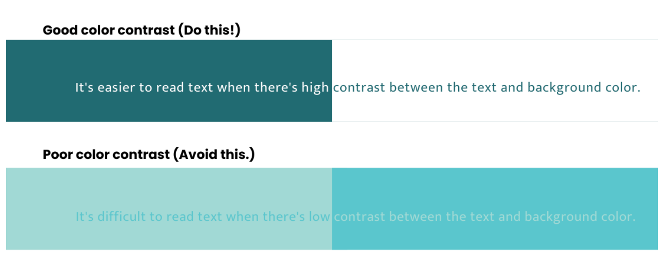
Color Contrast
Notes:
Use clear color contrast between text color and your background. Users with color blindness will be especially thankful to you. So let’s experience less of this and more of that.
We recommend WebAim to measure your color contrast ratio https://webaim.org/resources/contrastchecker/ and https://accessibe.com/. These are great tools that will give you an easy to decipher pass/fail grade for all things accessibility.

Slide 14
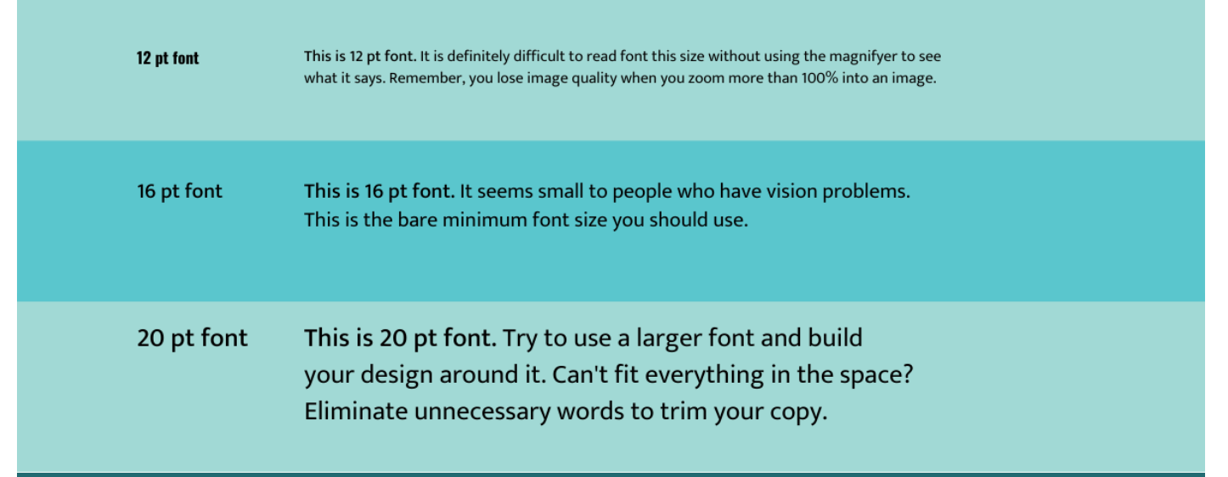
Large Font Sizes
Notes:
While people can use their magnifiers or zoom in on your content, why should they have to? This is especially true if it ruins the look and feel of what you are providing them.
Instead, create your content using larger font sizes, and build the design around it.
The ADA recommends a font size of at least 16 pt on any form of digital media. This is also the preferred size for most of the population.

Slide 15
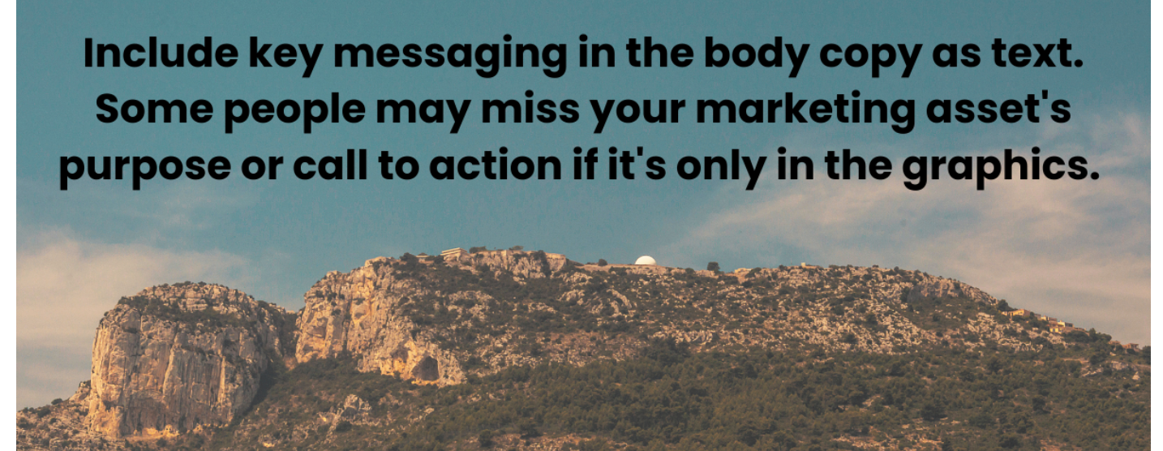
Text & Imagery
Notes:
Avoid using text on your images and graphics. Individuals who use screen readers can’t read text on an image. That’s because screen readers simply see that as a picture file and will overlook it.
Using text in your graphics means some of your readers may not be getting the full message you are trying to present. Ensure that the key content and messaging you are providing is in your text, and use images as a supporting player.

Slide 16
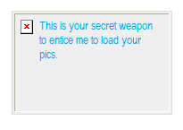
Alternative Text
Populate the alt text to provide context to what the viewer should expect to see.
Not having alt text could result in your email being caught in a spam filter
Email clients may not have images turned on
It’s a MUST-DO

Slide 17
Email Operating Systems
Per Litmus: https://www.litmus.com/blog/why-is-email-rendering-so-complex/
1,000 webmail clients around the world
250 mobile email apps
Notes:
Semantic HTML
It is important that you use semantic HTML as much as possible. What does that mean? HTML means Hyper Text Markup Language and is how the browser or client will read your email.
What happens?
The screen reader reads each header out as you progress through the content, notifying you what each element is. Like a Heading 1 or a paragraph.
It stops after each element, letting the reader go at whatever pace is comfortable.
The reader can jump to the next heading tag
The reader can bring up a list of all headings as a handy table of contents

Slide 18
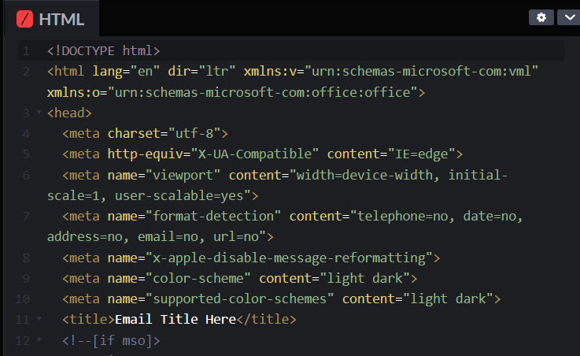
Setting the basics
<!DOCTYPE html>
lang=”und”
dir=”auto” or set explicitly “ltr”
charset - utf-8 covers the most
viewport (pinch and zoom)
format-detection
apple reformatting - fixes the half width email problem
color-scheme
title
Notes:
What happens?
Now the screen reader sees this content as a single block and reads it in one go, all at once.

Slide 19
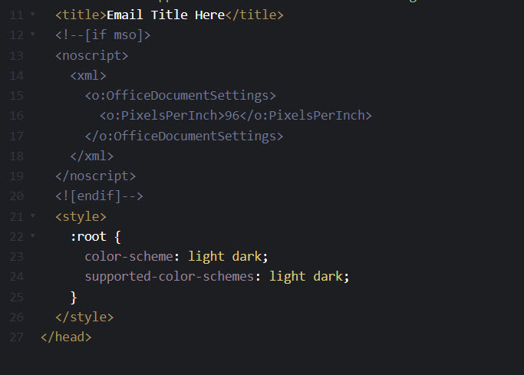
Setting the basics
xml
style
Notes:
What happens?
Now the screen reader sees this content as a single block and reads it in one go, all at once.

Slide 20
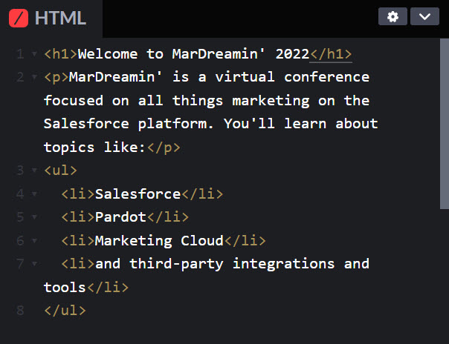
Semantic HTML (Hypertext Markup Language)
What happens?
The screen reader reads each element as you progress
It stops after each
It allows the reader to forward to the next heading tag
It can bring up a list of all headings as a handy table of contents.
Notes:
Semantic HTML
It is important that you use semantic HTML as much as possible. What does that mean? HTML means Hyper Text Markup Language and is how the browser or client will read your email.
What happens?
The screen reader reads each header out as you progress through the content, notifying you what each element is. Like a Heading 1 or a paragraph.
It stops after each element, letting the reader go at whatever pace is comfortable.
The reader can jump to the next heading tag
The reader can bring up a list of all headings as a handy table of contents

Slide 21
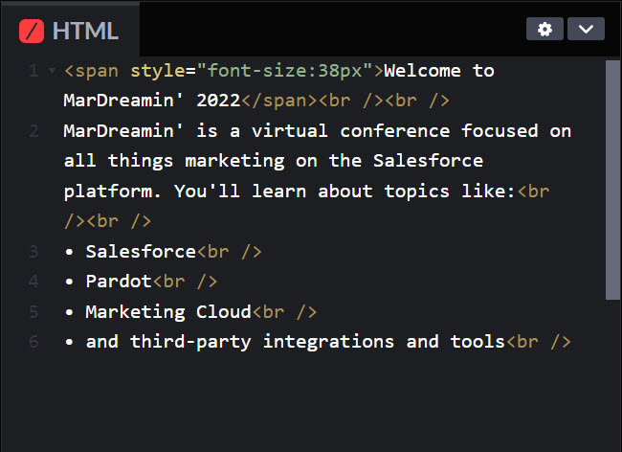
Semantic HTML (Hypertext Markup Language)
Not so great for the reader. What happens?
The screen reader reads this content in one go, all at once.
Notes:
What happens?
Now the screen reader sees this content as a single block and reads it in one go, all at once.

Slide 22
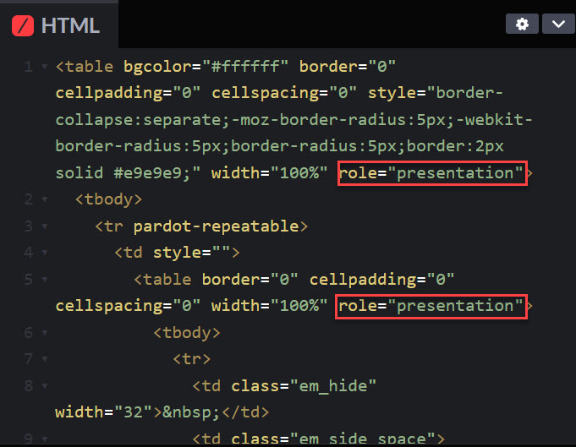
Tables
ARIA
Not to be used in substitute of Semantics
aria-hidden=“true”
ROLE
role=”presentation”
role=”none”
Notes:
What happens?
Now the screen reader sees this content as a single block and reads it in one go, all at once.

Slide 23
Use Legible Fonts
Sans-Serif fonts are considered compliant:
Tahoma
Calibri
Helvetica
Arial
Verdana
Times New Roman
Slab serif fonts can include
Arvo
Museo Slab
Rockwell
Notes:
What does that mean?
Inaccessible fonts have one or more of the following characteristics:
+ Make it difficult to distinguish between the shapes of different letters and characters + Slow the reader down + Make it hard to separate one letter from another with overlapping characters or letters + Are decorative or include unnecessary adornments + Are specialty display fonts, such as handwriting style, custom, or cursive • Besides being the right thing to do, using accessible fonts on your website is the only way you can avoid violating accessibility standards set out in US law. • The most accessible sans-serif fonts are Tahoma, Calibri, Helvetica, Arial, Verdana, and Times New Roman. Slab serif fonts including Arvo, Museo Slab, and Rockwell are also considered to be accessible. These font types are mostly used in headings rather than the body text.
Plain Text
This is an easy win for our Marketing Cloud Account Engagement (Pardot) users!
When building an email in Pardot, you are required to create a text version of every email you deploy. This ensures accessibility for all recipients and allows for you to include the pertinent information in a text email that assistive devices can easily access.
Any type of bright, strobing media can cause dangerous, life-threatening seizures. This can include emojis such as the Party Parrot or flashing Gifs.
Images that could cause seizures include:
Flash more than 3 times per second
Are sufficiently large
Are right with high contrast

Slide 24
Use Clear Language
Be very specific and avoid shorthand or abbreviations. For example:
Instead of 1-2, write 1 to 2
Instead of Nov, write November
Expand acronyms, at least once, then use the <abbr> tag to describe them
Notes:
Example:
If you're writing an article about ARIA, explain that ARIA is an acronym for "Accessible Rich Internet Applications".

Slide 25
Emojis
Use sparingly - alt text descriptions are embedded
Don’t do in a subject line: ⏲️⏲️⏲️ Event starts in 1 week
Not a substitute for words
Don’t do: Come out and 🎉 with us.
Use emoji after main message or a CTA
Do: Come out and celebrate with us! 🎉
Avoid ambiguous emojis 🙏
Do not use emoticons instead of emojis
Use a neutral yellow skin tone as it has the best light/dark mode contrast
Notes:
Emojis • Use sparingly and do not repeat - keep in mind that emojis have alt text descriptions embedded in them and they will be read out by the screen readers • Bad example: Timeclock timeclock timeclock Event starts in 1 week (I am guilty of doing this) • Do not use to replace words • Don’t do: Come out and 🎉 with us. • Use emoji after CTA and not before. We want people to get the message 1st and foremost • Do: Come out and celebrate with us! 🎉 • Avoid ambiguous emojis that are likely to be interpreted differently by different people. Is the folded hands emoji a gesture of thanks or prayer? 🙏 • Do not use emoticons instead of emojis. As described before, Emojis have alt text descriptions embedded and can be parsed by the screen reader as text, whereas emoticons are just manipulation of symbols and punctuation marks that will be read just that: punctuation marks. (again, guilty)
• Use a neutral yellow emoji and avoid dark or light skin color as it has the best contrast for light and dark mode backgrounds.

Slide 26
Coding for Dark Mode
Dark Mode
Why users prefer it?
Decrease eye strain
Reduce flicker, glare, and blue light
Color preference
Readability? We’ll cover that shortly.
What quick wins can we code for:
Logo
Fix unwanted color changes

Slide 27
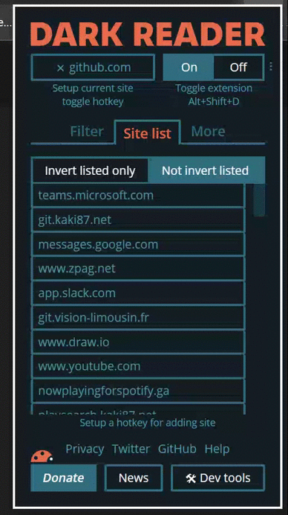
Dark Reader
For those websites that don't have a native dark mode feature there are apps, such as Dark Reader which is available for Chrome and Firefox. Unlike most dark themed extensions that create a custom dark mode for individual websites, Dark Reader creates a dark theme for the sites you visit without having to install custom styles or themes.
Let’s see it in action!
https://darkreader.org

Slide 28
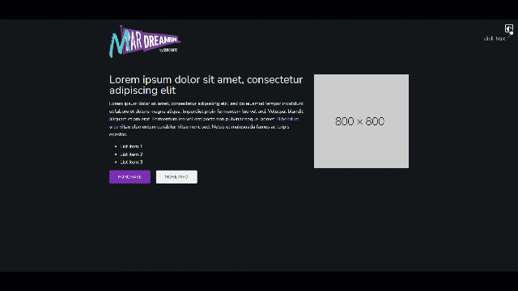
Coding for Landing Pages in Dark Mode
Coding your HTML layout template in Marketing Cloud Account Engagement to have a dark and light mode option is actually pretty simple when planning for it right from the beginning. This is controlled by a toggle button feature.
Let’s see it in action!

Slide 29
Coding Emails in Dark Mode
Coding for HTML emails in dark mode can be its own challenge.
Email clients render it differently
Some clients will force dark mode
May not always work with brand styles
Not always better for readability
Color contrast raises accessibility issues

Slide 30
Coding Emails in Dark Mode
Recommendations for email code fixes:
Logo (or any image) dark and light mode options
How to fix unwanted color changes to simple colored areas of your emails
Text color changes in VML (Outlook) with background images

Slide 31
Logo Options
Apply your logo as a PNG
Apply your logo with a border
Add a stroke to your border

Slide 32
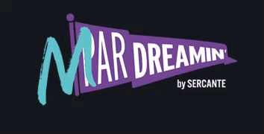
Light & Dark Logo Options
#1 request is to have the logo in dark AND light mode
Notes:
You can be sure your logos are legible in dark mode by doing the following:
Apply your logo as a PNG — PNG images can support transparent backgrounds. Leaving your logo set as a JPG may leave your logo with an unsightly white square.
Add a 2 pixel stroke to your logo — By adding a 2px outer stroke to your logo can make your logo stand out in dark mode, that will be invisible in light mode on a white background.

Slide 33
Adjust Colors for Your Brand’s
Preferred Dark Mode Theme
Enable dark mode for subscribers that have dark mode turned on:
Add Dark Mode styles for @media (prefers-color-scheme: dark)
Support dark mode styles in Outlook app by adding [data-ogsc] prefix
Added a class ‘darkmode’
Check out our test with the different logos and background colors

Slide 34
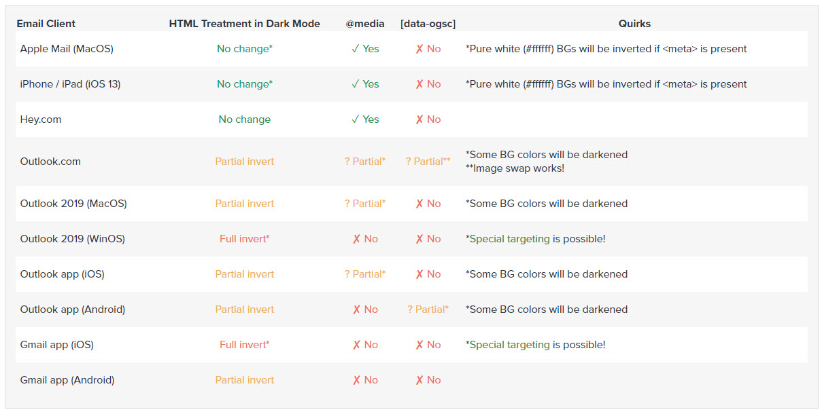
Coding Emails in Dark Mode
Not all email clients support dark mode no matter how we try. https://www.litmus.com/blog/the-ultimate-guide-to-dark-mode-for-email-marketers/

Slide 35
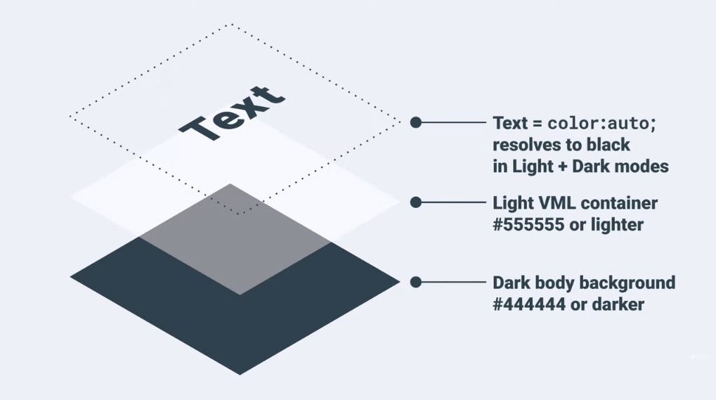
Adjust Colors for Your Brand’s
Preferred Dark Mode Theme
Background images can be tricky but with some inline styles we can gain some control
If your background color on the body tag is set to a dark color and your VML fill color is lighter than #555555, your text color:auto will resolve to black in Dark mode
If your background color on the body tag is set to a light color and your VML fill color is darker than #333333, your text color:auto will resolve to white in Dark mode

Slide 36
Additional Tips
Keep text at a reasonable size, 14px to 16px is typical
Line-height is just as important and based on the font, you may need to adjust that.
Clean typography
Don’t keep switching it out
Avoid using all caps
Don’t underline text
Use left-aligned text
Write descriptive link text
Bad example: I think you should read this article.
Good example: I think you should read this article about MarDreamin’ 2022.
Maintain a logical structure
Does your email still make sense when stacking responsive? Is the information still in the correct order?
Include a plain-text version for subscribers that prefer them
Notes:
Visual Hierarchy
Use headers and subheadings appropriately to provide the reader with an overview of the content and establish the key points. Also, use breaks and keep content left aligned when possible. This helps visually-impaired readers define the critical information that is being provided and allows for an easier experience when they don’t have to jump around due to justification changes.
Plain Text
This is an easy win for our Marketing Cloud Account Engagement (Pardot) users!
When building an email in Pardot, you are required to create a text version of every email you deploy. This ensures accessibility for all recipients and allows for you to include the pertinent information in a text email that assistive devices can easily access.
Any type of bright, strobing media can cause dangerous, life-threatening seizures. This can include emojis such as the Party Parrot or flashing Gifs.
Images that could cause seizures include:
Flash more than 3 times per second
Are sufficiently large
Are right with high contrast

Slide 37
Additional Tips
Visual Hierarchy
Headers
Subheadings
Breaks
Left Alignment
Plain Text
Required in Marketing Cloud Account Engagement
Accessible Links
Spacing or Bullets
Emoji Overload
Flashing
Large Sizes
Bright/High Contrast
Tool Tip: https://accessibe.com/
Notes:
Visual Hierarchy
Use headers and subheadings appropriately to provide the reader with an overview of the content and establish the key points. Also, use breaks and keep content left aligned when possible. This helps visually-impaired readers define the critical information that is being provided and allows for an easier experience when they don’t have to jump around due to justification changes.
Plain Text
This is an easy win for our Marketing Cloud Account Engagement (Pardot) users!
When building an email in Pardot, you are required to create a text version of every email you deploy. This ensures accessibility for all recipients and allows for you to include the pertinent information in a text email that assistive devices can easily access.
Any type of bright, strobing media can cause dangerous, life-threatening seizures. This can include emojis such as the Party Parrot or flashing Gifs.
Images that could cause seizures include:
Flash more than 3 times per second
Are sufficiently large
Are right with high contrast

Slide 38
Additional Tips
Visual Hierarchy
Headers
Subheadings
Breaks
Left Alignment
Plain Text
Required in Marketing Cloud Account Engagement
Accessible Links
Spacing or Bullets
Emoji Overload
Flashing
Large Sizes
Bright/High Contrast
Tool Tip: https://accessibe.com/
Notes:
Visual Hierarchy
Use headers and subheadings appropriately to provide the reader with an overview of the content and establish the key points. Also, use breaks and keep content left aligned when possible. This helps visually-impaired readers define the critical information that is being provided and allows for an easier experience when they don’t have to jump around due to justification changes.
Plain Text
This is an easy win for our Marketing Cloud Account Engagement (Pardot) users!
When building an email in Pardot, you are required to create a text version of every email you deploy. This ensures accessibility for all recipients and allows for you to include the pertinent information in a text email that assistive devices can easily access.
Any type of bright, strobing media can cause dangerous, life-threatening seizures. This can include emojis such as the Party Parrot or flashing Gifs.
Images that could cause seizures include:
Flash more than 3 times per second
Are sufficiently large
Are right with high contrast

Slide 39
Resources
https://www.w3.org/TR/WCAG20-TECHS/ARIA14.html
https://www.emailonacid.com/blog/article/email-development/how-to-code-accessible-emails/
https://www.w3.org/TR/wai-aria-1.1/
https://www.powermapper.com/
https://www.litmus.com/blog/ultimate-guide-accessible-emails
https://www.accessibe.com
https://digitalaccess.ucsf.edu
https://www.litmus.com/blog/why-is-email-rendering-so-complex/
https://www.litmus.com/blog/the-ultimate-guide-to-dark-mode-for-email-marketers/

Slide 40
Cara Weese
cara@sercante.com

