Slide 1
How to deploy data for success, scale and customer experience
Jason Cort Co-Founder, HowToSFMC.com
CRM Technology Lead, The Co-operative Group

Slide 2
Special Thanks To Our Sponsors
Title
Platinum
Gold
Silver

Slide 3
About me
CRM Technology Lead, The Co-operative Group
Co-Founder, HowToSFMC.com
4x SFMC Certified
2020+ Salesforce Marketing Champion

Slide 4
What to expect today
Why now?
Effective Data Modelling in Salesforce Marketing Cloud
How to scale

Slide 5
Why now?

Slide 6
Salesforce State of Marketing 2021
42%
Marketers satisfied with data quality and data hygiene
37%
Marketers satisfied with the timeliness of the data available to them
40%
Forecasted increases in data sources between 2021 and 2022
Notes:
Inspired by Salesforce State of Marketing report
Highlighted shortcomings for many marketers who want to use more data
There is more data coming
We need to do better
SFMC will enable us to do better

Slide 7
39%
Technology can help improve this
Marketers satisfied with the accessibility of their data
Notes:
Improving these Metrics is how to define success.
Since putting this presentation together, Salesforce have released a new State of Marketing with some similar themes (only a couple of days ago!)
Some of these predictions came true, 2021 it was 10 data sources, now it’s 15. Prediction is 18 next year.
Other comments this year are around doing more with less, tightening budgets and customer expectations continuing to rise.

Slide 8
Your data has limited value until you can reliably and repeatedly act on it

Slide 9
Effective Data Modelling in SFMC

Slide 10
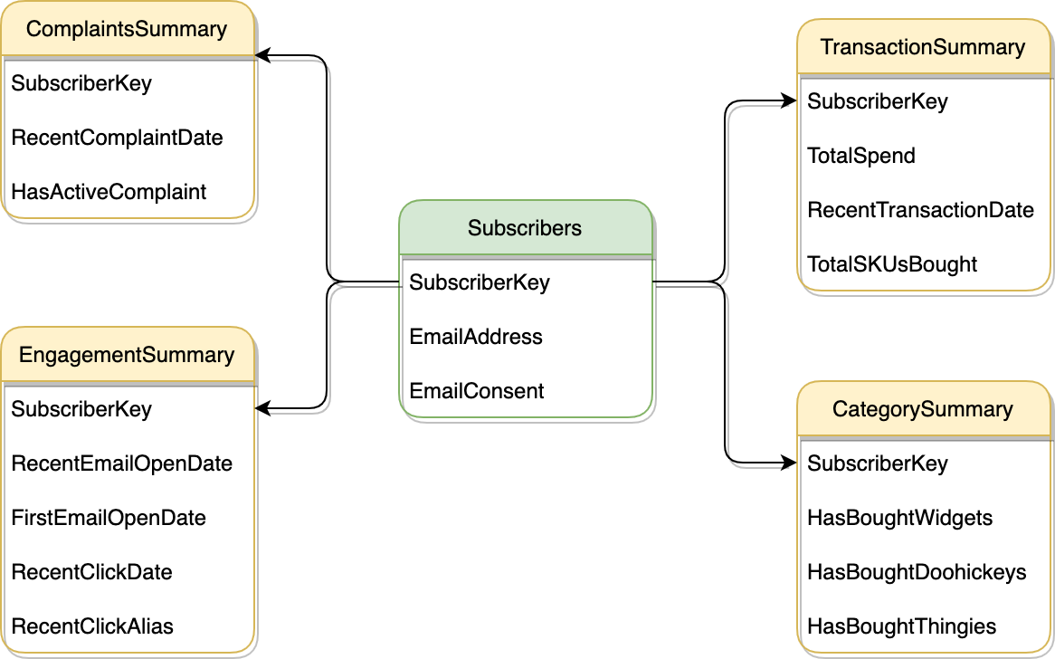
What is a Data Model?
Notes:
You may be familiar with terms like data schema, database layout, data structure etc.
In this instance, a Data Model is the structure of attributes in tables/Data Extensions and the relationships between them. It’s essentially the way your users interact with data and the way your data interacts with subscribers.

Slide 11
What is effective data modelling?
Enhances Processes
Empowers Users
Step 1
Step 2
Step 3
Step 4
Satisfies Customers
Drives Business Value
Doesn’t Stop
Notes:
Data models don’t define processes - if you have a cumbersome process, a data model may help alleviate the problem, but don’t expect it to solve it
Empower users - give the right people the right data and they’ll give you the right results
Satisfy your customers - customers expect more and more from digital experiences every year. If you satisfy and delight them, they’ll be back
Drive business value - whether you’re looking to do more campaigns with better segmentation or just manage the cost of selling products by offering lower discount
Data isn’t stopping, data doesn’t stop. Build a monolith that can be “completed” doesn’t create a scalable data model. (Sorry to the team)

Slide 12
Data Modelling Output Best Practices
Well Defined Data Dictionary
Enables Personalised Experiences
Enhances OOTB Tooling
Delivers Business Objectives
Operationally Efficient
Standardised Attributes
Notes:
The bits that end users see and work with
Inherited a data model that once had:
Email - Boolean (Meant consent)
EmailAddress - Boolean (Meant email address was present)
CustomerEmail - Boolean (Meant the email related to a customer)
CustomerEmailAddress - Email Address (The Actual email address)

Slide 13
Data Modelling Build Best Practices
Isn’t repetitive
Is consistent
Modular in design
Low dependencies
Is iterable
Managed with configuration vs. pure code
Notes:
The bits that end users see and work with
Inherited a data model that once had:
Email - Boolean (Meant consent)
EmailAddress - Boolean (Meant email address was present)
CustomerEmail - Boolean (Meant the email related to a customer)
CustomerEmailAddress - Email Address (The Actual email address)
Isn’t repetitive:
Don’t have the same attribute lots of times, unless it’s a relationship attribute
Is consistent:
No matter who uses the data model, they should all get the same result
Modular in design:
Building a monolith means dismantling a monolith when it comes time to change and will inhibit your ability to scale
Low dependencies:
You want your model to be dependent upon as few elements as possible. Combined with modular this means that if on a given day you’re missing transaction data, you can still run a campaign that doesn’t need it. But if your model needs transactions to be complete at all you’ll be a day without campaigns
Is iterable:
One of the biggest bugbears of mine is one all singing and dancing data extension, table, object with 200 fields so when you want to iterate you’ve got nowhere to iterate in to.
Managed with configuration vs Pure code:
At the heart, I’m a developer and I’m a huge proponent of the value of code. But I’m also a massive advocate for being “lazy”. Where possible, use configuration rather than pure code. It’s a little bit of extra effort up front to create the configuration element. But the efficiency gains from it are amazing.
Additional one for SFMC specifically, aim to have your core segmentations and personalisation requirements in 1 to 1 related Data Extensions where possible.

Slide 14
How to make the most of your data
Modelling for scale

Slide 15
Considerations
Purpose
What function does this data perform?
User
Who is using the data?
What is the skillset?
Tooling
What tools do you have at your disposal?

Slide 16
Considerations
Customer Experience
How does this impact your customers?
Process
Where does it live in your processes?
Value
Does this add value to the business and/or the customer?

Slide 17
Purpose
Segmentation
Operational
Analytical
Personalisation
What function does this data perform?
Notes:
Every attribute in a data model needs to have a purpose and a function
Operational - Like an email address?
Segmentation - Like an age?
Personalisation - Like a name?
Analytical - Like a stratified control group?
Example where specifically considering the purpose can lead to additional value with no repetition: If there is a segmentation requirement for “Has transacted in the last 90 days”. You could tackle that as a boolean yes/no field. You could also tackle that as a date field for “most recent transaction date”. That way if there’s any new segmentation requirements around how long it has been since someone transacted, the data is there. You don’t need to add a new attribute for “Has transacted in last 180 day”. You just change the most recent transaction date criteria to be 180 days rather than 90 days.

Slide 18
User
Who is using the data?
Notes:
Each business is different, so take these users with a grain of salt. You may be in an org where everyone can do everything and you’ve got some superstars or you may be in an org where everyone is specifically tasked with a small subset of activities. You may have some more T-Shaped marketers who can do bits of campaign dev, analysis and marketing and then a lot of one of those things. Different operating models call for different things.

Slide 19
Users
Campaign Developer
Campaign Analyst
Digital
Marketer
Notes:
Each of these is a customer of or a contributor to the requirements of a Data Model
Campaign Developer - Wizard of HTML and super competent with AMPscript
Campaign Analyst - Knows the raw data in and out and can find out anything you need, writes some amazing SQL and can put together audiences.
Digital Marketer - Has the eye for opportunity, design and campaign performance, makes sure the customer is happy and getting the most relevant content.
Think about your users and who does what and why.

Slide 20
Processes
Where does your data model live within your processes?

Slide 21
Processes
Campaign Ideas
Campaign Content
Campaign Reporting
Audience Selection & Campaign Validation
Campaign Dispatch
Strategic Analysis

Slide 22
Tooling
What tools do you have in Salesforce Marketing Cloud?

Slide 23
Tooling
SQL
Code based data manipulation and selections
Filters
No hassle, no code required - structured data selections
Journeys
Dynamic, decision based customer experiences
AMPscript
Code based data formatting, selection and much more for use in campaigns
Notes:
4 key tools natively at your disposal in SFMC. If you’re already using Journey Builder it’s likely you have all of these available to you at no extra cost and they may already be parts of various workflows.
Think about which users can use each tool etc.

Slide 24
Working an example

Slide 25
An example team

Slide 26
What this team and the process leads to…
Campaign Ideas
Campaign Content
Campaign Reporting
Audience Build & Campaign Validation
Campaign Dispatch
Strategic Analysis

Slide 27
How does this scale?
Solving a bottleneck, by modelling your data and empowering users

Slide 28
Resource and skills analysis
In the example team we have a lot of Digital Marketers compared to other parts of the team.
This creates bottlenecks with multiple asks going to singular dependencies.
Notes:
In this instance, empowering the Digital Marketers to do a little more by making your data model accessible to them in tools they would typically use is going to add a lot of value.

Slide 29
What about some tweaks to process…
Campaign Ideas
Audience Build
Campaign Dispatch
Strategic Analysis
Campaign Validation
Campaign Content
Campaign Reporting
Notes:
We’ve identified the change
Summarily: Make the data more accessible to Digital Marketers, using a tool they may be familiar with or has a low barrier to entry such as Data Filters.

Slide 30
Building your data model
Driving value, with the right code in the right places

Slide 31
Start with your contactable concept. This may be a lead, contact, household or what makes sense in your business
Notes:
SQL Query to get your Contact Identifier (SubscriberKey, PersonContactID etc.) File import etc. synchronised objects from Sales/Service Cloud, Snowflake whatever… Start with your contactable concept.

Slide 32
Add some key details
Email Address
Email Opt In
Notes:
You can start doing marketing email activity with as little as this.
It wouldn’t be best practice to just email everyone who was opted in to email, but fundamentally all email marketing starts with “Find me opted in people” Segmentation is just the art of finding a smaller group of opted in to email people to deliver the same results, so you can send something different to everyone else.

Slide 33
Add another data extension
Average Order Value
Recent Order Date
Email Address
Email Opt In
Notes:
Again - Fundamentally now you can segment lapsing shoppers. Opted in and not transacted for 3 months? Opted in and not transacted for 3 month but historically high value shopper? Options are there for you.

Slide 34
Add a few more attributes to personalise
Average Order Value
Recent Order Date
Email Address
Email Opt In
First Name
Age
Town
Notes:
Throw a bit of personalisation in here now
Hi Jason!
It’s been a while.

Slide 35
A couple more attributes
Average Order Value
Recent Order Date
First Order Date
# of cancelled orders
Email Address
Email Opt In
First Name
Age
Town
Favourite Colour

Slide 36
Keep going
Last Website Login
Forgotten Password
Website Sign up Date
Average Order Value
Recent Order Date
First Order Date
# of cancelled orders
Email Address
Email Opt In
First Name
Age
Town
Favourite Colour

Slide 37
Keep going
Last Website Login
Forgotten Password
Website Sign up Date
Average Order Value
Recent Order Date
First Order Date
# of cancelled orders
Email Address
Email Opt In
First Name
Age
Town
Favourite Colour
Uses your app

Slide 38
Keep going
Last Website Login
Forgotten Password
Website Sign up Date
Average Order Value
Recent Order Date
First Order Date
# of cancelled orders
Email Address
Email Opt In
First Name
Age
Town
Favourite Colour
Uses your app
Active Support Case
Active Support Status
# of cases

Slide 39
Until eventually
Loyalty Tier
Reward Points
Last Website Login
Forgotten Password
Website Sign up Date
Average Order Value
Recent Order Date
First Order Date
# of cancelled orders
Email Address
Email Opt In
First Name
Age
Town
Favourite Colour
Uses your app
Active Support Case
Active Support Status
# of cases

Slide 40
You can do this, with a filter
Loyalty Tier - Gold
Recent Order was more than 2 weeks ago
Never logged in
Has an email address
Is Opted in
Lives in London
Uses your app
No Active Cases
Notes:
If you factor this in to the process above, digital marketers can quickly and reliably get an opportunity size for the message with filtered data in SFMC.
Campaign analyst gets time to spend on more complex campaign opportunities or bigger strategic analysis projects.
By using a structured data model, the code the Campaign Developer is writing can be re-used because the structure remains consistent.

Slide 41
Now personalise
A little bit of AMPscript

Slide 42
AMPscript Toolbox
LookUpRows
Find data based on search criteria
IF/ELSE/ENDIF
Apply decisions based on your data
V
Output the data or decisions
Format
Change the way the output appears
TitleCase
For pesky all upper or lower case data
TreatAsContent
Force AMPscript to evaluated as written
Notes:
Everyone has their own favourite tools, whether it’s a screwdriver or a place they like to write code. Here are my go to AMPscript tools when I’m creating simple personalised content. Moving on to more advanced you’d include things like a FOR Loop, but if you’re new to AMPscript, these functions will get you going at a pretty swift pace.

Slide 43
Example
%%[
SET @SubscriberKey = _SubscriberKey
SET @LookUpDE = "CustomerTransactionSummary"
SET @LookUpDERows = LOOKUPROWS(@LookUpDE,'SubscriberKey',@SubscriberKey)
SET @LookUpDERow = ROW(@LookUpDERows,1)
SET @RecentOrderDate = FIELD(@LookUpDERow,"RecentOrderDate")
]%%
Hey, you’ve not shopped with us since %%=V(@RecentOrderDate)=%%. Are you still fully stocked?

Slide 44
Output
Hey, you’ve not transacted with us since 01/07/2022. Are you still fully stocked?

Slide 45
How to scale

Slide 46
Standardise
Create patterns and stick to them
Notes:
Standardisation doesn’t have to mean simplify
Standardisation doesn’t have to mean stop thinking
Standardisation means more time to do less boring stuff

Slide 47
Automate
Let the technology do what the technology does best
Notes:
Work out what can be automated and when
Don’t automate everything for every hour, but if you need to update at 10am every day - crack on. By adding things in SFMC, you can do that no problem with automation studio.
Automation is a massive topic and would take days to really get into the nitty gritty of. But. definitely read the book recently written by Greg Gifford/Jason Hanshaw if you’re unsure of how to automate in SFMC

Slide 48
Iterate
Don’t get stagnant
Notes:
Lots of scalable projects end up monolithic and unable to scale because the actual concept of scaling isn’t iterated on.
Example of this: My team are on the 5th or 6th iteration of how we actually build a data model. Each one adding improvements to the process in some capacity.

Slide 49
Being able to scale is a culture shift, not just a technology shift.
Notes:
Scalability isn’t going to be solved by expensive and capable software.

Slide 50
Jason Cort
Twitter: @HelloJasoco
HowToSFMC.com

