Slide 1
Embrace a first-party data strategy for Sales and Marketing
Jaime López Sr. Director, Content & MOps at Aiven
Natasha Martin Marketing Automation Manager, Love’s Travel Stops

Slide 2
Jaime López
Natasha Martin
Sr. Director, Content & MOps
Aiven
Marketing Automation Manager, Love’s Travel Stops & Country Stores

Slide 3
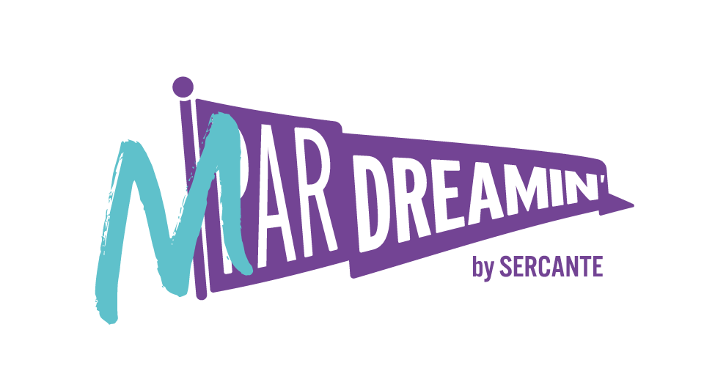
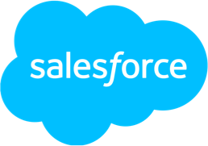
Special Thanks To Our Sponsors
Title
Platinum
Gold
Silver

Slide 4
Agenda
The data party
What is first-party (and zero-party) data and why it matters
What to bring?
Ideas to enhance your customer data strategy
What can I do?
Examples in MC and MCAE

Slide 5
The data party
Data types and why they matter

Slide 6
Why does this matter?
Regulatory framework constantly changing
Consent is the strongest grounds for data processing
3rd party data trade is noncompliant or very restricted in EU, California

Slide 7
Data Types
Zero-Party Data
* Explicitly given (progressive profiling)
* Collected through account signups, surveys, etc.
* Most reliable, but preferences may change over time
First-Party Data
* Collected through purchases, known web engagement, other direct interactions with a brand
* Very reliable
Second-Party Data
* Vendor partnerships
* Data collected from another company and paired with internal first-party data
* Less reliable
Third-Party Data
* Ability to target anonymous segments through a third-party aggregator
* Uses AI and “fuzzy matching”
* Least reliable
Self-reported
Internal systems data, 1:1 relationship
Some anonymized, AI-matched
Anonymized identity mapping, lower volume, more niche, shared
Anonymized, AI-matched
Customer Preferences
Customer Purchases
Vendor Partnership Data
Multi-brand aggregators
Notes:
JAIME 1-6

Slide 8
What Type of First-Party Data Should You
Prioritize?

Slide 9
What data to prioritize?
Think about your customer’s journey with your brand (holistically)
Define your engagement strategies and goals with messaging
Determine how those tie back to these measurable areas: lift, upsell, retention, or win-back opportunities
Identify messaging that will be most impactful to achieving those measurable goals
Define data points needed to make each of those messaging journeys happen
Notes:
Think about your customer’s journey with your brand holistically (aquiring, onboarding,engaging, retaining as brand advocate)
What are your engagement strategies/goals and how do those tie back to measurable data points: lift, upsell, retention, or win-back opportunities?
From there, identify messaging that will be the most impactful, and what data points you’ll need to make each one of those messaging journeys happen (triggering, personalization, conversion tracking)

Slide 10
How Will You Use That
Data in Campaigns
And Messaging?
Notes:
Build out a solution architecture for the highest priority messaging campaigns you want to run to make sure you’ve identified all the data you’ll need:
Data to apply logic when determining whether to trigger a message (through APIs, with Automation Studio, or via Salesforce Core)
Data to apply logic and personalization within your channel messaging templates
Data to reference within Journey Builder to determine exit flows, track conversions, or send customers down a specific messaging path
Data to measure the effectiveness of a campaign (this usually requires a connector to Tableau CRM or extraction to another system for analysis, but you can use tools like Datorama to achieve this)

Slide 11
How will you use the data?
Apply logic when determining whether to trigger a message (through APIs, with Automation Studio, or via Salesforce Core)
Apply logic and personalization within your channel messaging templates
Reference within Journey Builder to send customers down a specific messaging path, track conversions, or determine exit flows
Measure the effectiveness of a campaign (this usually requires a connector to Tableau CRM or extraction to another system for analysis, but you can use tools like Datorama to achieve this)
Notes:
Build out a solution architecture for the highest priority messaging campaigns you want to run to make sure you’ve identified all the data you’ll need:
Data to apply logic when determining whether to trigger a message (through APIs, with Automation Studio, or via Salesforce Core)
Data to apply logic and personalization within your channel messaging templates
Data to reference within Journey Builder to determine exit flows, track conversions, or send customers down a specific messaging path
Data to measure the effectiveness of a campaign (this usually requires a connector to Tableau CRM or extraction to another system for analysis, but you can use tools like Datorama to achieve this)

Slide 12
What Technologies Do
You Need to Surface
That Data?
Interesting examples in MC and MCAE
Notes:
Depends on the specific needs of your business
Work internally or with an analytics team to identify source systems for that data and how you can surface that data to be actionable
We’ll look at a couple common architecture patterns now:

Slide 13
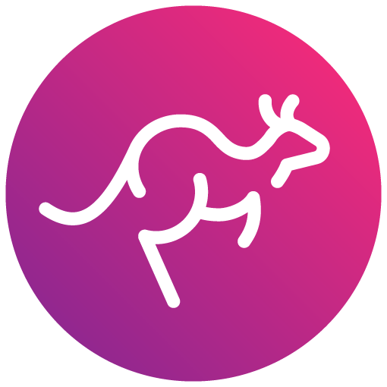
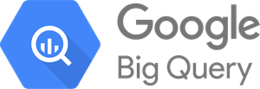
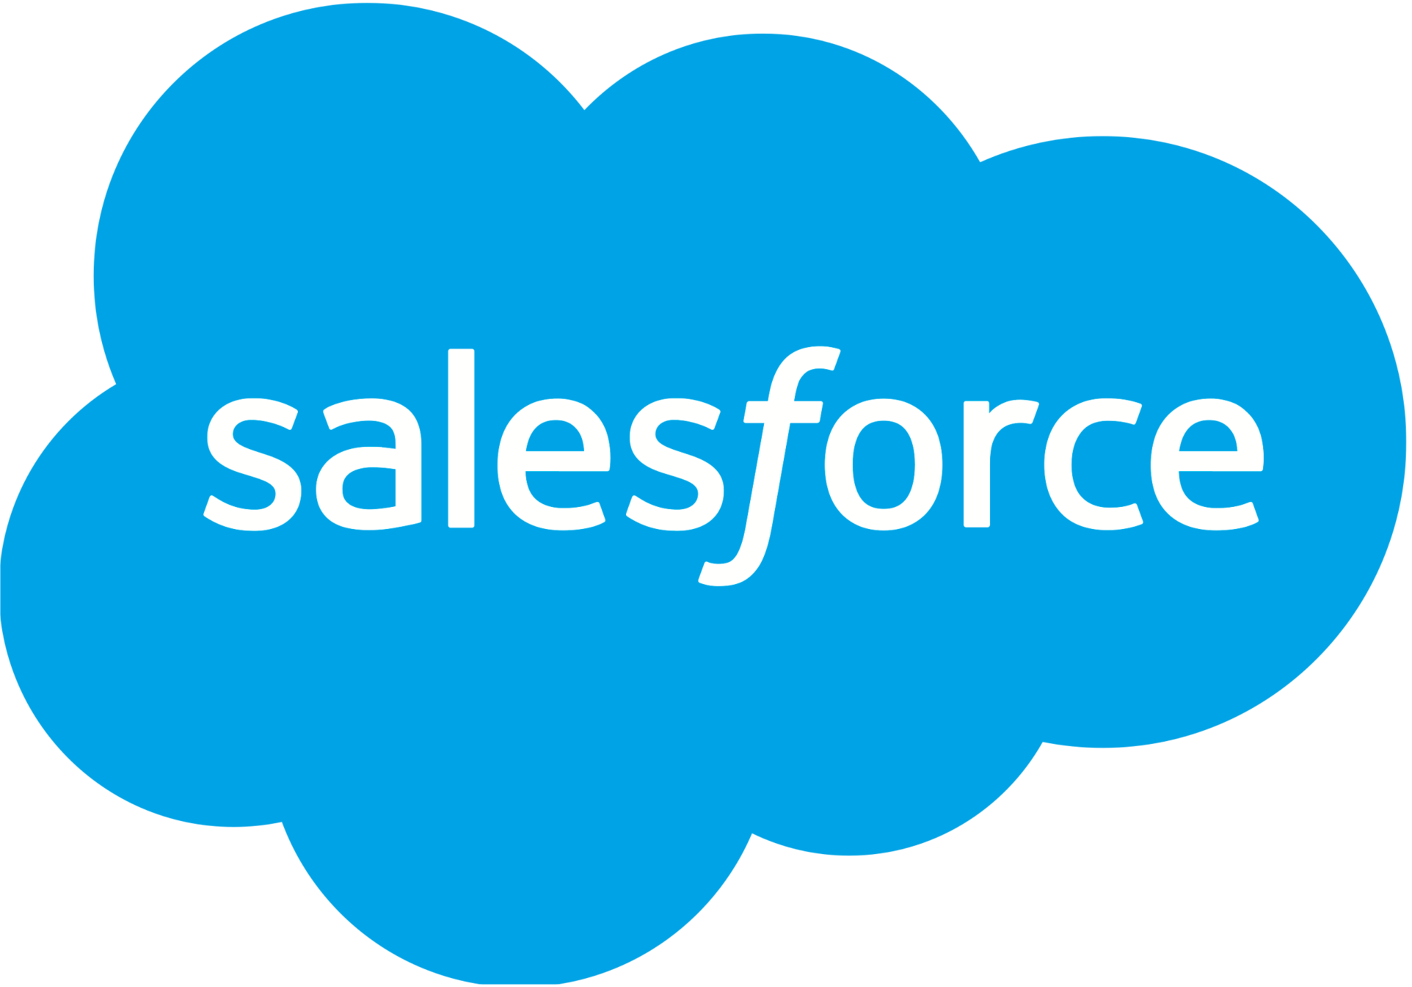
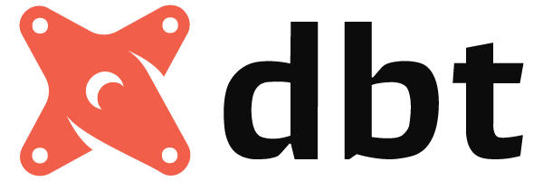
Aiven’s data architecture (MCAE)
First-party
Product
Website + docs
MCAE
Third-party
Marketing channels
Marketplaces
Service channels

Slide 14
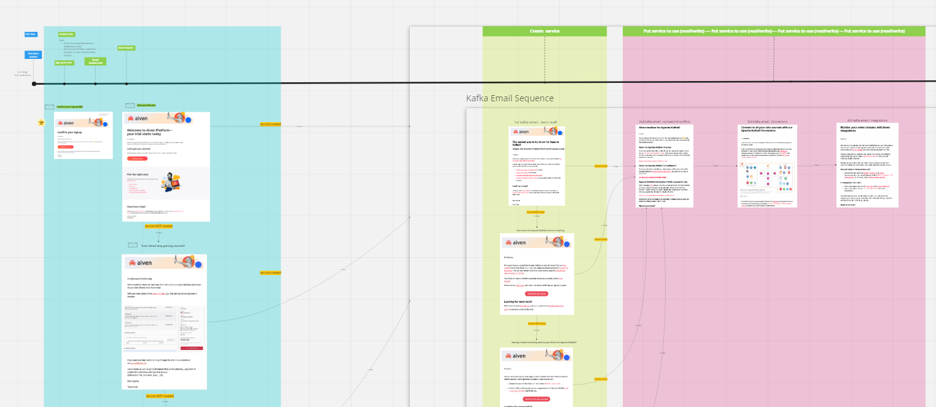
Aiven’s trial communications
Create first service
Confirm credentials & provision project
Use service & load data
Activate user in <4h

Slide 15
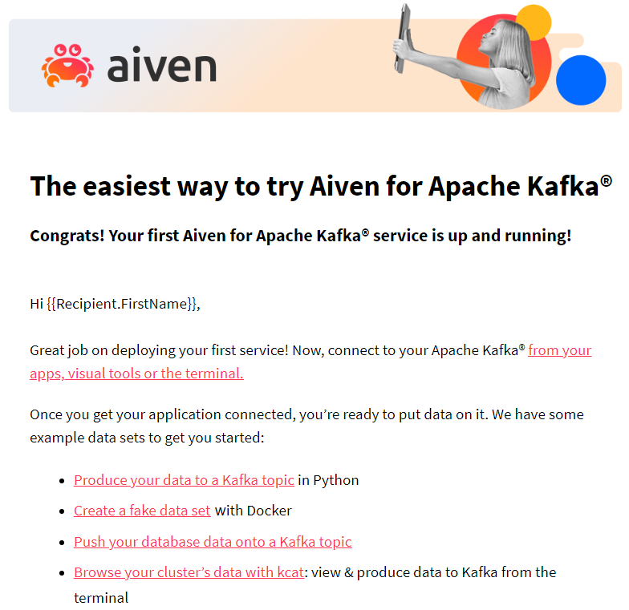
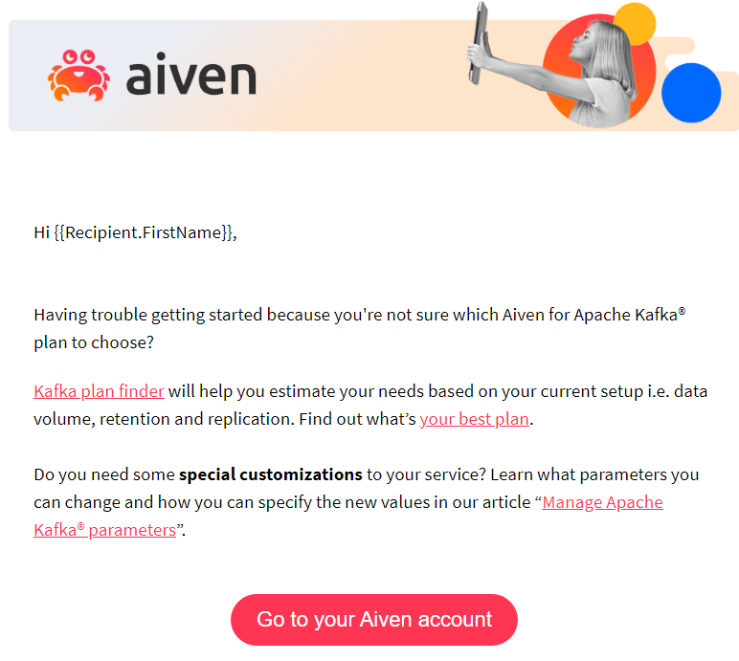
Actionable, product-specific content
Journey coverage
Activate user in <4h
Load data

Slide 16
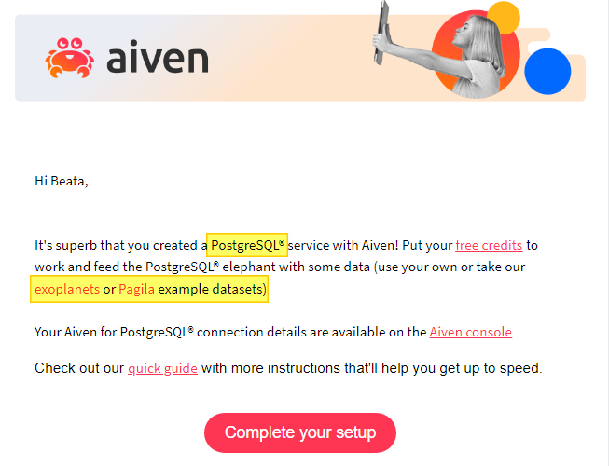
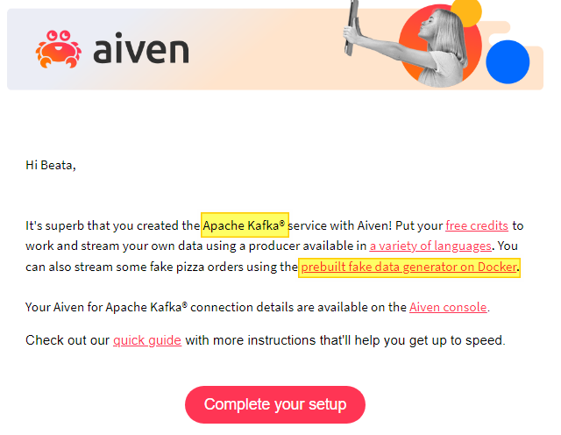
Actionable, product-specific content
Portfolio coverage
Apache Kafka
PostgreSQL

Slide 17
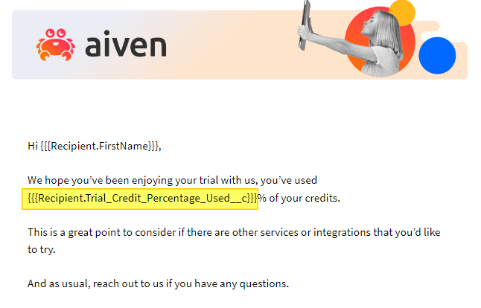
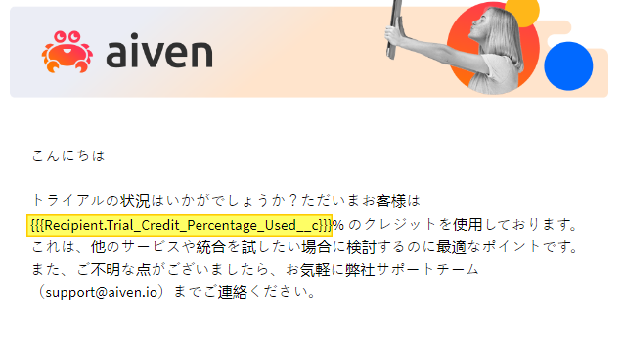
Localized content
Portfolio coverage
US English
Japanese

Slide 18
Some things to keep in mind
Object data access
Fields for dates, credits, services used, statuses, etc control the whole flow
You need them in Prospect, Lead and Contact - and possibly Account
Limitations of Pardot & Maintenance
Dynamic Content is awesome, but can only handle 25 variations (?!)
You’re gonna need a whole lot of Engagement Programs
Unit tests are not enough, you need end-to-end test cases

Slide 19
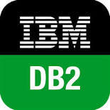
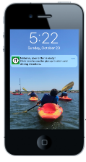
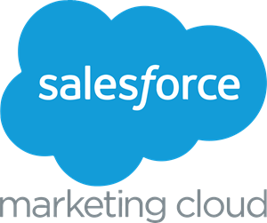
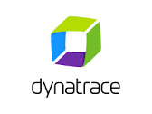
Data Architecture (MC)
First-party
Transactions
Build Customer Aggregates
Using AI/ML and Internal
Segmentation Strategies
Centralize Data:
Data Warehouse
Website + Campaign
Engagement
Form
Capture
Second-party
Social
Media
SDKs, APIs
Marketplaces
(+ CDP)
Monitoring:
Brand
Manufacturers
Notes:
Centralize
Aggregate (use those engagement strategies you defined to determine what aggregates you want to surface)
Integrate
Monitor

Slide 20
Data Architecture (MC)
First-party
Transactions
Centralize Data:
Data Warehouse
Website + Campaign
Engagement
Form
Capture
Second-party
Social
Media
Marketplaces
Brand
Manufacturers
Notes:
Centralize
Aggregate (use those engagement strategies you defined to determine what aggregates you want to surface)
Integrate
Monitor

Slide 21
Data Architecture (MC)
First-party
Transactions
Build Customer Aggregates
Using AI/ML and Internal
Segmentation Strategies
Centralize Data:
Data Warehouse
Website + Campaign
Engagement
Form
Capture
Second-party
Social
Media
Marketplaces
Brand
Manufacturers
Notes:
Centralize
Aggregate (use those engagement strategies you defined to determine what aggregates you want to surface)
Integrate
Monitor

Slide 22
Data Architecture (MC)
First-party
Transactions
Build Customer Aggregates
Using AI/ML and Internal
Segmentation Strategies
Centralize Data:
Data Warehouse
Website + Campaign
Engagement
Form
Capture
Second-party
Social
Media
Marketplaces
(+ CDP)
Brand
Manufacturers
Notes:
Centralize
Aggregate (use those engagement strategies you defined to determine what aggregates you want to surface)
Integrate
Monitor

Slide 23
Data Architecture (MC)
First-party
Transactions
Build Customer Aggregates
Using AI/ML and Internal
Segmentation Strategies
Centralize Data:
Data Warehouse
Website + Campaign
Engagement
Form
Capture
Second-party
Social
Media
SDKs, APIs
Marketplaces
(+ CDP)
Monitoring:
Brand
Manufacturers
Notes:
Centralize
Aggregate (use those engagement strategies you defined to determine what aggregates you want to surface)
Integrate
Monitor

Slide 24
Engagement Strategies
For Mobile Push
Using First & Second-Party Event Data

Slide 25
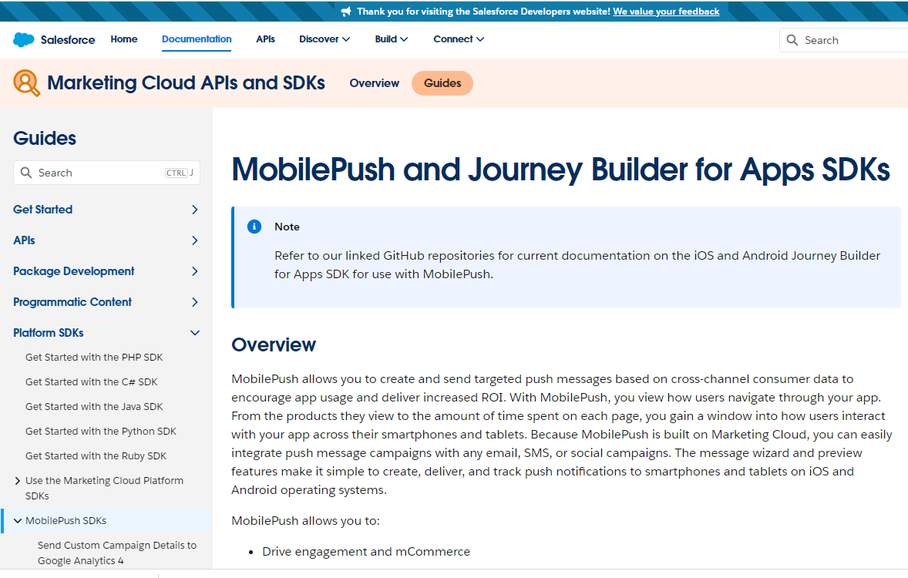
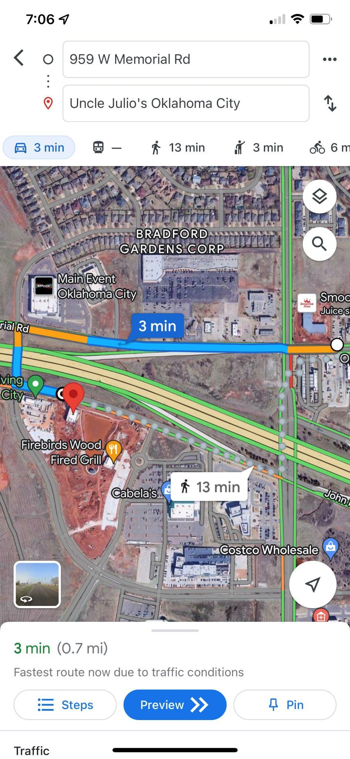
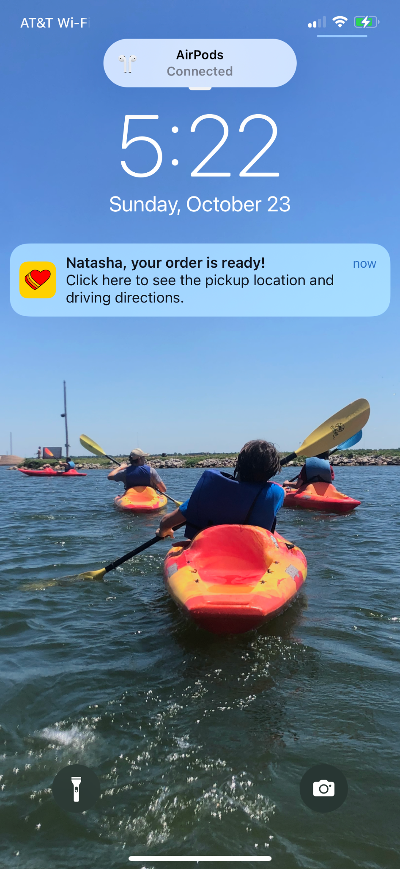
Work with your mobile app development team to integrate the MobilePush
SDK into your company app.
Review best practices for setting the subscriber key once a customer creates an account or logs in, to
mitigate billable subscriber counts.
Notes:
Integrate SDK into your customer app
Use to surface in-app messaging and push alerts to customers
Review best practices for setting subscriber key (billable subscriber implications) - 2 options

Slide 26
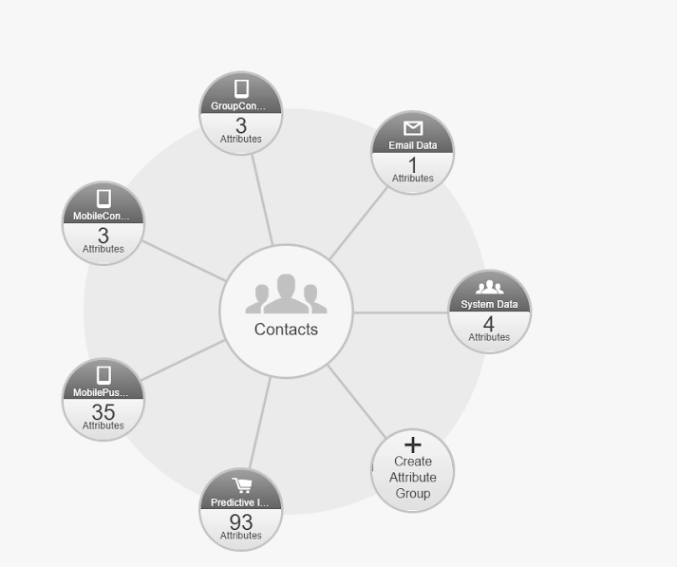
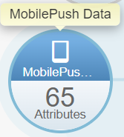
Once a customer associates their account in the app via login or other action, you can tie them to a customer record, even if they log back out.
Next, determine what type of event and behavioral data you want to capture.
SFMC
Customer
Profile
App
Events
Customer
Purchases
Notes:
Once app user creates acct or logs in via app, you can tie them back to a subscriber record (recommend mapping to a Salesforce Customer ID - which should also be your subscriber key in SFMC)
Determine what app behaviors you want to track to determine engagement (last session date, purchase, deal activation, viewing certain app screens, etc.)

Slide 27
Option A
SFMC
Customer
Profile
App Behavioral
Vendors
Engagement
SDK
App
Events
Customer
Purchases
Notes:
Surface app events through a third-party vendor that integrates with your mobile app and logs events that can be tied back to a user
Integrate with marketing automation platform (via connector, etc.)
Aggregate that data through a series of queries in Automation Studio to surface a Customer Profile that can be used in engagement campaigns, content personalization, etc.

Slide 28
Option B
SFMC
Customer
Profile
Real-time Journey Entry
Customer
Profile
App Behavioral
Vendors
Engagement
SDK
App
Events
Customer
Purchases
Notes:
Can still Aggregate that data through a series of queries in Automation Studio to surface a Customer Profile that can be used in engagement campaigns, content personalization, etc.
BUT can also inject customers into journey builder flows in real-time when they take certain actions in your app

Slide 29
Option B
SFMC
CDP
Customer
Profile
Real-time Journey Entry
Customer
Profile
App Behavioral
Vendors
Engagement
SDK
App
Events
Customer
Purchases
Notes:
Can still Aggregate that data through a series of queries in Automation Studio to surface a Customer Profile that can be used in engagement campaigns, content personalization, etc.
BUT can also inject customers into journey builder flows in real-time when they take certain actions in your app

Slide 30
App Behavioral Platforms

Slide 31
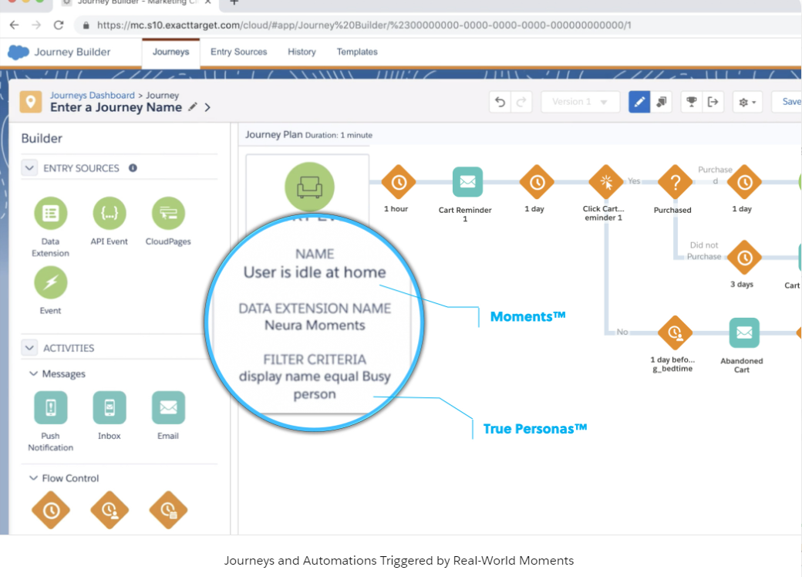
Insights and Behavior
Attribution
Analyze every step of a Customer Journey without leaving Marketing Cloud
Attribute app events to real-world user behavior
Notes:
Created targeted mobile app user segments and personas

Slide 32
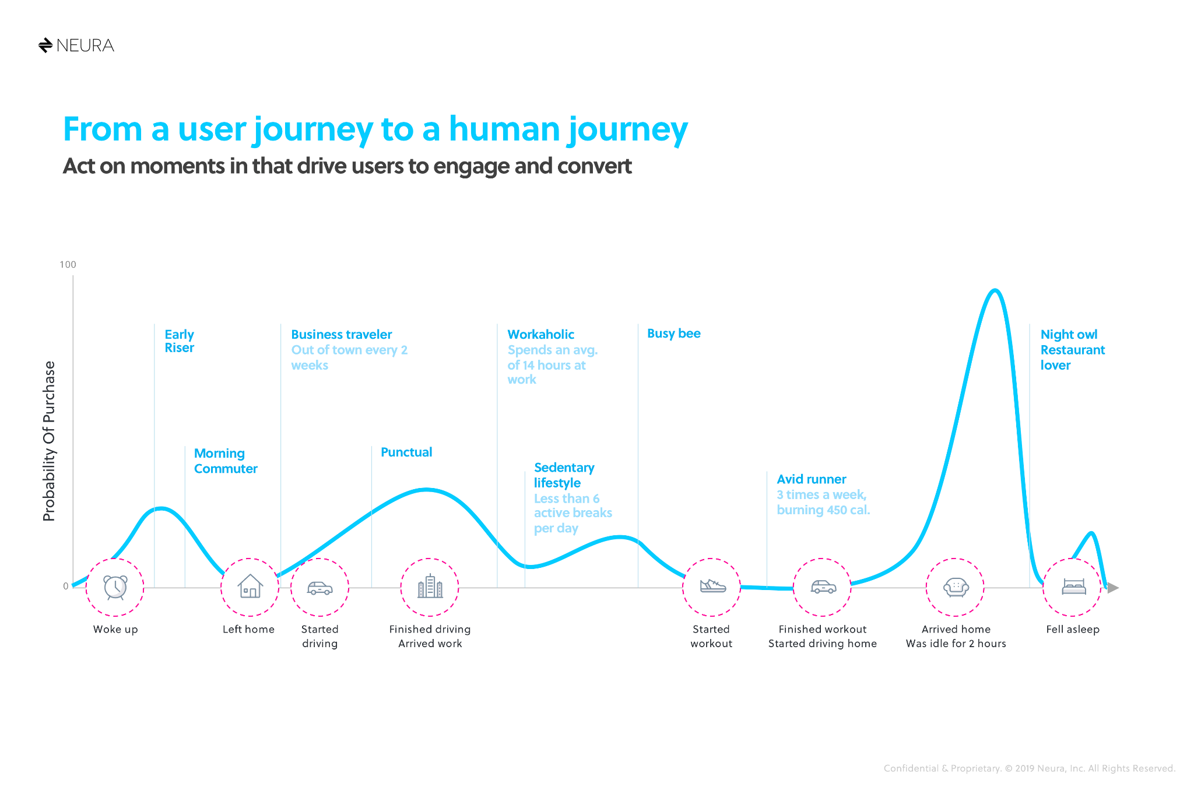
Notes:
Use collective behaviors to identify best timing/opportunities to engage customers

Slide 33
Engagement Mobile SDK

Slide 34
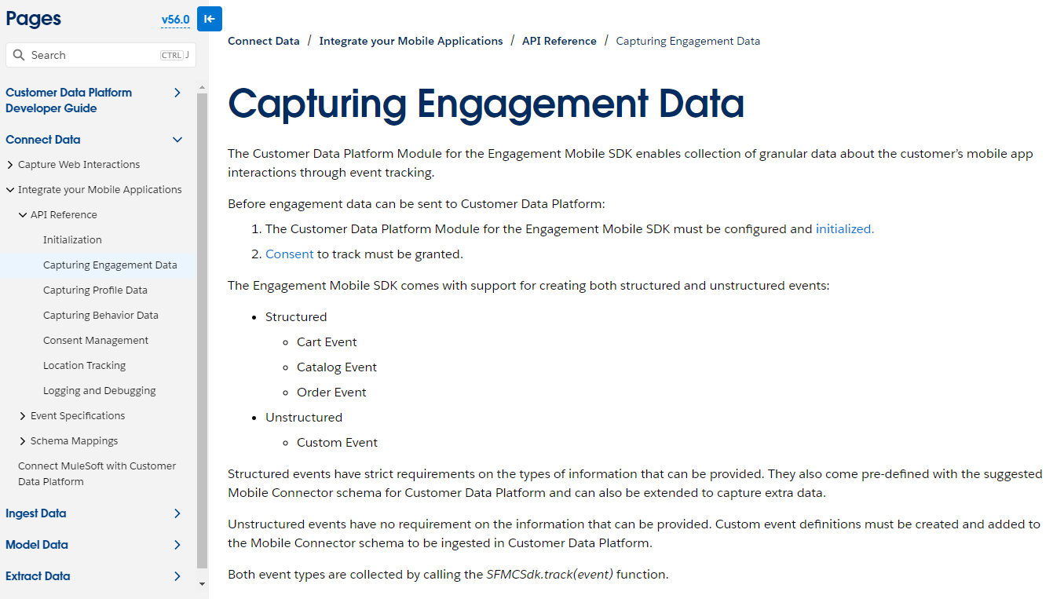
Notes:
Engagement Mobile SDK combines MobilePush SDK and CDP functionality - supported in version 8+ for iOS and Android
Also offers Template events with predefined schemas you can use to get started with engagement events that can be used to trigger in-app messaging or journey injections

Slide 35
From MobilePush v8.0.0 onwards, if you're also implementing the CDP module, add the CDPModuleConfig along with the PushModuleConfig in the configure method.
func initSalesforce(pushConfig: PushConfig, cdpConfig: CdpConfig) {
SFMCSdk.initializeSdk(ConfigBuilder()
.setPush(config: pushConfig, onCompletion: { result in
// success/failure
})
.setCdp(config: pushConfig, onCompletion: {result in
// success/failure
})
.build())
}
Notes:
If you plan to also implement CDP, have your development team review the documentation for setting up the Initialization + Device & Contact Registration correctly

Slide 36
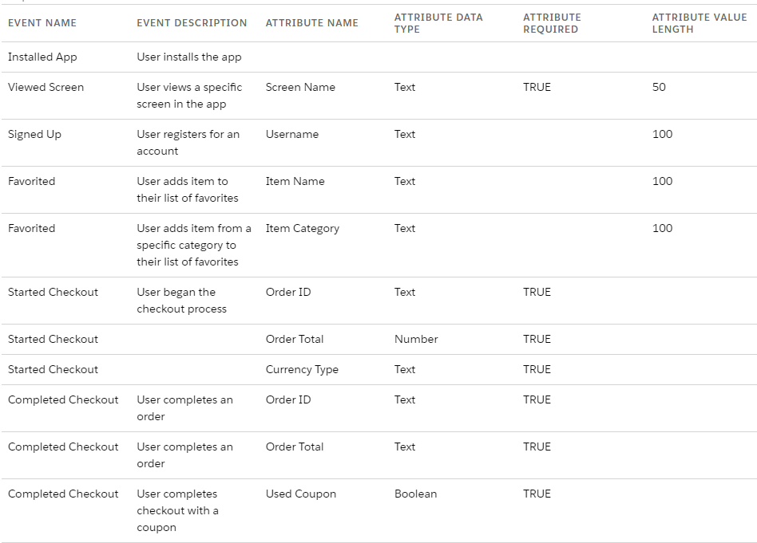
Engagement
Events and
Attributes
Notes:
Sample of event names and attributes to get an idea of the setup and brainstorm what app events and associated attributes are important to your organization

Slide 37
Marketing Cloud currently allows a maximum of 20 unique Event Names to be defined per MobilePush app
Notes:
So spend some time prioritizing your most important app events

Slide 38
Marketing Cloud currently allows a maximum of 20 unique Event Names to be defined per MobilePush app
And up to 10 Event Attributes per Event.
Notes:
So include this in your strategy discussions as well

Slide 39
Conclusions
Understand what data you need and which party controls it
Future-proof your core programs by gathering and maintaining first-party data
MCAE and MC offer endless possibilities to use it - sky’s the limit!

Slide 40
Thank you!
@NatashaMrtn
@JaimeLopez1989
@NatashaMrtn
/in/jaimelop
/in/natashamrtn

