Slide 1
Trifecta of Website Event Management
Jennifer Lynn Schneider Solutions Architect, Qualified

Slide 2
What do we know to be true today?
Virtual events are abundant.
Your website is your biggest asset!
What we did 3-5 years ago isn’t working well anymore.
B2B is B2C is B2B2CB is blah-blah-blah
“We interact with humans, we are human, and we are primarily interacting with each other digitally… Be where the humans are… Simple as that…”

Slide 3
Top Strategies
Event Management at your digital storefront…
Homepage Invite the masses
Brand Awareness
Landing Page
Nurture Educate & Convert
Ad Click
Paid Audiences & ABM

Slide 4
Personalize greetings & CTA’s to your goals!

Slide 5
Homepage
Goal: Awareness
Web Method: Web Capture via bot preferred.
Platform Alignment: Salesforce | Sales Enablement | Chat & Web Personalization
Measure: Tie to opportunity data in Salesforce for Revenue & Pipeline Generation
Invite the Masses!

Slide 6
Anonymous | TOFU Known Visitors
[Arrives on your Site]
Serve up unique experience
[Strategy | Options or Focus]
Convert in chat conversation
[Scalability with Bot]
Tigger Marketing Automation Platform
Measure in Salesforce
[Campaign Hierarchy & Attribution]
Who? [is on your website]
Where? [did they come from]
[How are we] engaging them?
Convert them!?
[Where do we] measure the ROI?

Slide 7
Landing Page
Goal: Convert & Educate
Web Method: Navigate to Landing Page | Form | 3rd Party
Platform Alignment: Salesforce | Marketing Automation | Sales Enablement | Chat & Web Personalization
Measure: Tie to opportunity data in Salesforce for Revenue & Pipeline Generation
Nurture Educate & Convert

Slide 8
Nurtured Prospects
[Arrives on your Site via Sales Enablement or Marketing Automation]
Serve up unique experience
[Strategy | Options or Focus]
Convert by navigating to Landing page
[Form or Chat?]
Trigger Marketing Automation Platform
Measure in Salesforce
[Campaign Hierarchy & Attribution]
Who? [is on your website]
Where? [did they come from]
[How are we] engaging them?
Convert them!
[Where do we] measure the ROI?

Slide 9
Ad Click
Goal: Convert and Opportunity
Web Method: Web Capture via human preferred
Platform Alignment: Salesforce | Sales Enablement | Chat & Web Personalization | Google Analytics | Google Ads | Linkedin Ads | Facebook Ads
Measure: Tie to opportunity data in Salesforce for Revenue & Pipeline Generation
Paid Audiences & ABM

Slide 10
Target Top Accounts | ICP | Target Audiences
[Arrives on your Site via Paid Ad]
Serve up unique experience
[Focus & Extend Digital Story]
Convert in Chat
[Straight to human]
Update existing record
Measure in Salesforce
[Campaign Hierarchy & Attribution]
Who? [is on your website]
Where? [did they come from]
[How are we] engaging them?
Convert them!
[Where do we] measure the ROI?

Slide 11
Remember to have a “conversation”…
Validate
Enrich
Update
Tone

Slide 12
Which Strategy will YOU try?!

Slide 13
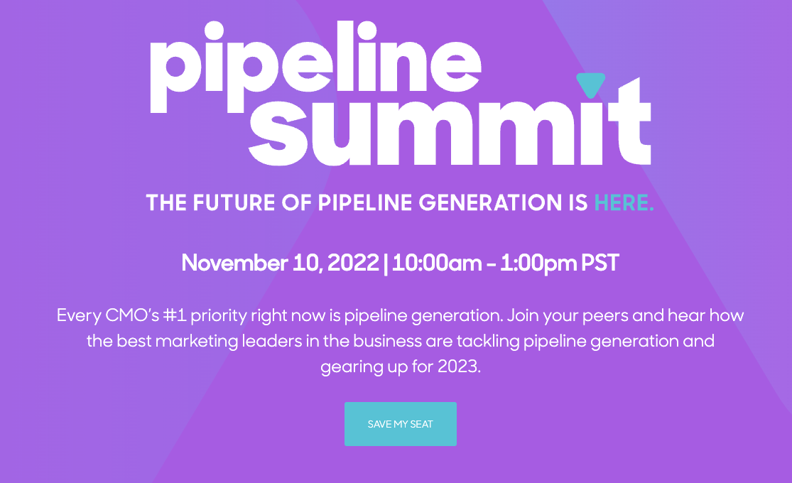
See it in action & register today!

Slide 14
Special Thanks To Our Sponsors
Title
Platinum
Gold
Silver

Slide 15
Jennifer Lynn Schneider
Jennifer@Qualified.com

