Slide 1
How To Bring Pardot Capabilities Into Salesforce Flow

Slide 2
Speakers
Jacob Catalano
Product Manager, Sercante Labs
Mike Creuzer
Pardot Partnerships & API Integrations Lead
Adam Erstelle
Vice President, Technology

Slide 3
Special Thanks To Our Sponsors
Title
Platinum
Gold
Silver

Slide 4
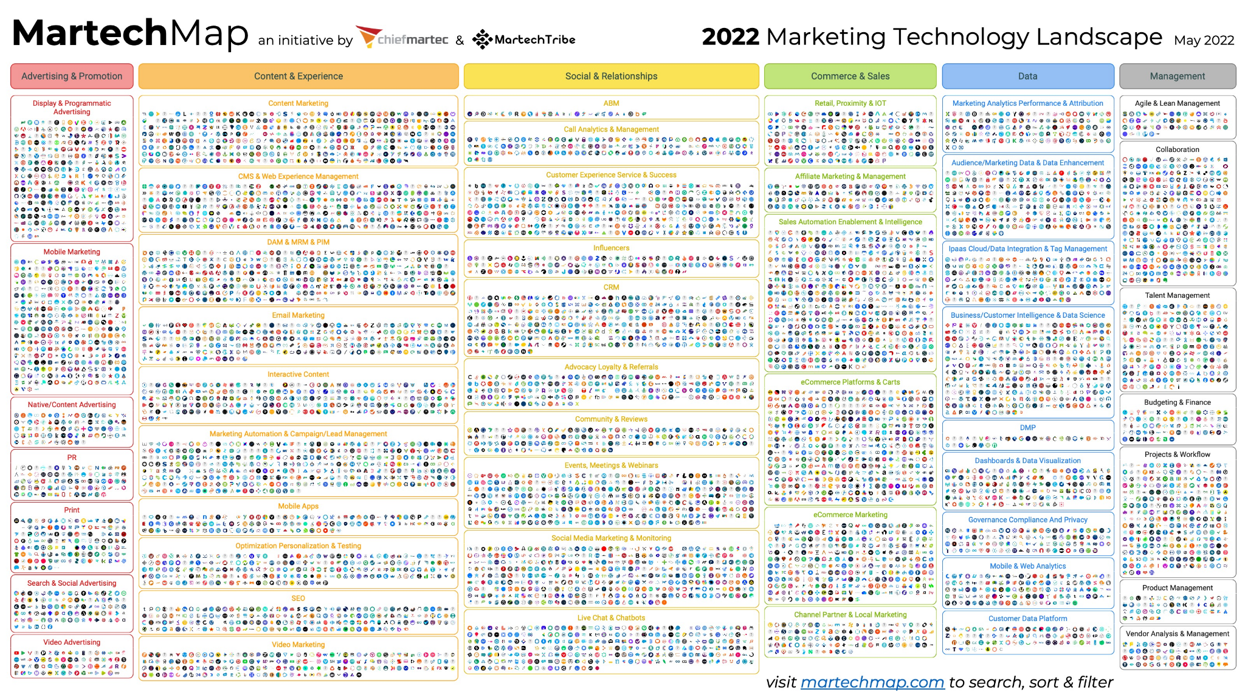
Disjointed MarTech Experience
9,963 indexed martech solutions
Visit martechmap.com to search
Notes:
We have a LOT of tools out there, and all these tools need to talk to each other in order to be effective. Most of these won’t integrate to MCAE/Pardot directly, but we can get them to work together

Slide 5
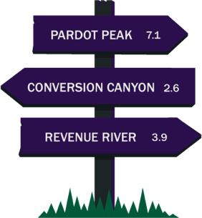
12
Average # of MarTech Solutions
12
Solutions Potentially Impacting Efficiency
Notes:
The key focus of our development toolkit is to solve the general problem of a disjointed marketing experience from end-to-end. A company’s marketing ecosystem is not just one solution but on Average is made up of over 12 Martech solutions. That is 12 solutions that potentially introduce manual interventions, context switching, and any number of other inefficiencies.

Slide 6
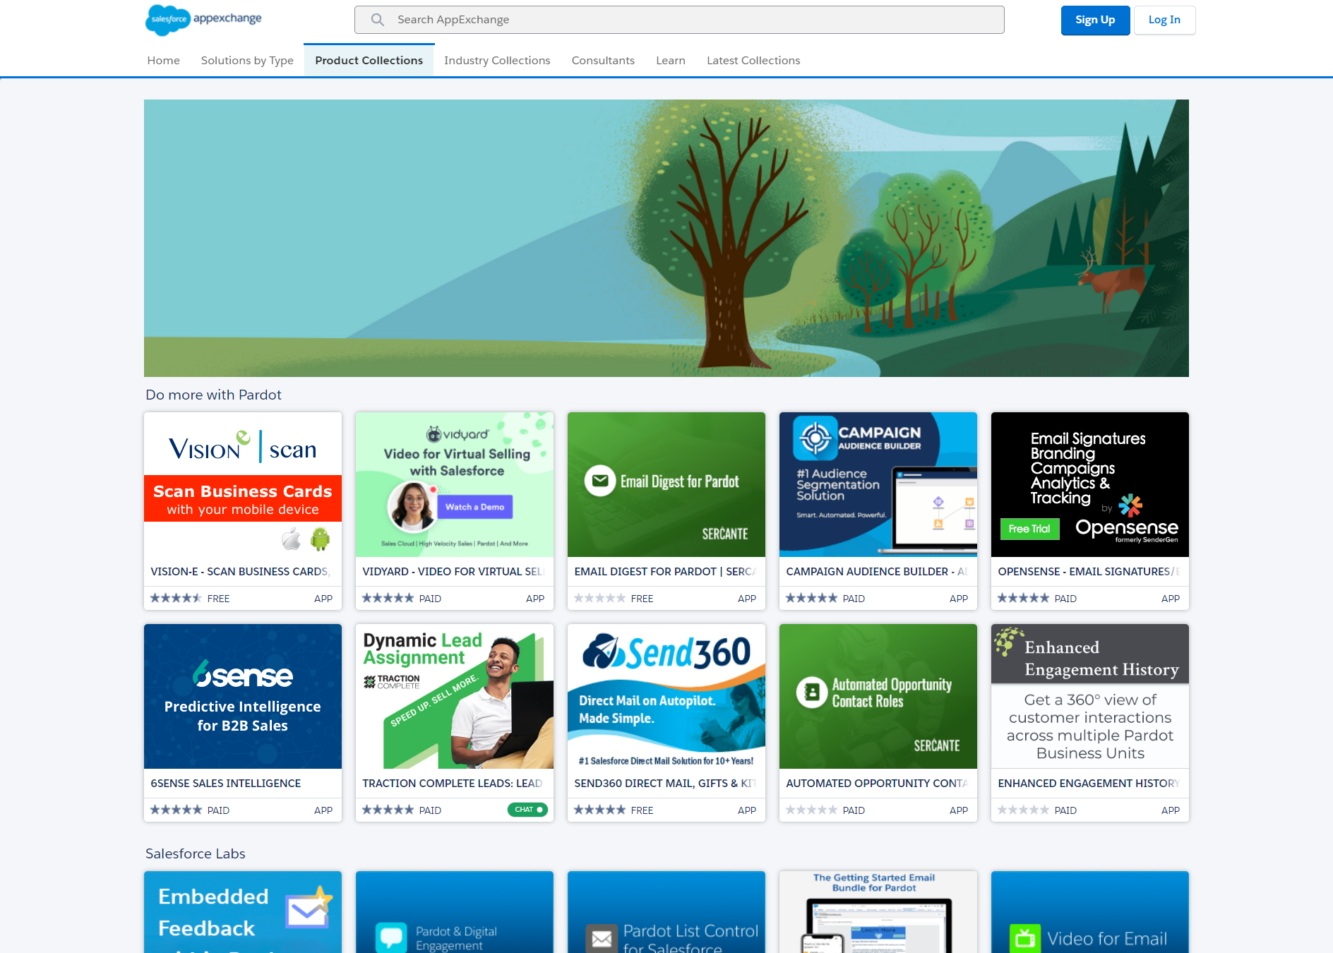
From Code to Clicks App Experience
Custom Code
SI Partners
ISV Partners
Notes:
We have many people who can glue together our Marcom tech stack.

Slide 7
How can the API help me?
Notes:
Now that you have a big picture, I am now going to pass it over to Adil to dig into what makes this version so great for developers.

Slide 8
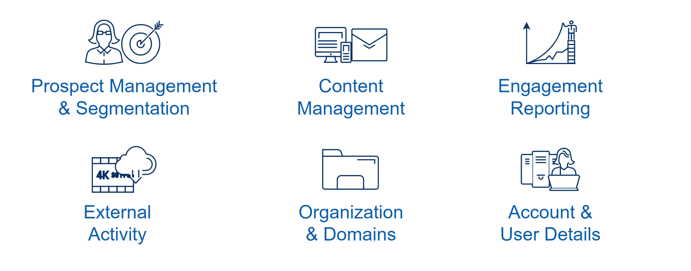
Pardot API Coverage
Notes:
The API allows us to to work on a variety of different aspects in MCAE, the whos, the whats, the what happened inside pardot, and the what’s happened outside pardot - make it actionable.
API V3 and V4 - Limited access on how API interacted with objects
API V5 - Full CRUD

Slide 9
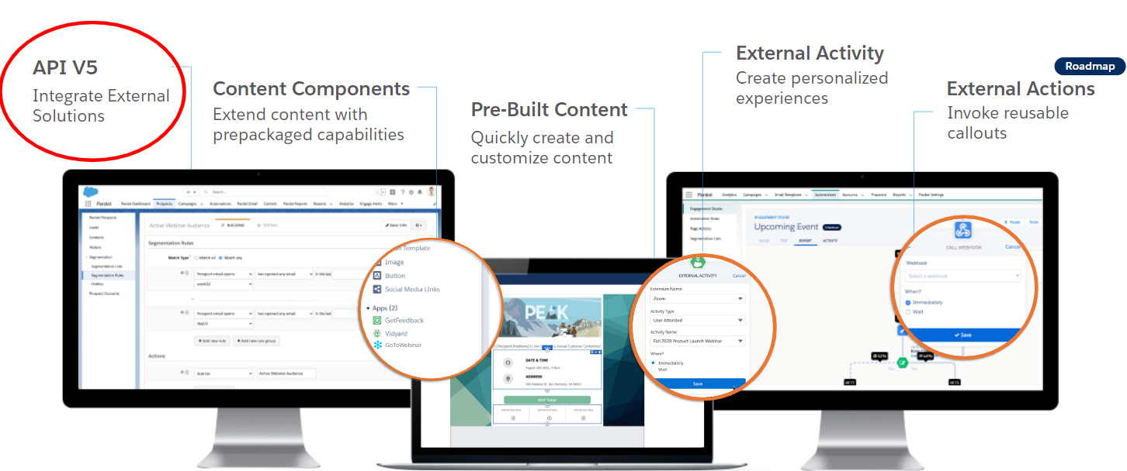
Account Engagement Development Suite
Notes:
We can use the API to build things. We can use it to glue different tools together. We can build that orchestration we are all striving for. We can make our tools effective.

Slide 10
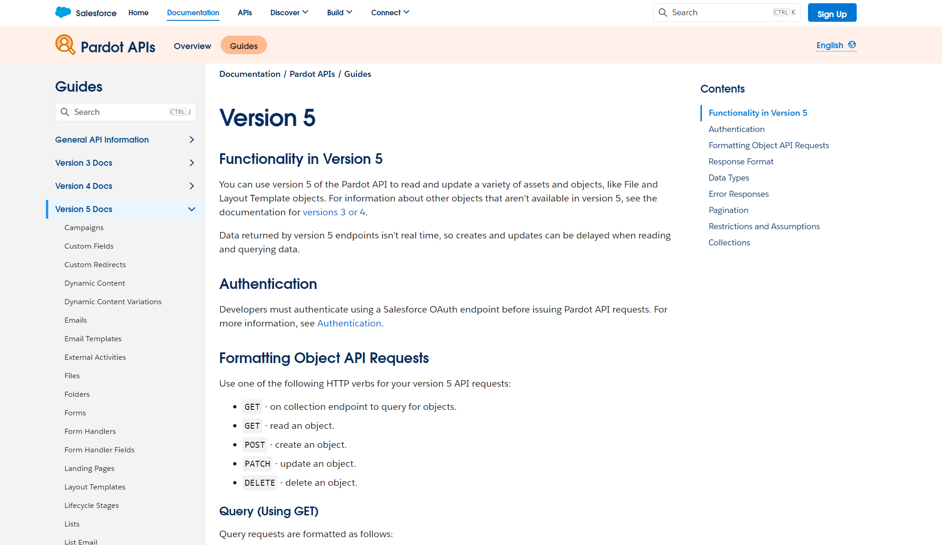
API V5 Taking integration to the next level
Develop faster using REST and Salesforce syntax
30 Object Endpoints to manage your data
Get the right data, at the right time, in one call
https://developer.salesforce.com/docs/marketing/pardot/guide/version5overview.html
Notes:
This brings us to the API version 5. This is a feature upgrade and things we couldn’t do in the past we can do now. So if you have asked can we do something and have been denied, ask again.

Slide 11
Getting Started is Easy!
Create a Connected App
(so that you can login with the API)
Explore API Docs, use Postman.com to try it out
Build Flows using “Flow Actions for Pardot”
Notes:
This brings us to the API version 5. This is a feature upgrade and things we couldn’t do in the past we can do now. So if you have asked can we do something and have been denied, ask again.

Slide 12
Demo Time
Browsing the API Docs
Getting Started with Postman
Flow Actions for Pardot
Notes:
This brings us to the API version 5. This is a feature upgrade and things we couldn’t do in the past we can do now. So if you have asked can we do something and have been denied, ask again.

Slide 13
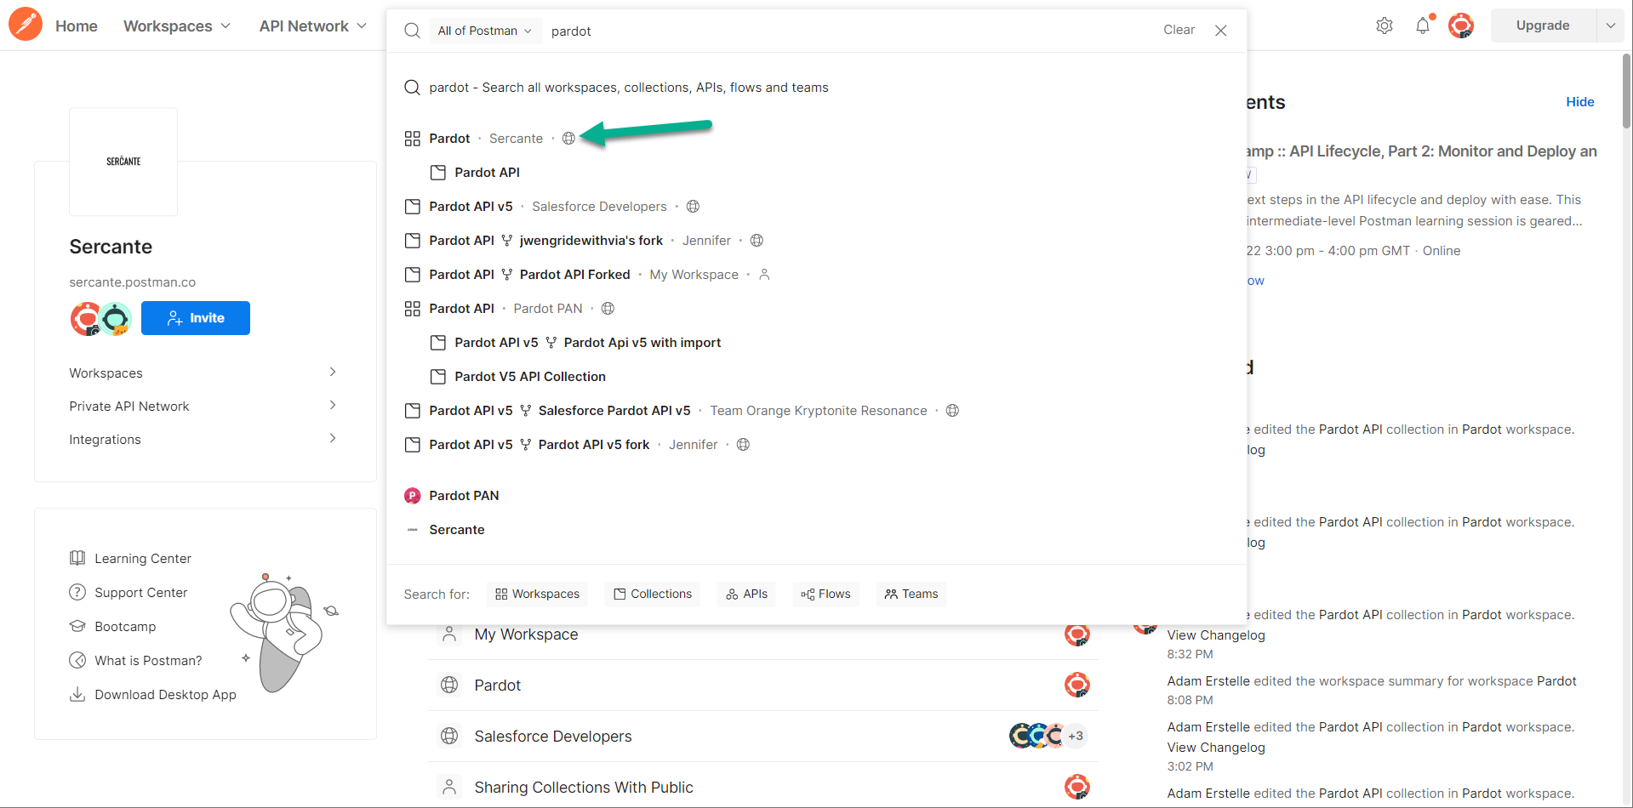
Postman.com
A great free tool, just search Pardot for some pre-built API Collections!
Notes:
This brings us to the API version 5. This is a feature upgrade and things we couldn’t do in the past we can do now. So if you have asked can we do something and have been denied, ask again.

Slide 14
Time to Demo
Notes:
Now that you have a big picture, I am now going to pass it over to Adil to dig into what makes this version so great for developers.

Slide 15
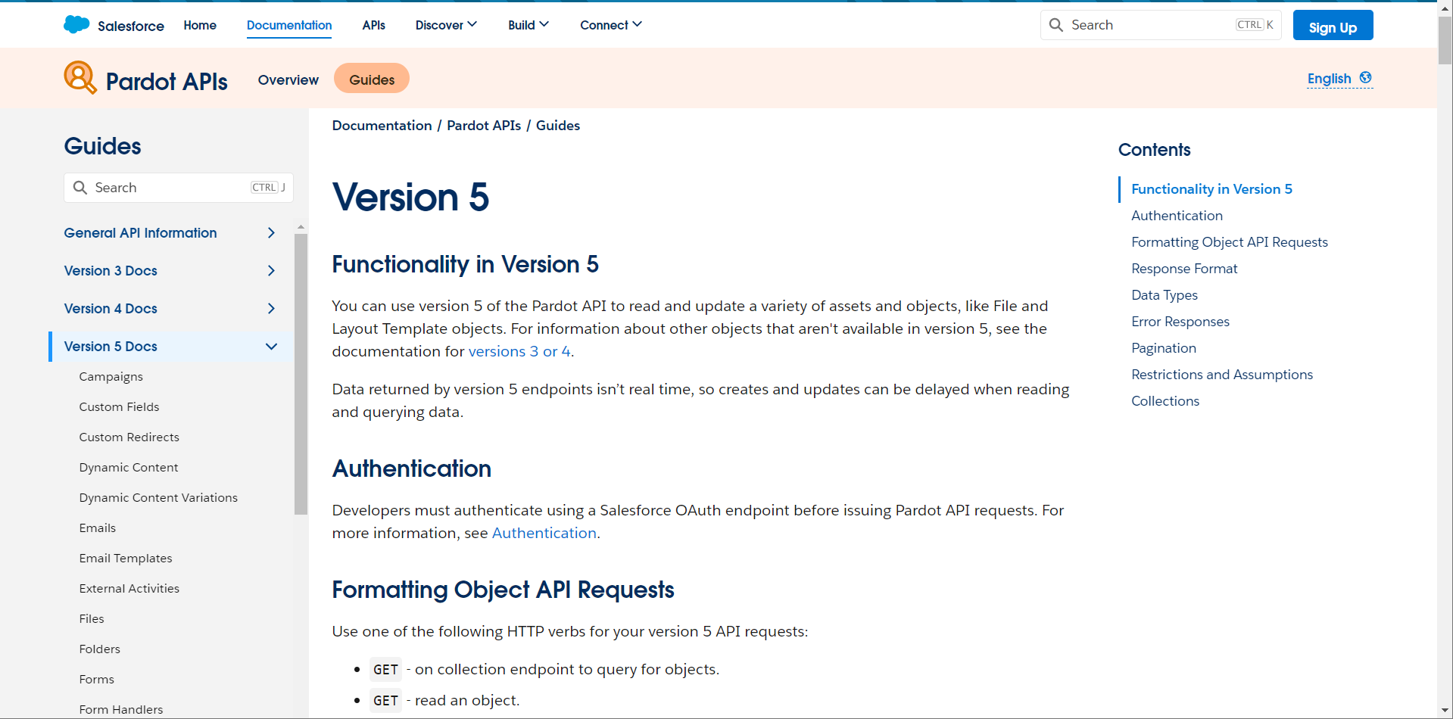
Pardot API Developer Home Page
Best place to begin the discovery of what is possible

Slide 16
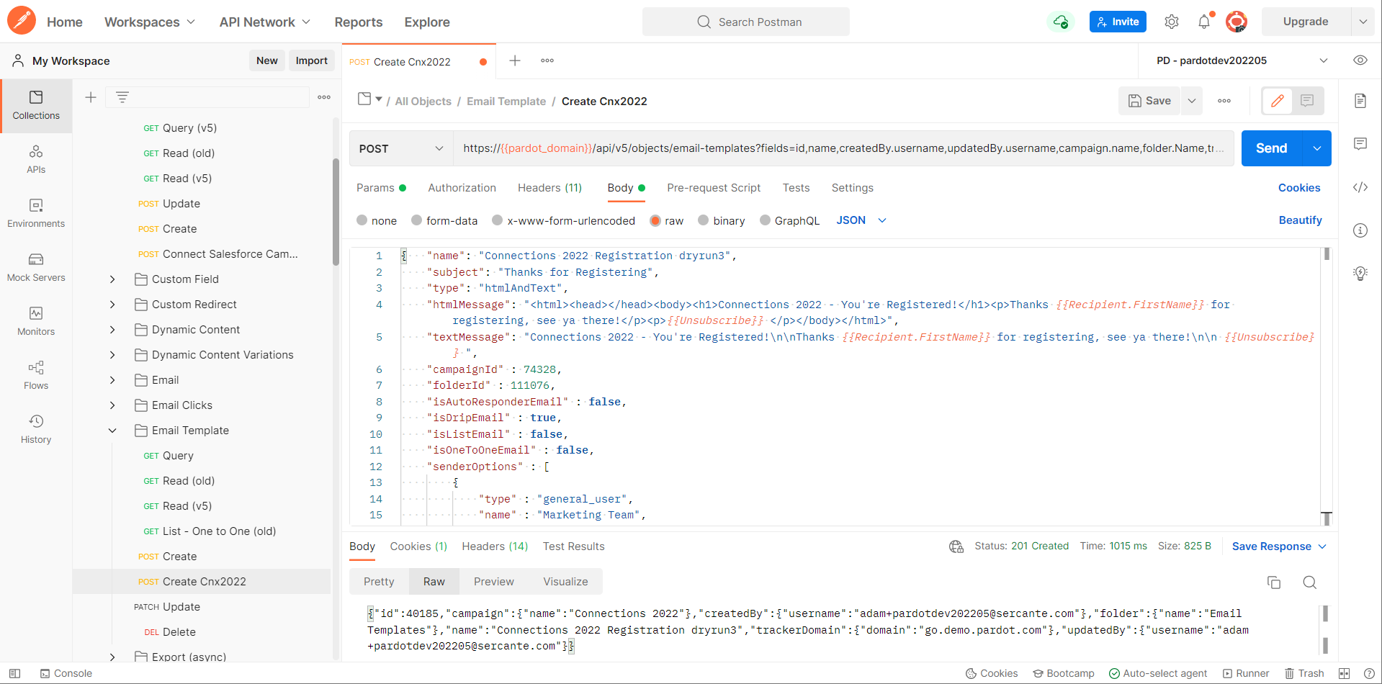
Postman.com
Example - Sending new Email Template

Slide 17
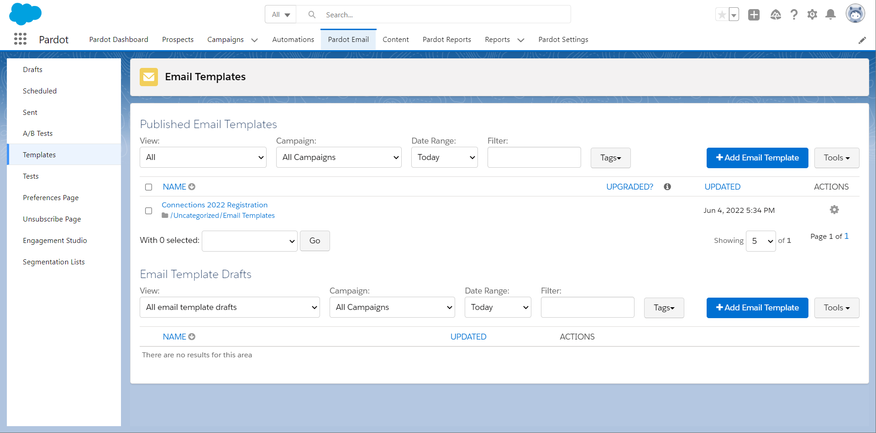
Email Template in Pardot
See it did work. No magic at all, we promise

Slide 18
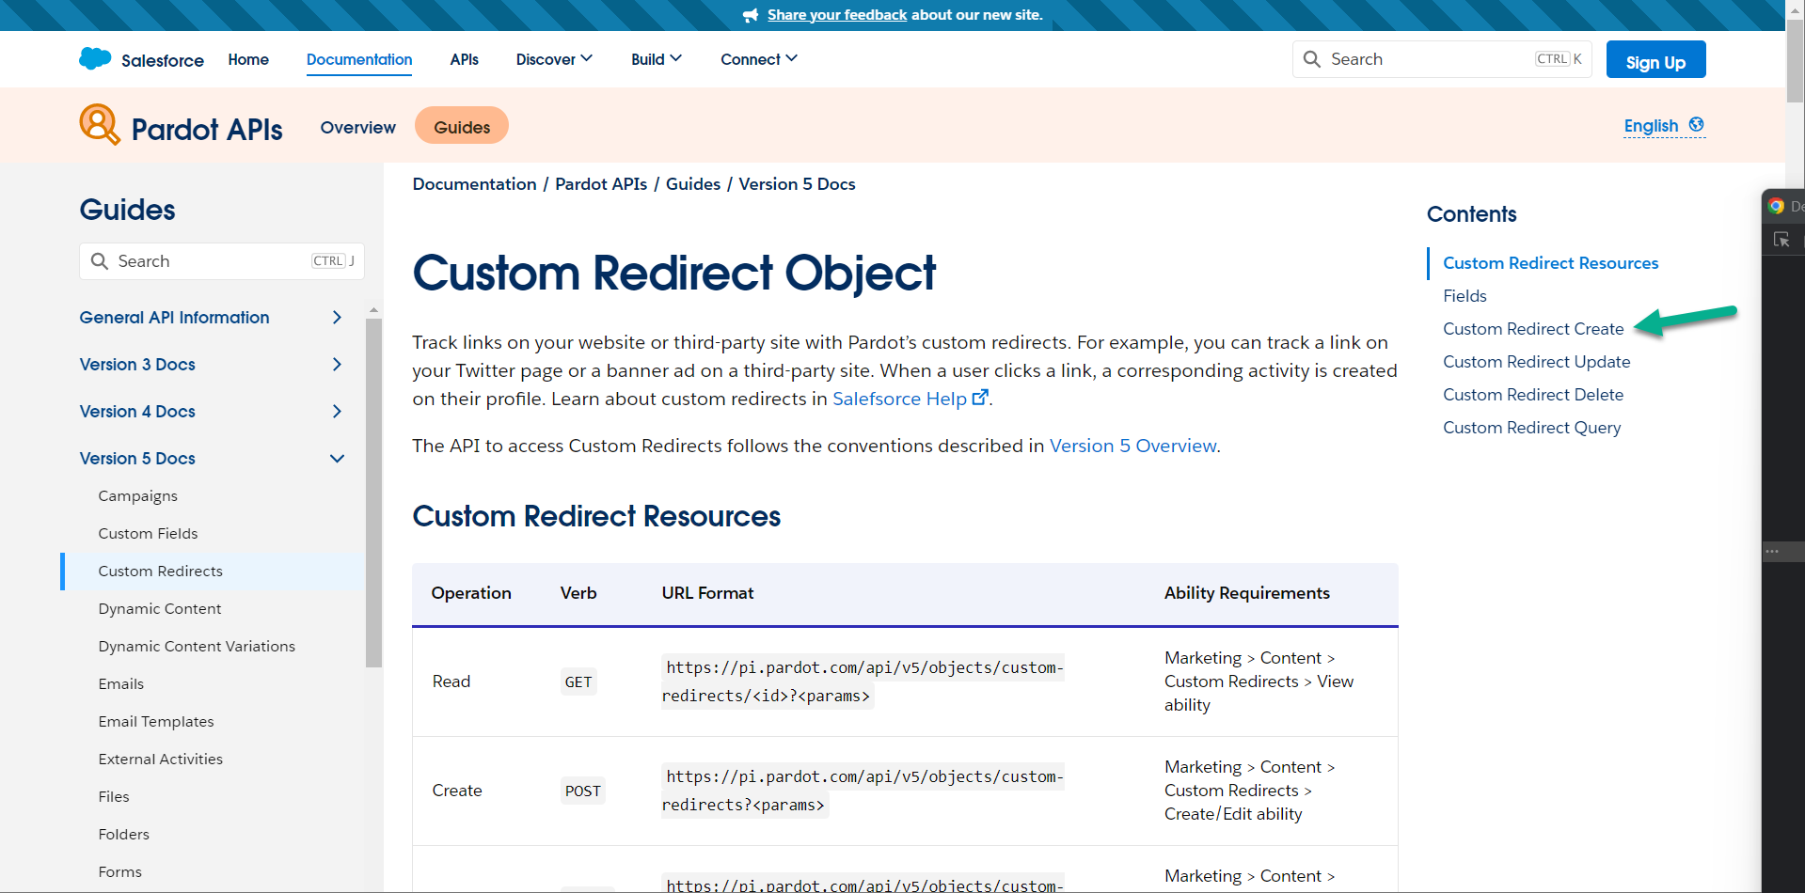
We want to create Custom Redirects from Salesforce
First step, check the docs to see if it is even possible. Yep!

Slide 19
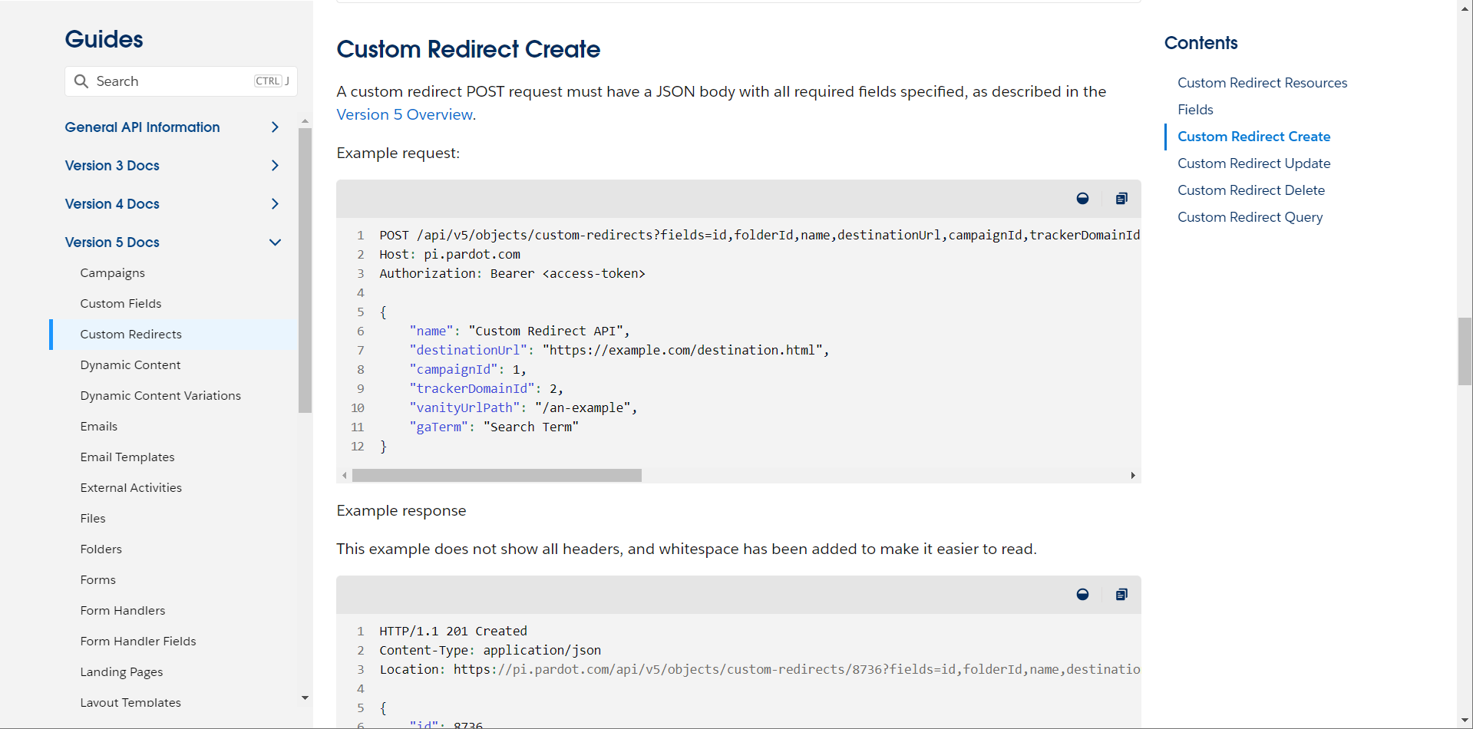
We want to create Custom Redirects from Salesforce
Ok, we see the details of how this can look

Slide 20
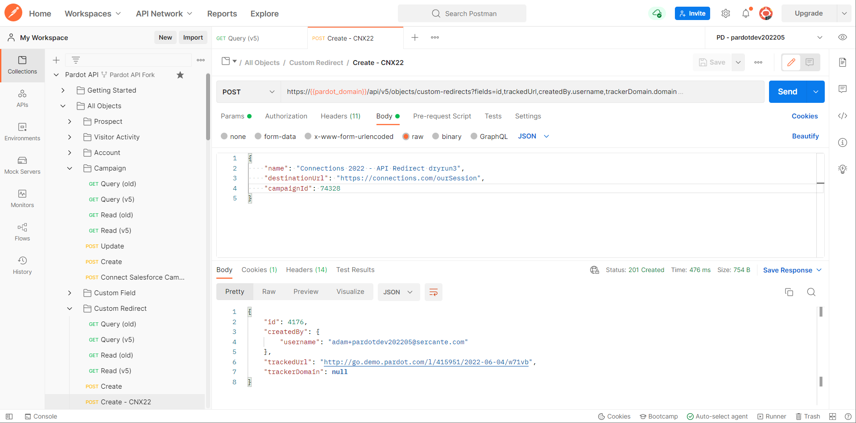
Postman.com
Example - Sending new Custom Redirect

Slide 21
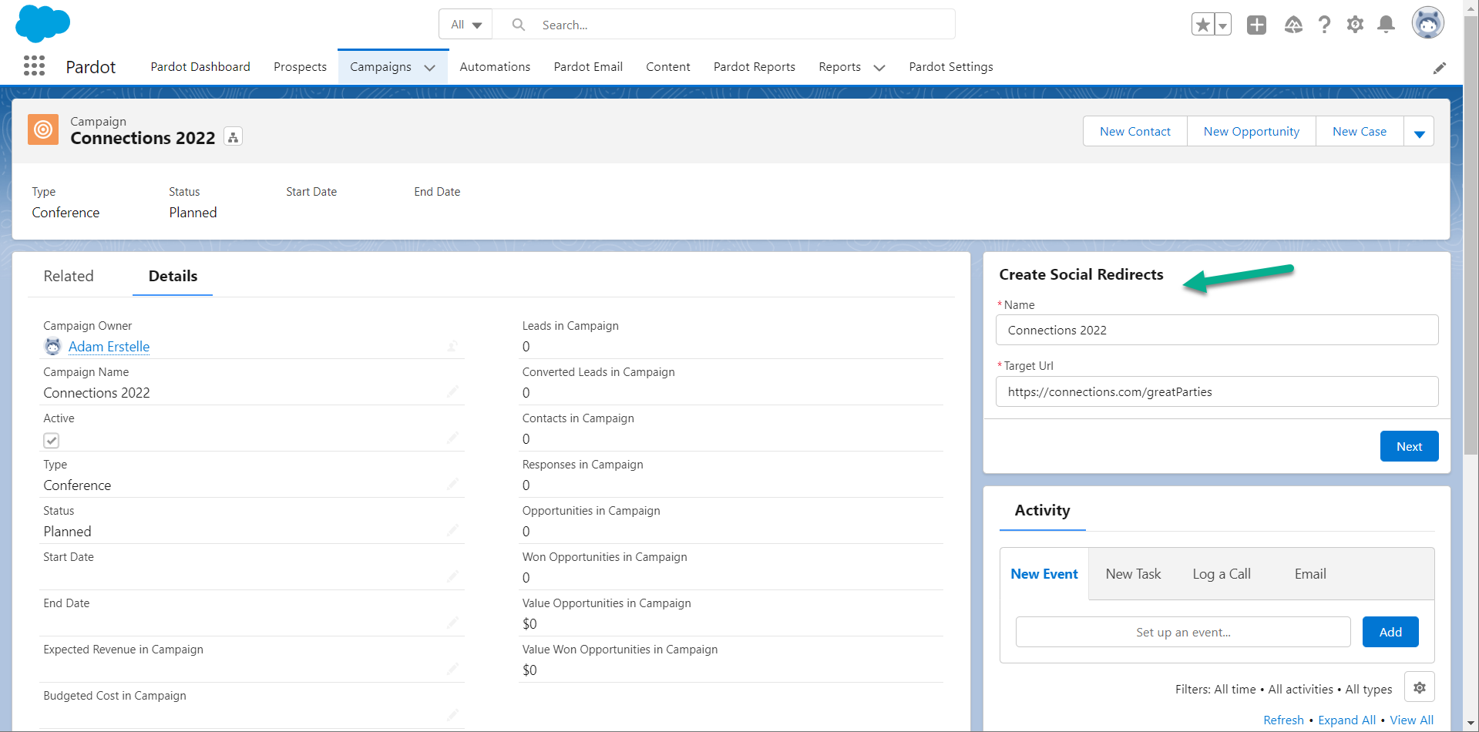
Postman’s cool, but it’s for discovery - not day to day
Marketers want something easier. So let’s build a Screen Flow!

Slide 22
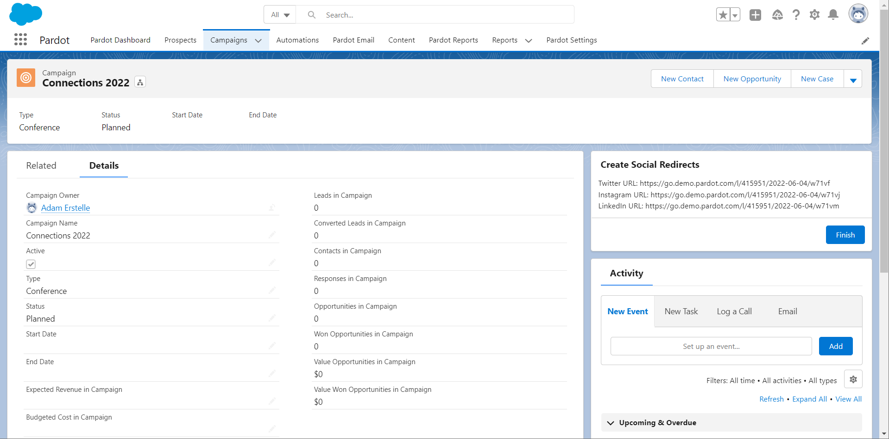
Postman’s cool, but it’s for discovery - not day to day
Marketers want something easier. So let’s build a Screen Flow!

Slide 23
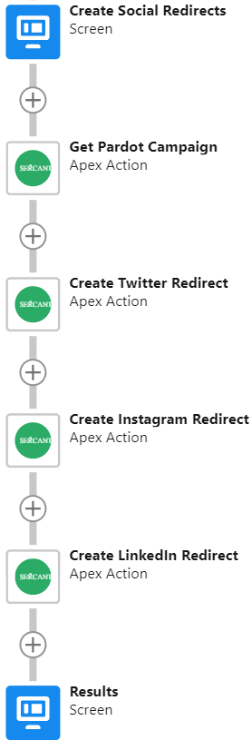
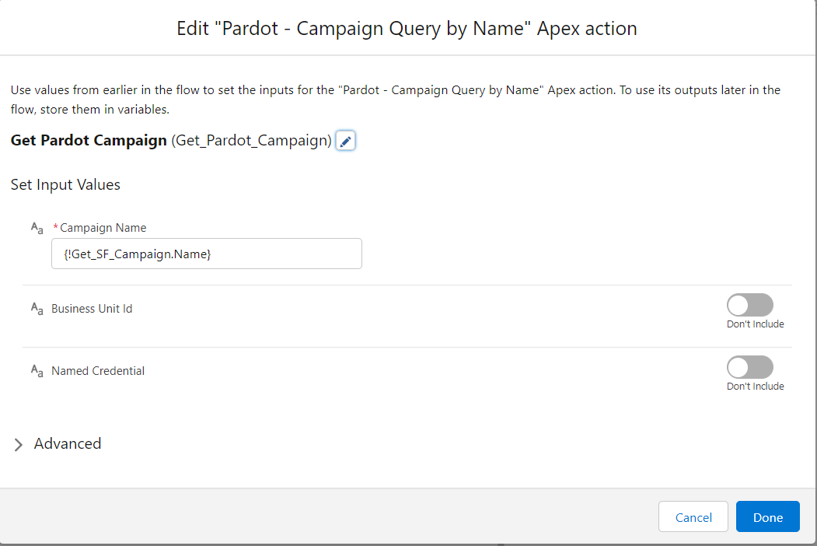
Building a ScreenFlow
This is hard with screenshots. Don’t worry, we have a video!

Slide 24
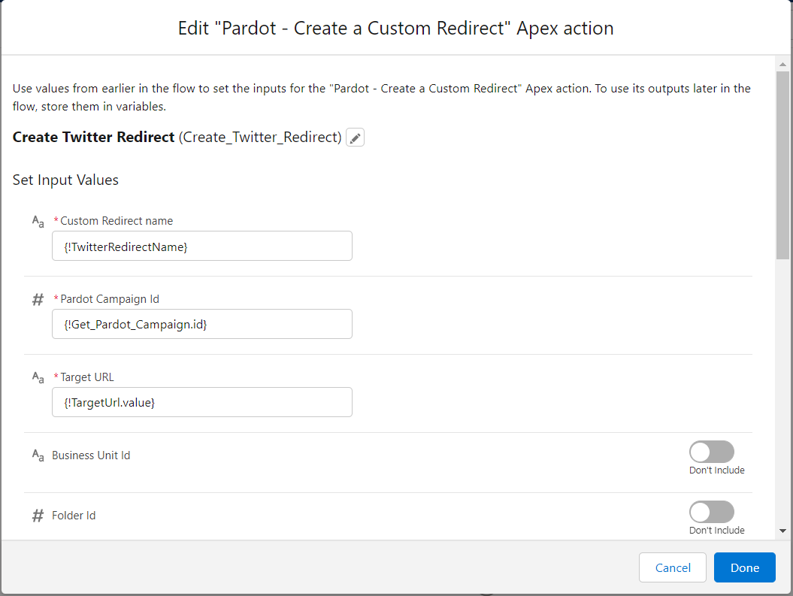
Building a ScreenFlow
Really wishing the video was working right now

Slide 25
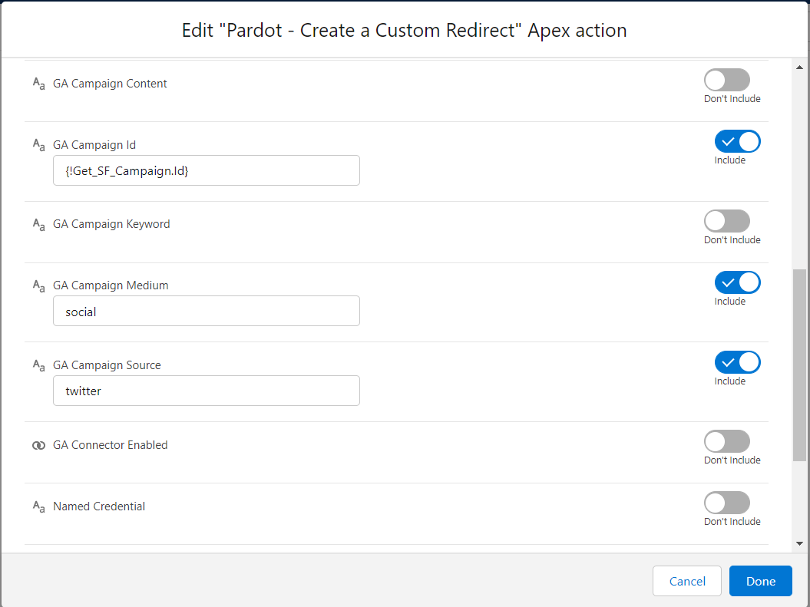
Building a ScreenFlow
Really wishing the video was working right now

Slide 26
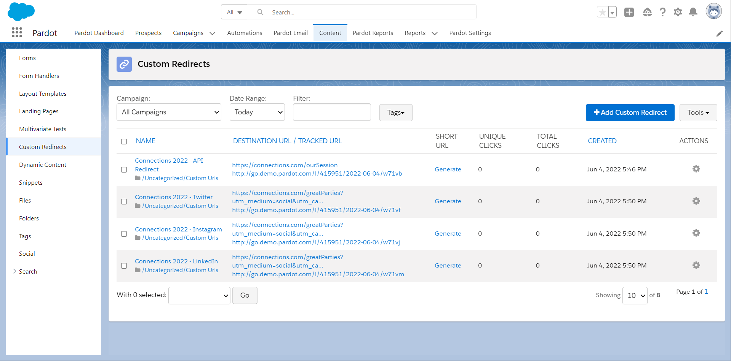
Custom Redirect Results
Notice the URLs have utm parameters?

Slide 27
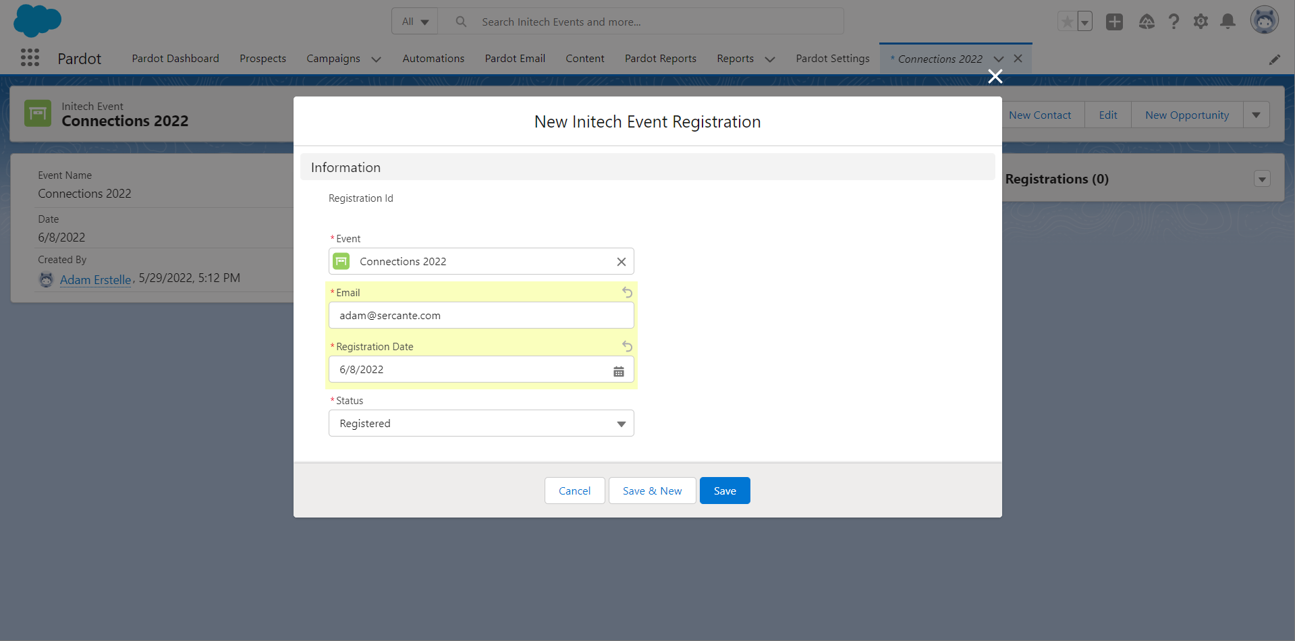
The Event Platform’s Registrations should integrate
But it doesn’t. Surprised? Neither are we. It’s ok, the API lets us glue it together

Slide 28
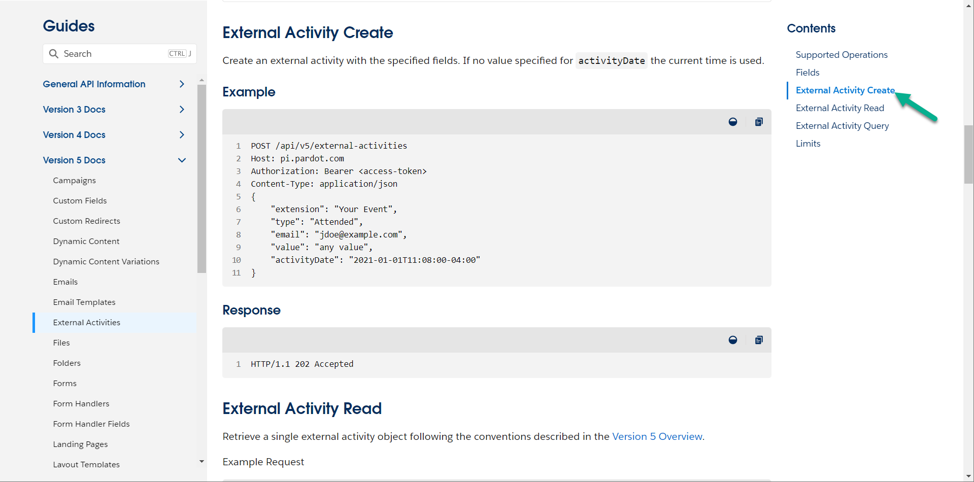
Back to the Docs
Always: Read The Friendly Manual

Slide 29
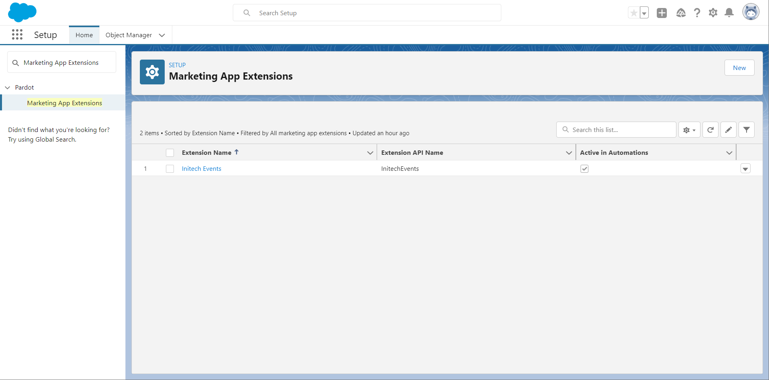
Marketing App Extensions
Salesforce Config that lets Pardot Accept custom Activities

Slide 30
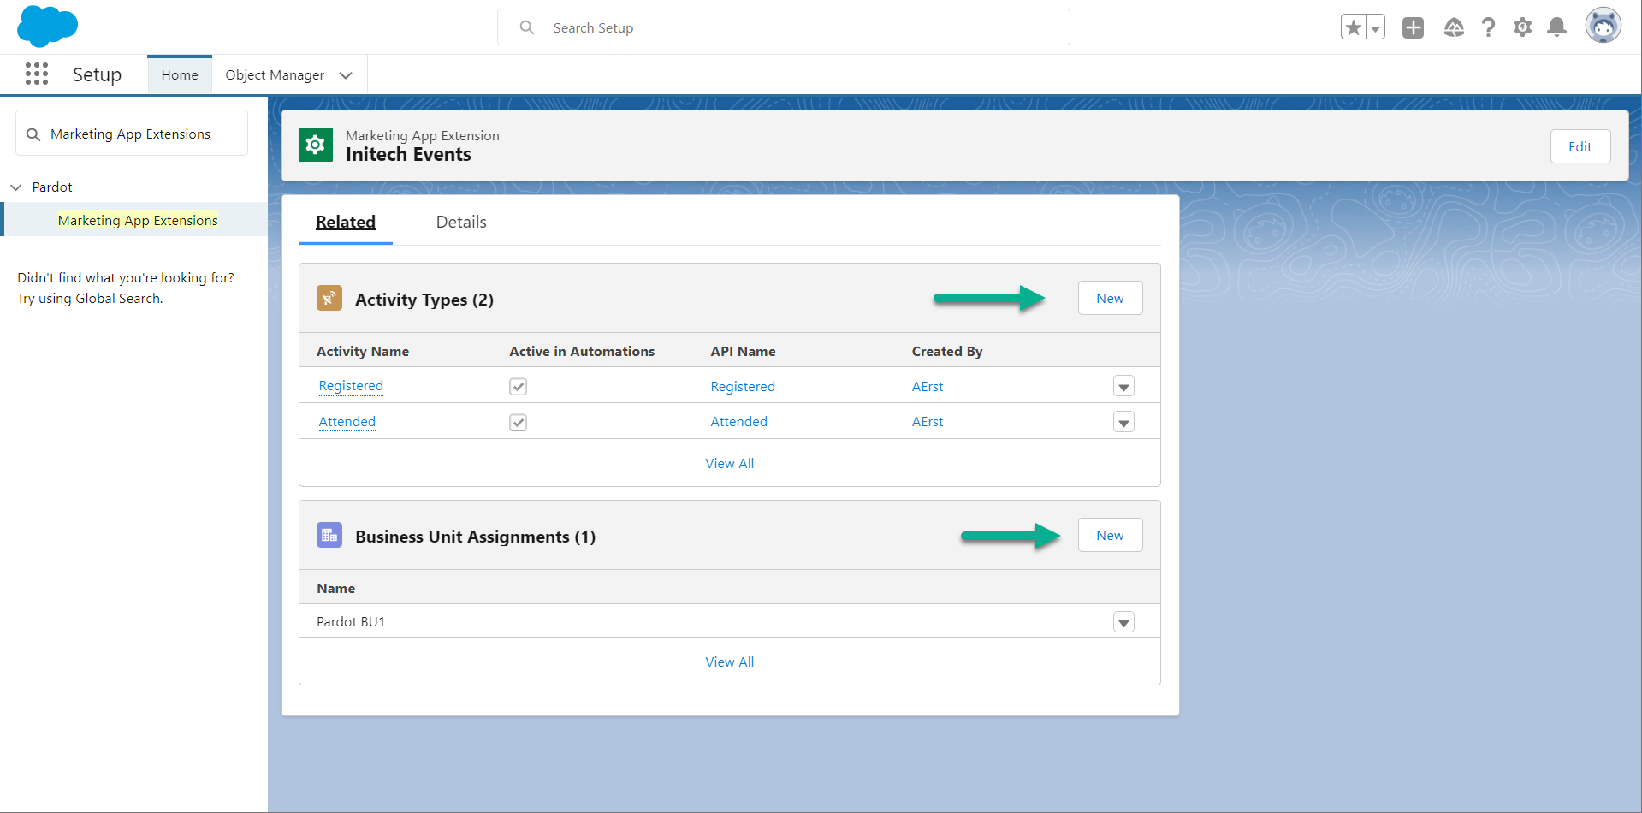
Add Activity Types
For this Custom Platform, what kinds of things do you want to track?

Slide 31
Add Activity Types
Which Pardot Business Units should see these types of Activities?

Slide 32
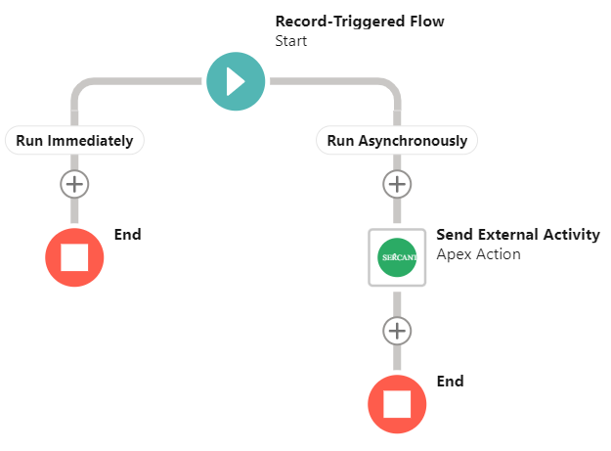
Our Glue: A Record-Triggered Flow
Yay, we can read this one!

Slide 33
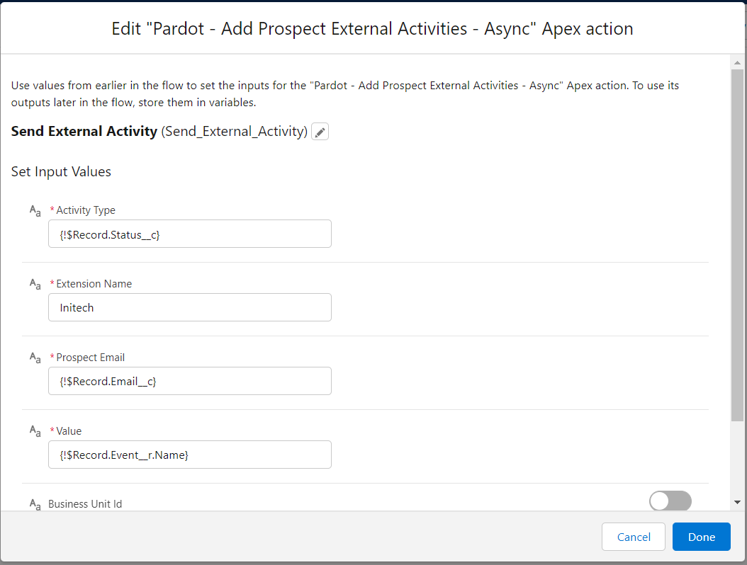
Our Glue: A Record-Triggered Flow
Values coming from the Record, a Lookup, and Hard-Coded!

Slide 34
Ok, let’s go save that registration
Now remember, it’s the Initech Platform that automatically creates these records!

Slide 35
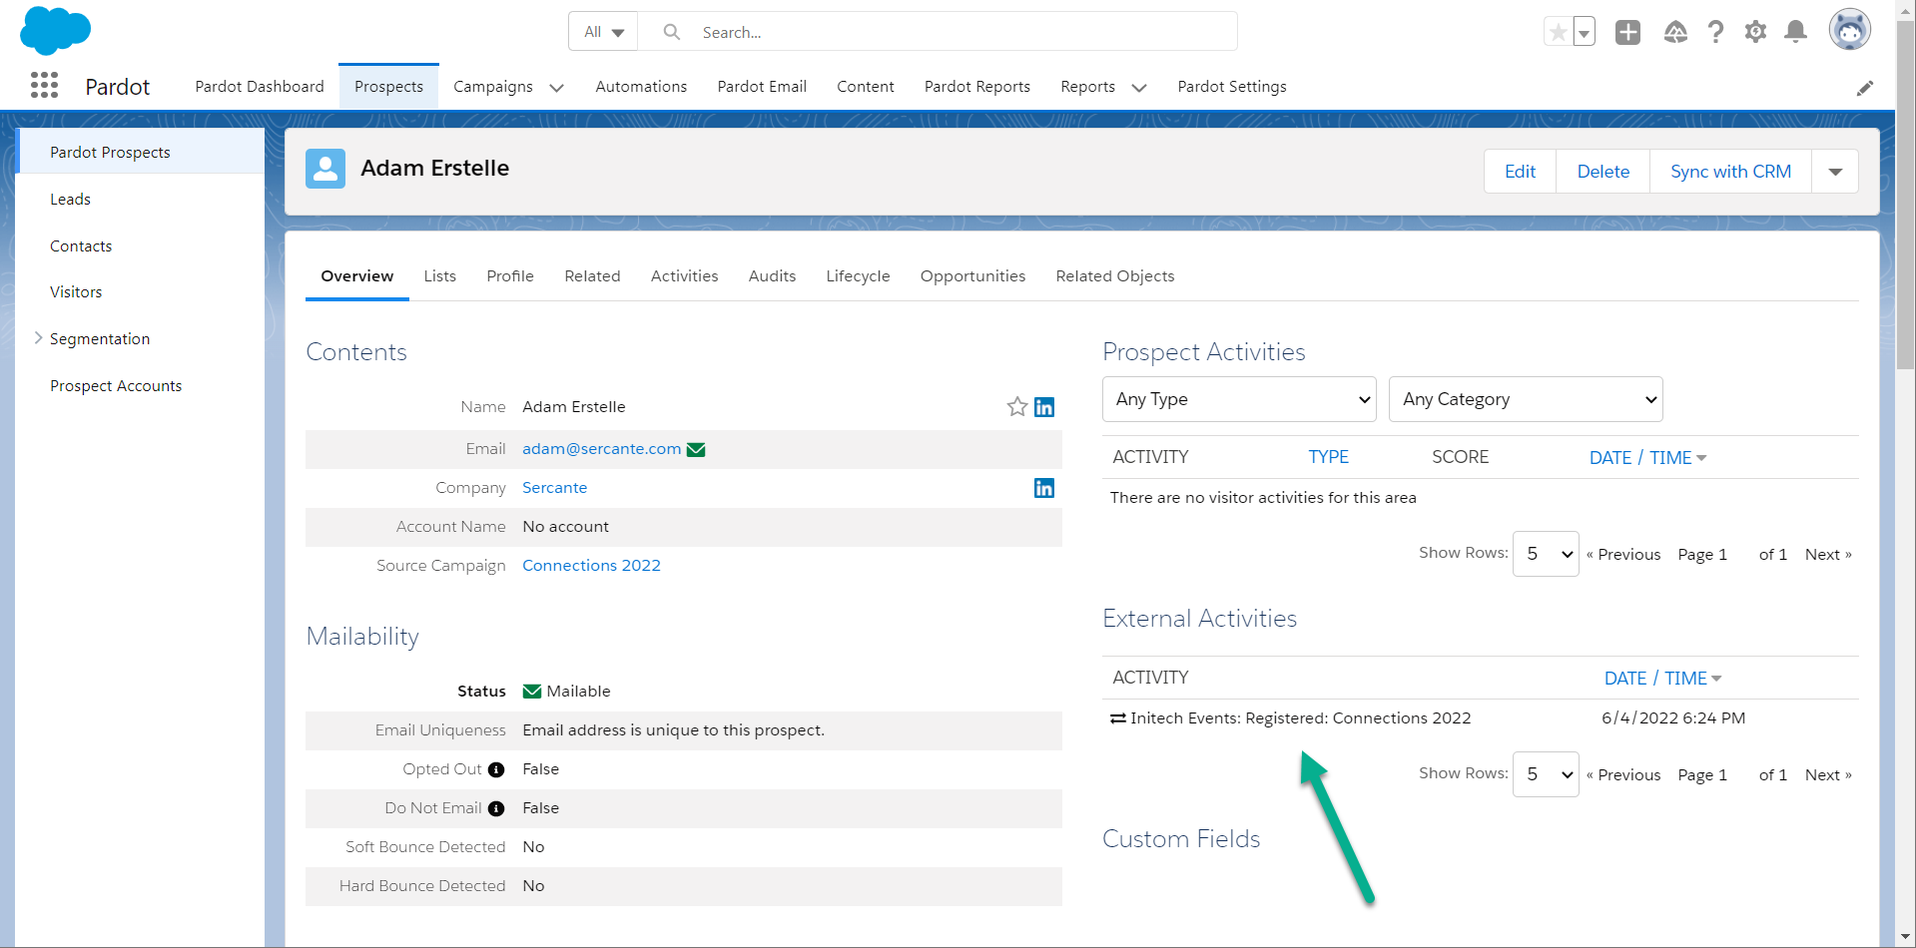
Yay, Pardot is now smarter
Now we have a bunch of ingredients for a complete Engagement Studio Program

Slide 36
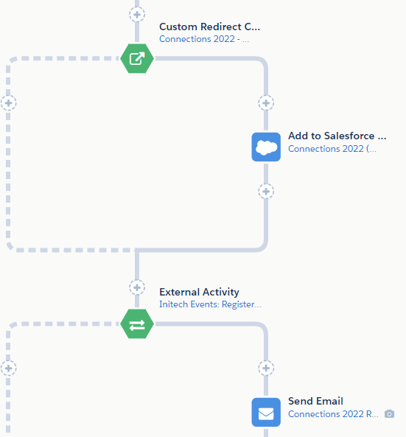
Putting it all together

Slide 37
Resources to Get Started
Learn the API:
Specifications: https://sfdc.co/V5Spec
Quick Look Trail: https://sfdc.co/APIQL
Blog Post: https://sfdc.co/blFMNa
Tools Shown Today:
Postman Collection: https://go.sercante.com/cnx22postman
Flow Actions for Pardot: https://go.sercante.com/cnx22flow
Other Apps to Check out:
Account Engagement Apps on AppExchange: https://sfdc.co/AEApps
Sercante’s Apps: https://go.sercante.com/cnx22labs

Slide 38
Special Thanks To Our Sponsors
Title
Platinum
Gold
Silver

Slide 39
Jacob Catalano
Jacob@sercante.com

Slide 40
REST Standards
Learn and develop faster leveraging the new REST API mirroring Salesforce Syntax
API V4
API V5
Notes:
Like Chris mentioned, we’ve put a lot of effort into making our endpoints REST-standardized. They’ll feel like a natural fit for a developer that’s coming from Salesforce. We’ve adopted a lot of the same naming conventions and URL structure to match.

Slide 41
Field Selection
Select only the data required for your use case to conform to minimal data best practices. Get only the data you need, when you need it
Example Request w/ Field Selection
Example Response:
GET /api/objects/campaigns/101?fields=id,name,isDeleted
Host: pi.pardot.com
Authorization: Bearer <access-token>
HTTP/1.1 200 OK
Content-Type: application/json
{
"id": 101,
"name": "My Campaign",
"isDeleted": false
}
Notes:
Versions 3 & 4 used output formats that made assumptions to try to tailor the data to the caller’s use case. Those are gone in favor of pure field selection for every endpoint. Now, we only return the fields you specifically ask us for. We’ll no longer waste time trying to populate results for a field you don’t care about. This leads to better performance, and the user gets exactly what they want.

Slide 42
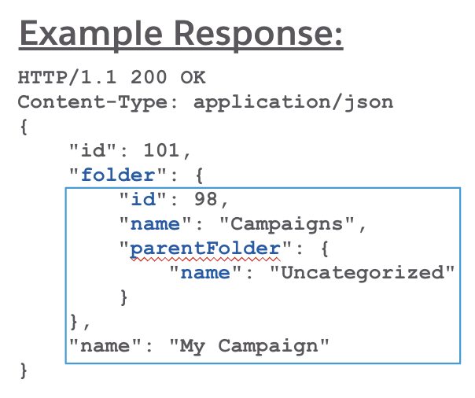
Relationships
Leverage relationships to get the data you need in one call
You can go 3 object relationships deep
Example Request w/ Field Selection

