Slide 2
Welcome Speakers!
The MarDreamin’ Team would like to thank you for your participation in this incredible event. It is because of you that we are able to provide a global community of Marketers with the best tips and tricks in the world of Salesforce and marketing automation. Sharing our knowledge is one of the key goals for this event. We understand that by doing so we are growing the community which ultimately means growing the “pie” - and that means more opportunities for everyone. Whether you’re joining us from California, Spain or even Australia we welcome you to this event and hope you share our enthusiasm. Again, thank you for your time and for sharing your gift with others. You’re all incredible trailblazers! If you have any questions please don’t hesitate to reach out to us.

Slide 4
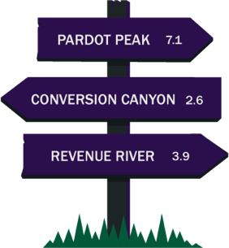

Slide 6
Right click on each image to replace it with your ideal image
Session Title
Speaker Full Name Title, Company
Use this slide if you are presenting on your own

Slide 7
Use this slide if you are presenting with someone else. There is another slide to add your images.
Session Title
Speaker Full Name Title, Company
Speaker Full Name Title, Company

Slide 8
Right click on each image to replace it with your ideal image

Slide 9
Notes:
Leave this slide in - it will be updated later

Slide 11
Right click on each image to replace it with your ideal image
Title
Optional description
Title
Optional description
Title
Optional description

Slide 15
Step 1
Step 2
Step 3
Step 4

Slide 16
Step 1
Step 2
Step 3

Slide 22
Speaker Full Name
Email Speaker Full Name
Email

