Slide 1
Journey Builder: Design And Build Custom Journeys
Tim Ziter Senior Consultant, Cervello

Slide 2
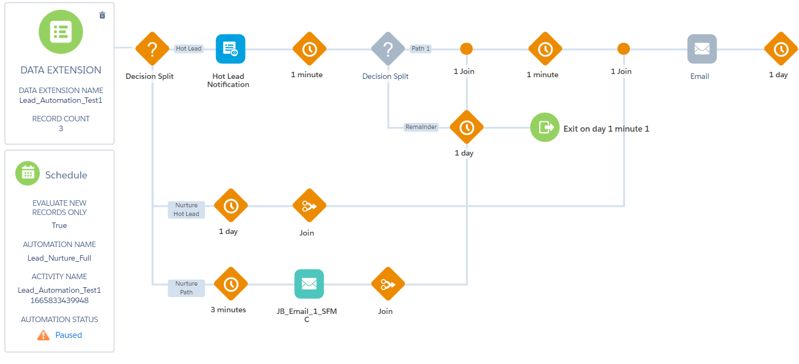
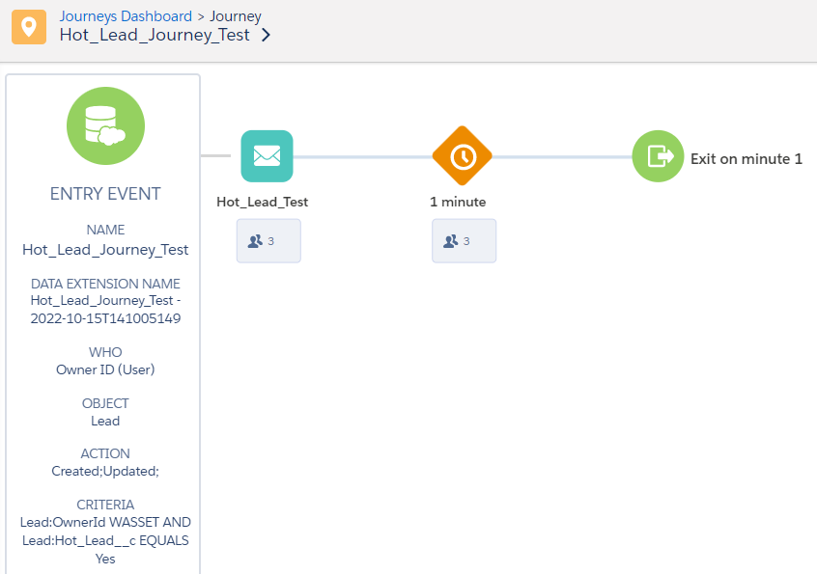
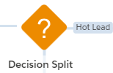
Agenda
Overview
Case Study
Martech tools
Salesforce CRM
Journey Builder
Entry Event x 2
Activities
Decision splits
Object activity
Content
Q&A
Platforms/Tools
Custom Journeys

Slide 3
Case Study: Overview
Cervello Bank is looking to grow their commercial banking business. They’ve invested in an all-out marketing blitz that has generated a large amount of leads but not seeing client conversion.
Sales is swamped and aren’t motivated to follow up on the un-qualified lead for months at which point they are cold and not productive.
Marketing needs an automated solution that qualifies leads and supports sales to drive bottom funnel conversion.
Problem

Slide 4
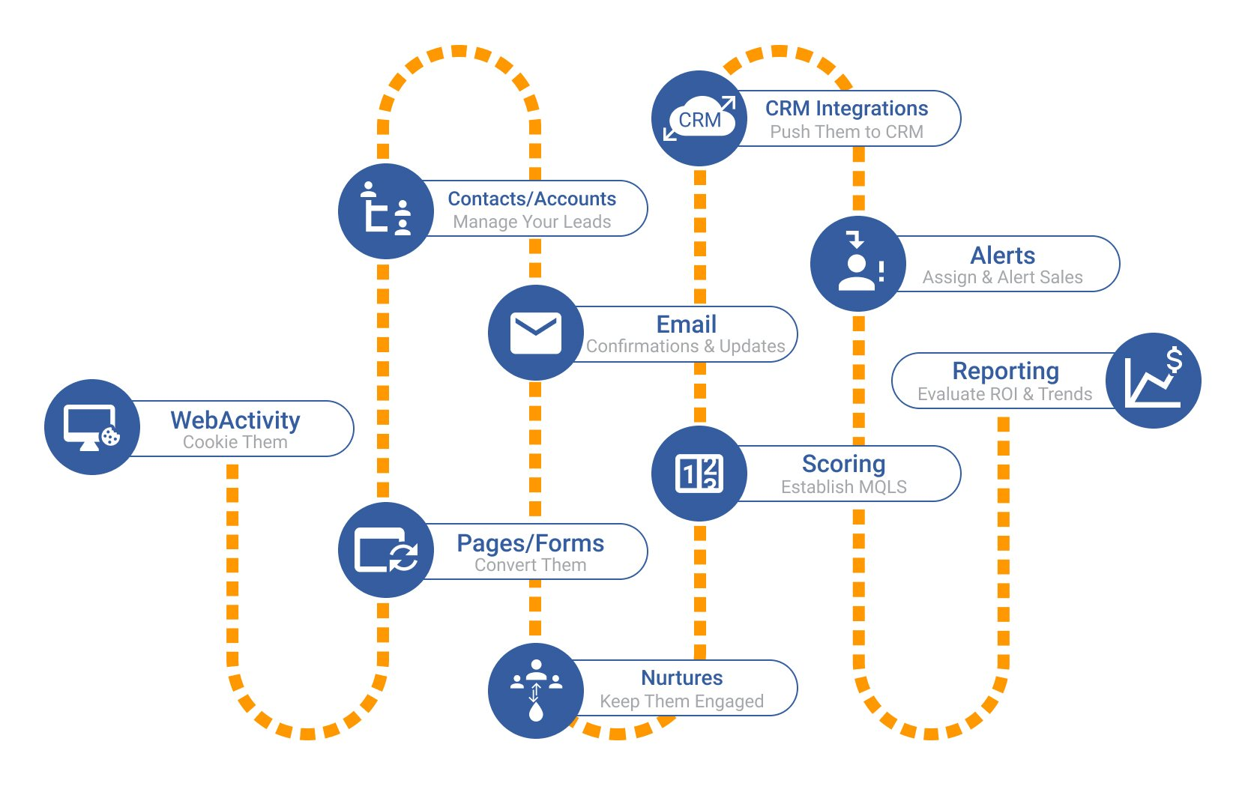
Case Study: Overview
Solution
Rank/prioritize leads into easy-to-understand buckets
Nurture leads to keep them warm
Notify sales to follow up on “Hot” leads
“Always On” automated solution

Slide 5
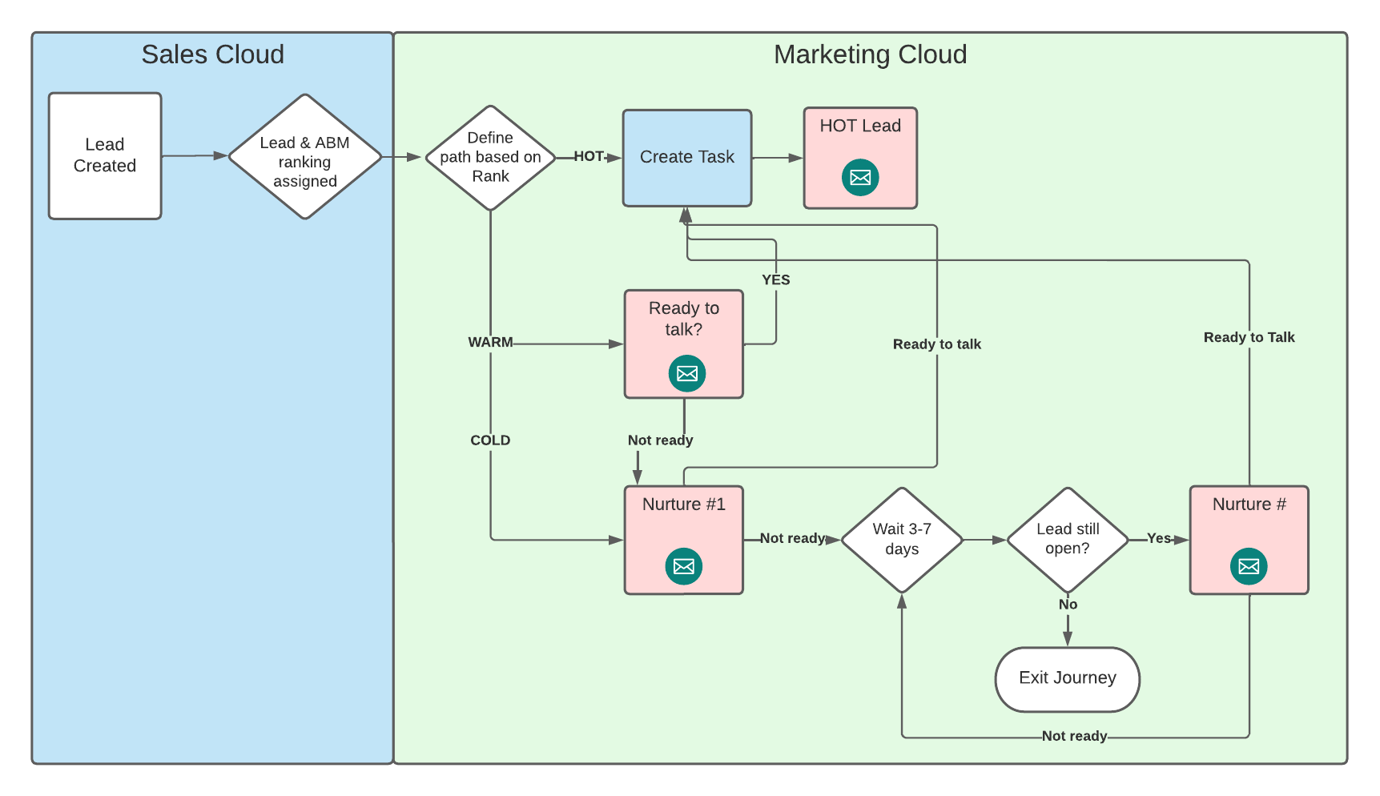
Case Study: Flow
Sales Cloud
Lead & ABM ranking
Marketing Cloud
Sort leads
Custom paths
Create tasks
HOT lead email
Nurture leads
Integrate with sales

Slide 6
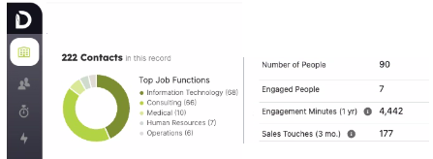
Martech Tools - Ranking
Simple lead ranking solution
Hot, Warm, Cold
Intent tagging
Account based ranking
Tier ranking
Engagement metrics
Geoffrey Polli
Tara Quehl

Slide 7
Ranking Overview
Lead Score | ABM Score | Rank | Action
Predictive Score: Hot | Tier 1 | Hot | Notify sales immediately
Predictive Score: Hot | Tier 2, 3 | Warm | Email pushing sales meeting
Predictive Score: Warm | Tier 1, 2 | Warm | Email pushing sales meeting
Predictive Score: Cold | Tier 1-3 | Cold | Nurture email series

Slide 8
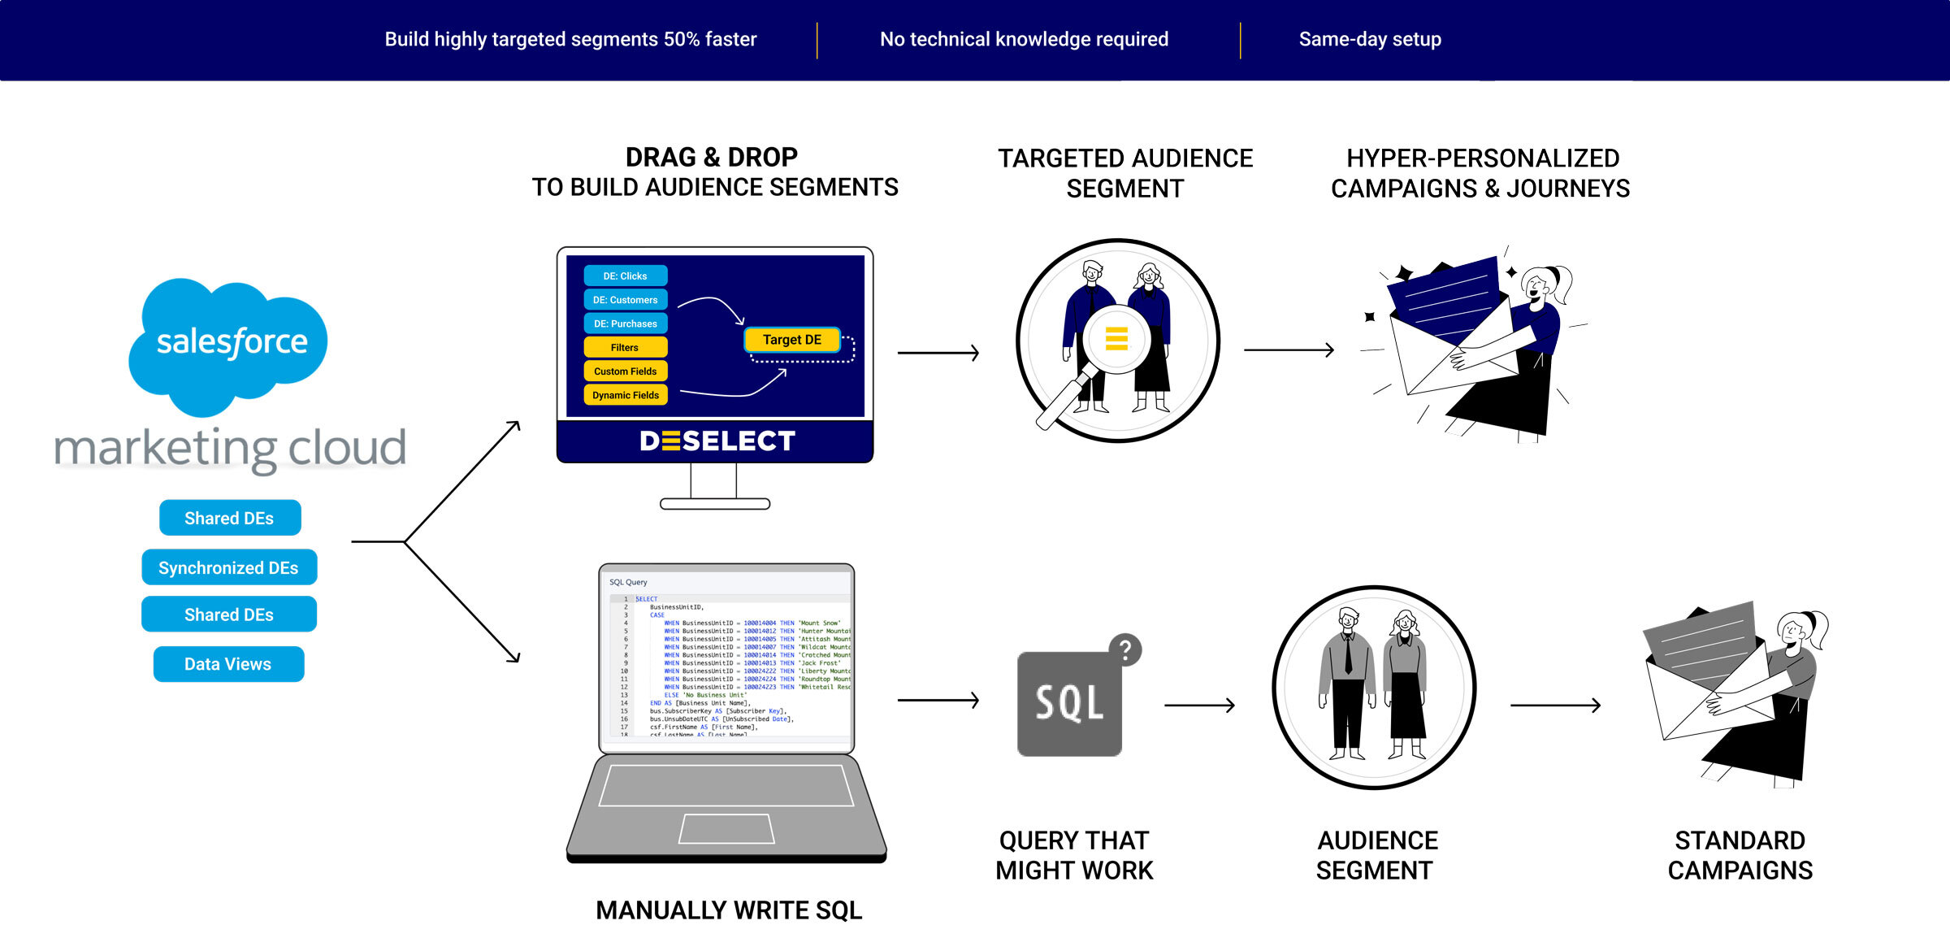
Martech Tools - Automation
Clicks not code
Query in minutes
Easy to update
No SQL
Danny Kopack

Slide 9
The Build

Slide 10
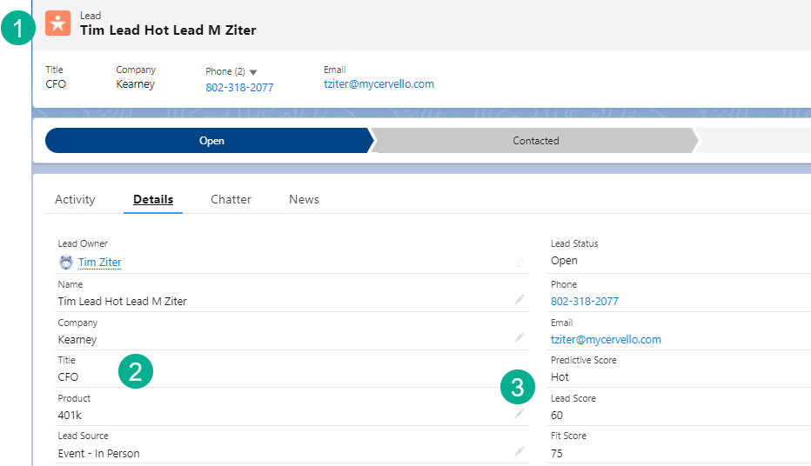
Salesforce CRM
Leads & Accounts
Lead & Account
OOB fields/data
SalesWings lead scoring
Demandbase ABM scoring
Setup
Required fields
Field names & types
Watchouts:
Incomplete leads
Lookup, formula fields
Setup – Required Fields
Field Names & Data Types

Slide 11
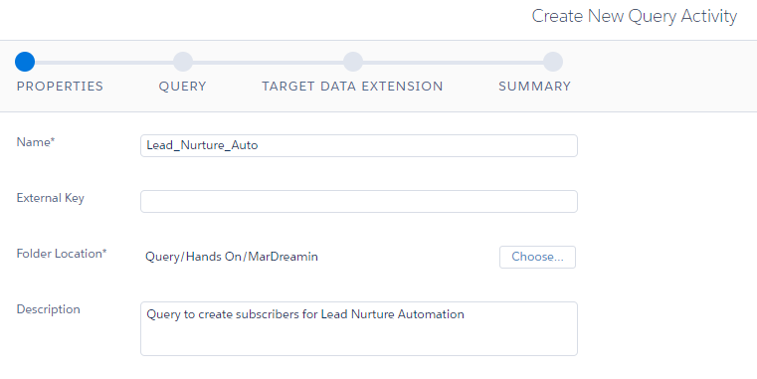
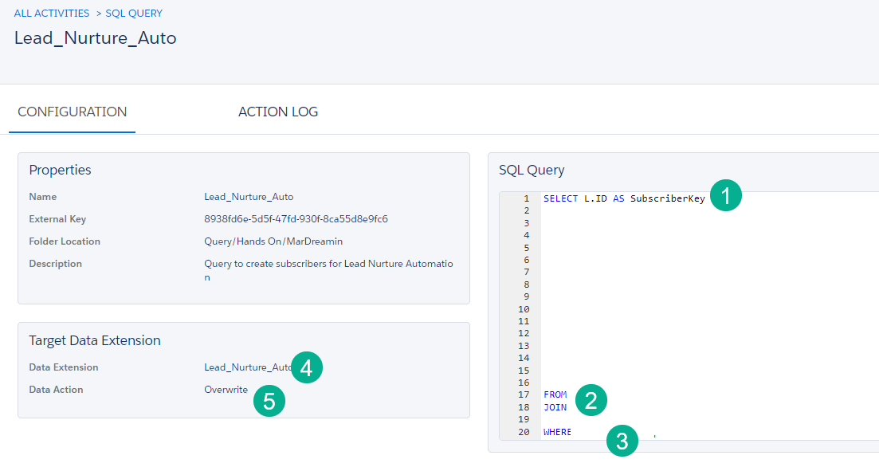
Automation Build
Query Setup
Query – three main components
SELECT
Variable, fixed, case
FROM
JOIN logic
Match
WHERE
Data Extension
Data Action
Watchouts:
Formatting to help readability
Naming pitfalls
Nested AND/OR
Query Build
Validate Data

Slide 12
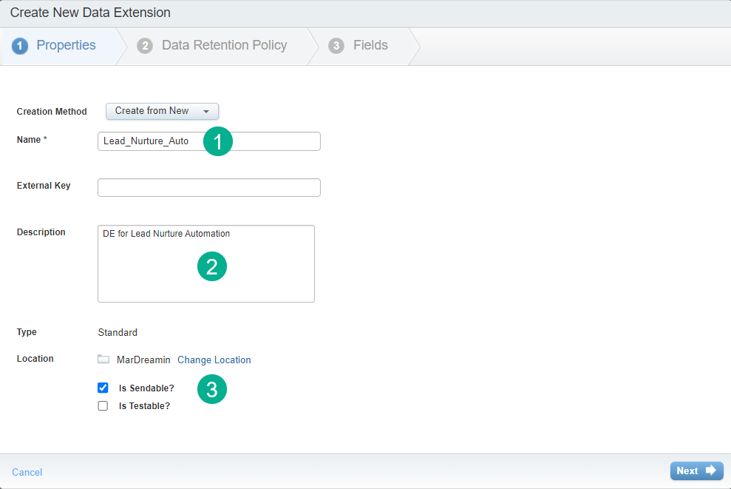
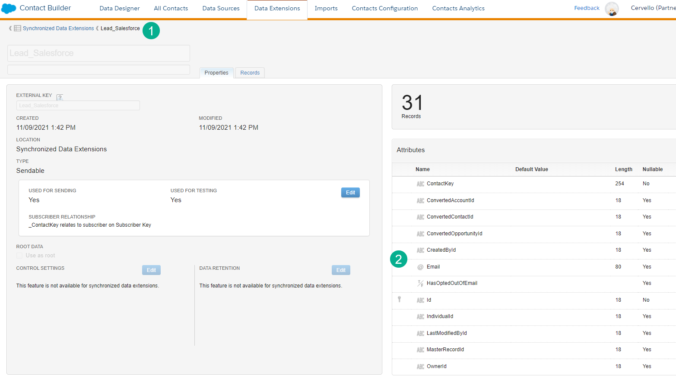
Automation Build
DE Setup
Data Extension Setup
Type
Sendable
Subscriber relationship
Attribute/field settings
Synchronized DE alignment
Watchouts:
Primary key
Type, length, default
CreatedDate
Nullable
DE Fields

Slide 13
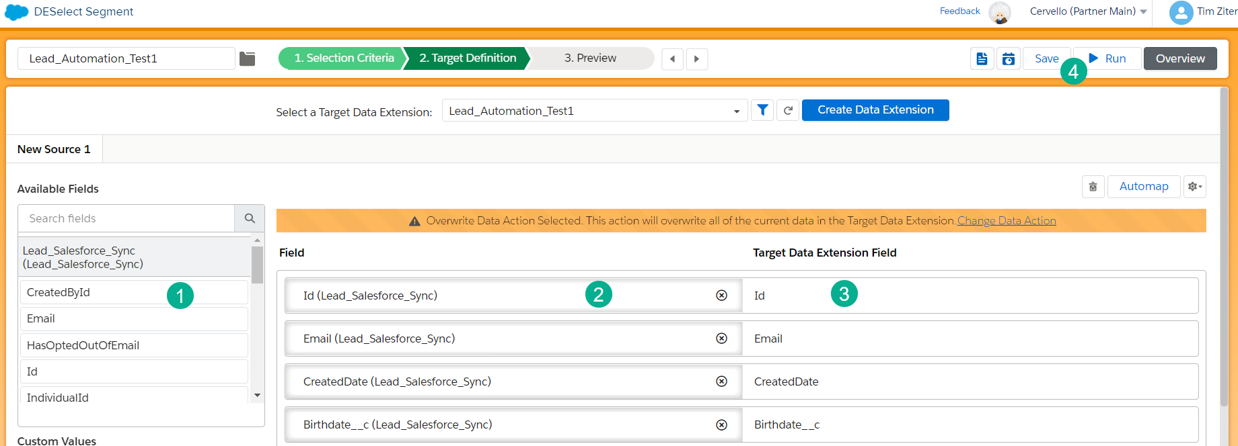
Automation Build
Selection Criteria
DESelect
New selection
Selection criteria
Source DE
Filters
Target definition
Data extension setup
Naming convention
Target Definition
Run!

Slide 14
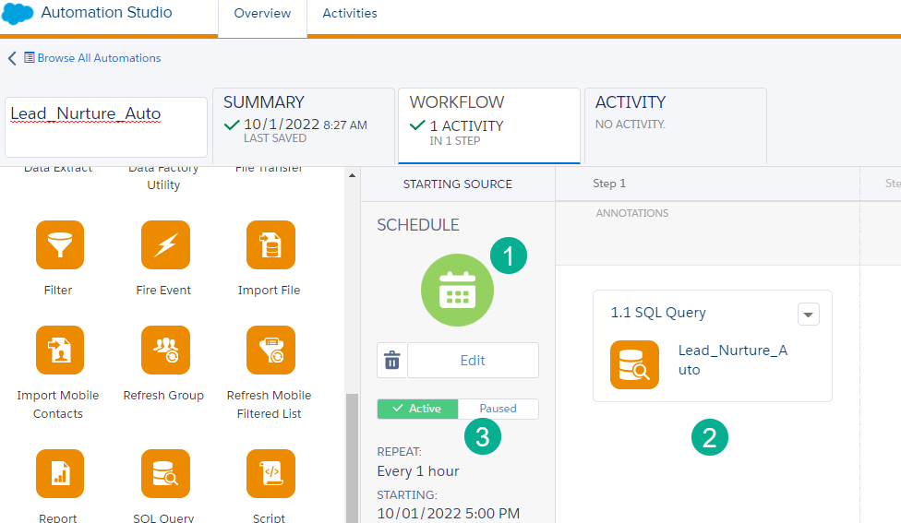
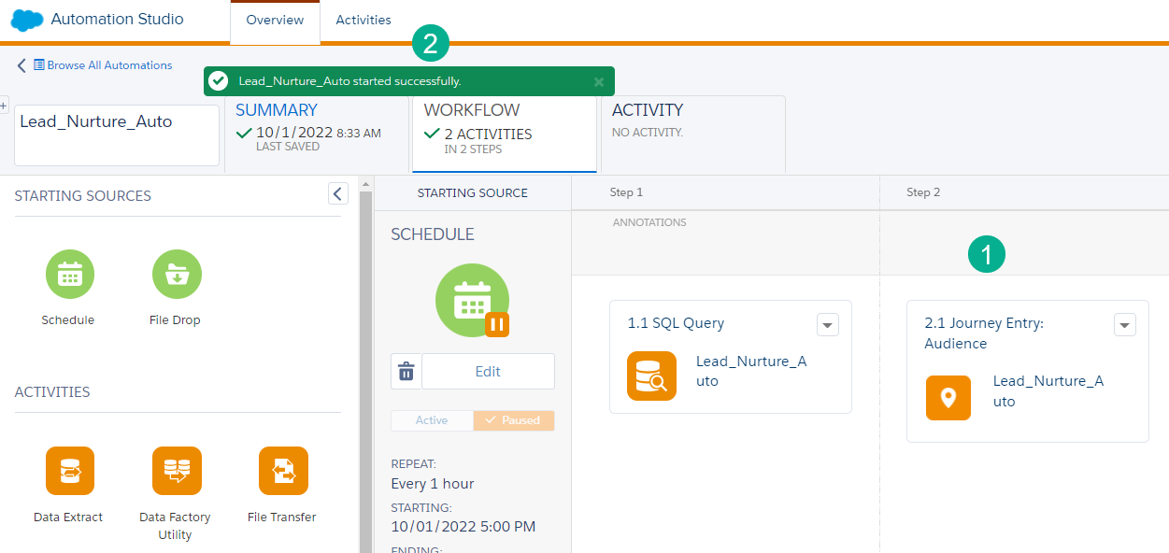
Automation Build
Automation Setup
Automation Setup
Schedule
Notifications
Add activity
Run once
Activate
Journey connect
Watchouts:
Active vs paused
Journey activity add
Connecting to Journey

Slide 15
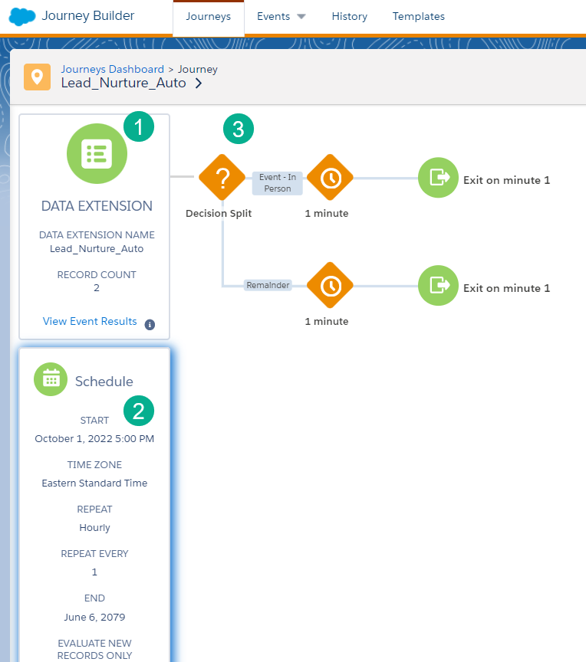
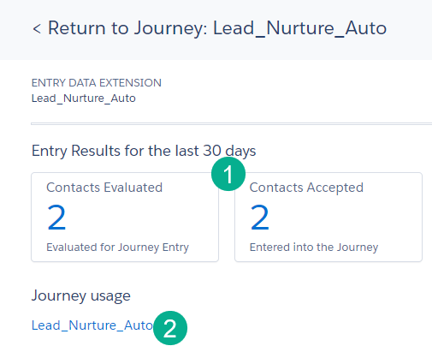
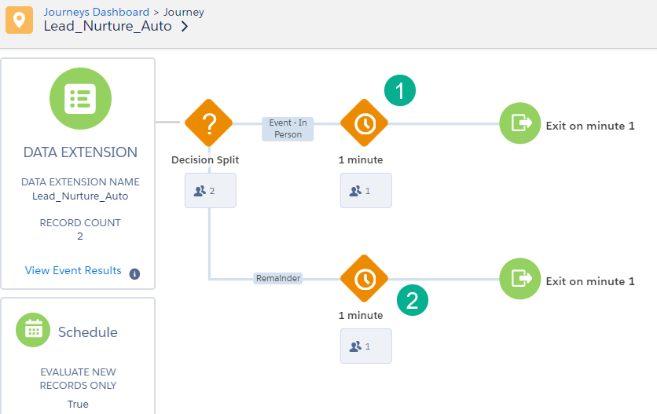
Journey Build
Entry Event Setup
Entry event setup
Evaluate records
Decision split quick setup
Activate
Send in records/data
Watchouts:
Journey settings
Wait steps
Paths
Activate & Validate
Journey Paths

Slide 16
Journey Build
One-to-many
1-to-many
Contact data first
Attribute to attribute
Correct matching key
One-to-one
Art of possible
Watchouts:
Null errors
One-to-one
Custom Fields

Slide 17
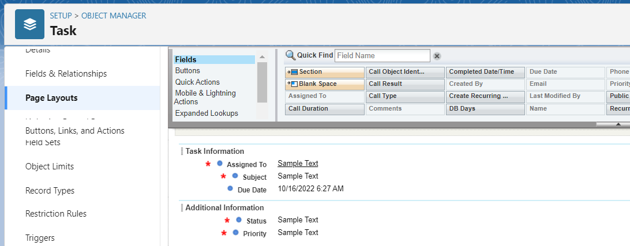
Journey Build
CRM required fields
Create task
Required fields
Customized field entry
Test
Update lead
Field choice
Test
Watchouts:
CRM settings
API call limits
Create task setup
Personalized fields
Summary

Slide 18
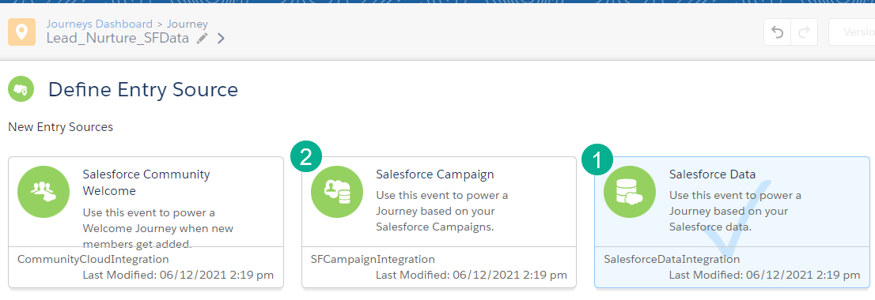
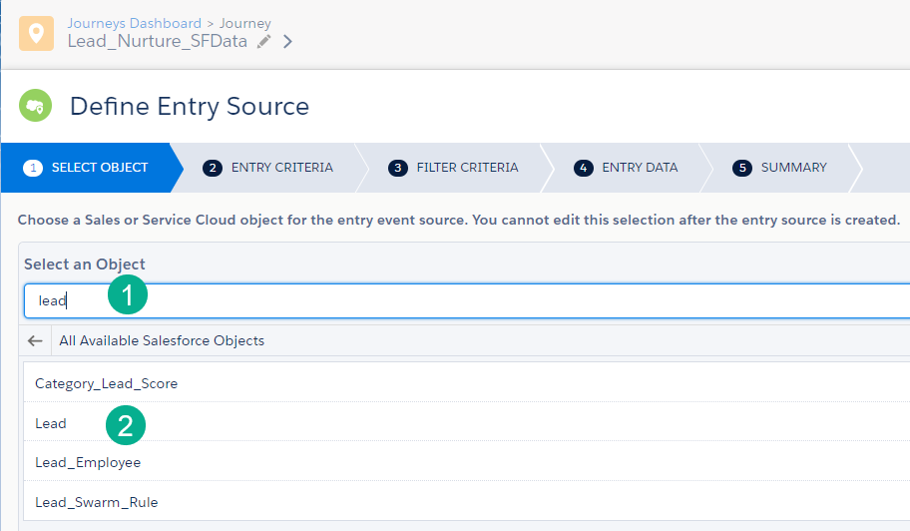
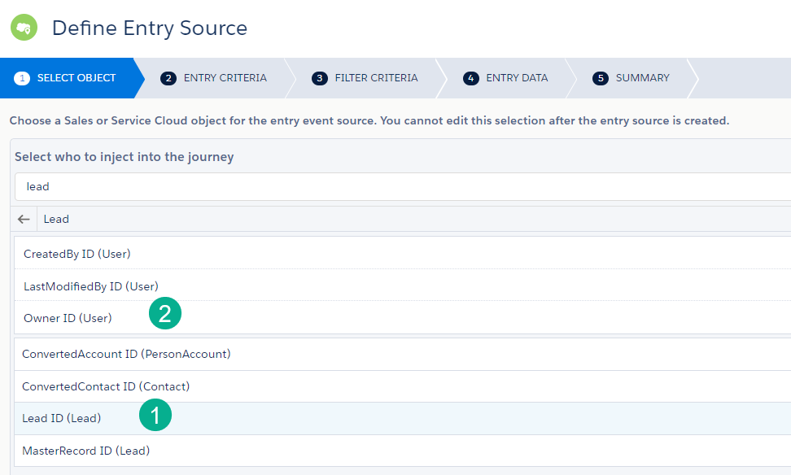
Journey Build
SF data entry
Entry event setup
Salesforce data vs other
Object select
The who
Contact
User
Watchouts:
Stick with SF data
Child objects
Campaign member
Opportunity contact
The details of the who
Search objects
The who

Slide 19
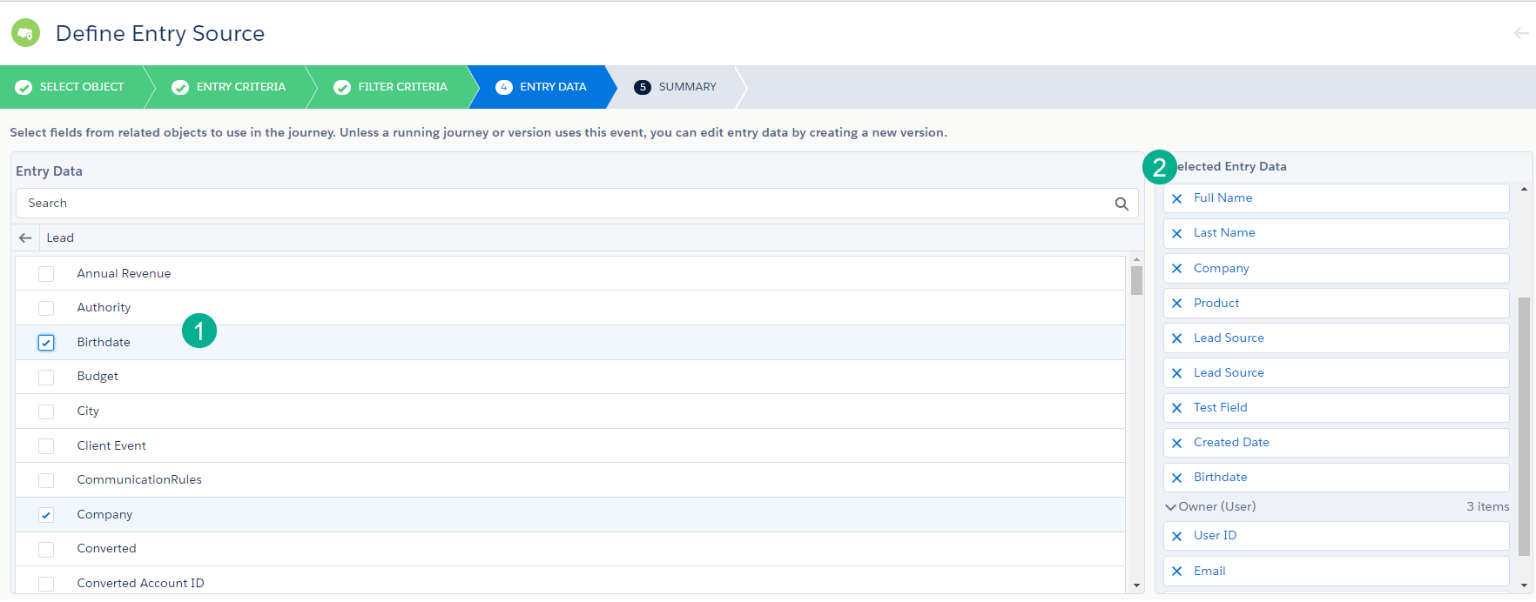
Journey Build
Primary-related criteria
Criteria
Created and updated
Primary vs related objects
Lookup and formula fields
Data
Default fields
Object fields
Watchouts:
Created/updated triggers
And/Or selectors
Field name varieties
Data fields
Summary

Slide 20
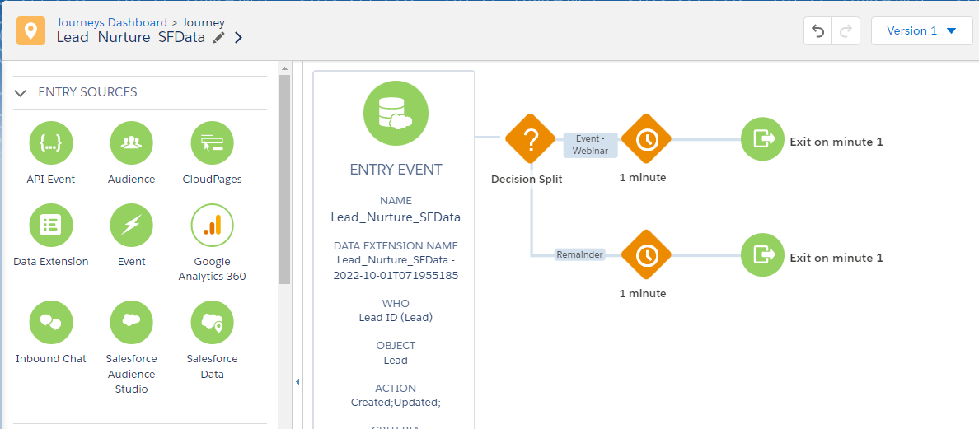
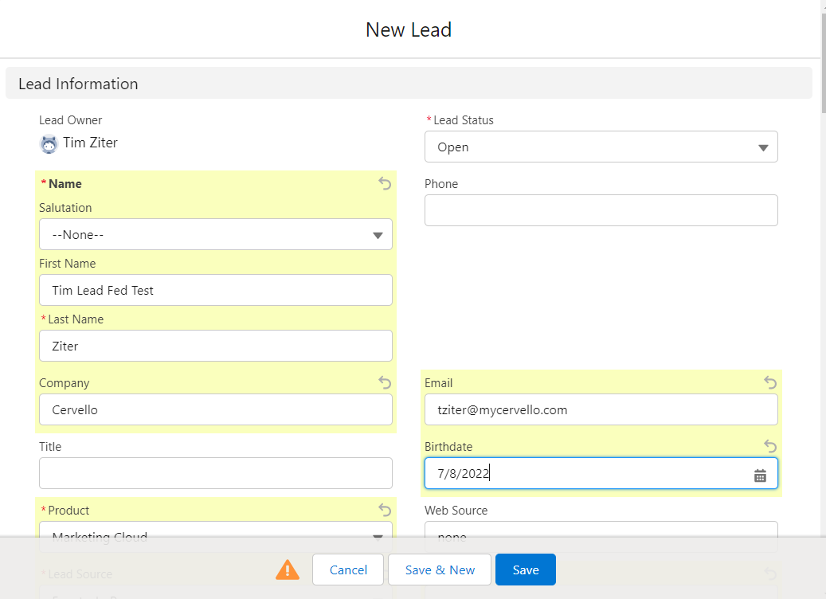
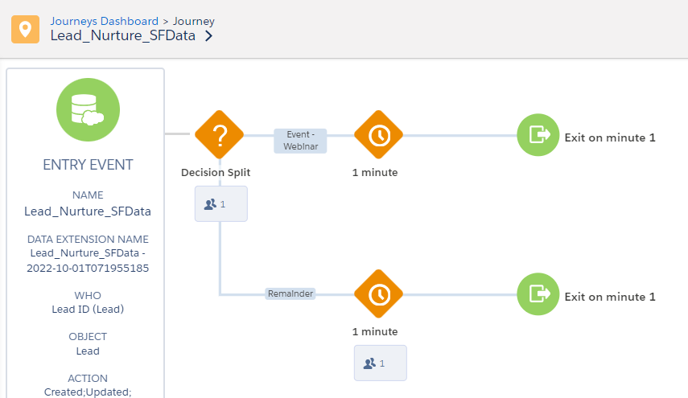
Journey Build
Canvas build
Canvas build
New lead test
Validate data
Watchouts:
Create leads all fields
DE location
Lead create/update - test
Flow
Data

Slide 21
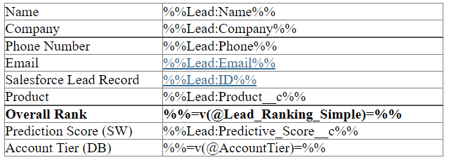
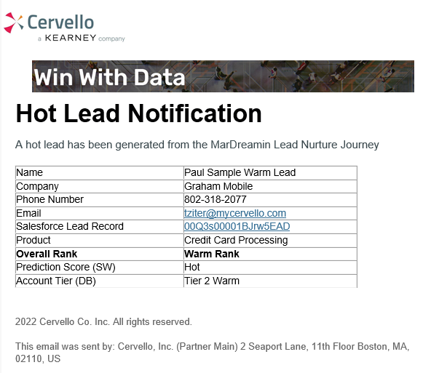
Content – Hot Lead
Data
Unique data fields
Align to content
Lookup addl variables
Click into lead functionality
Email prompt
E2E testing
Data align
Click into lead
Email prompt

Slide 22
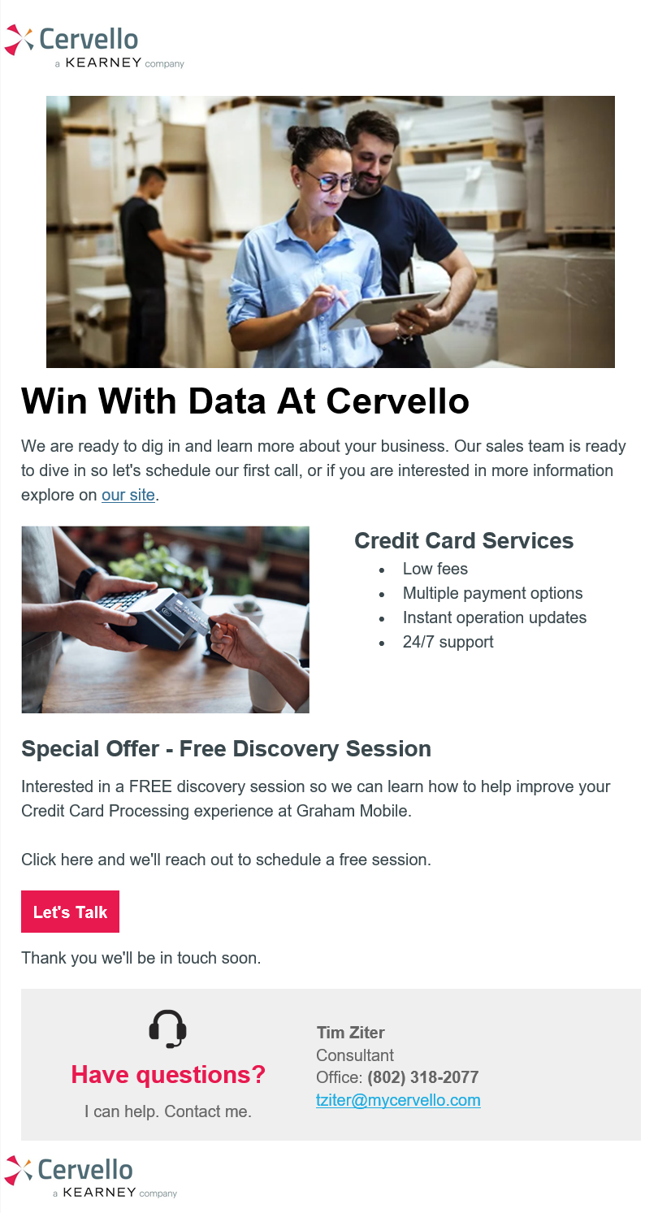
Content – Hot Lead
Basic personalization
Build
Email design system
Personalization
Signature block
Dynamic content
Dynamic sender profile
Watchouts
Engagement split
Code snippets vs free form
Signature block
Dynamic content
Dynamic sender profile

Slide 23
Best practices/tips

Slide 24
Automation tips
Queries - USE DE SELECT! If you can’t use the following:
Remember the three basic sections of every query SELECT, FROM, WHERE
In the SELECT statement use the “, variable” for each line for efficient syntax
Build your Data Extension as you are building the query
Watch those JOINS: Double check each join to make sure it’s not limiting or adding too much data to your data pool
Don’t forget about null values
Use Run Once to quickly run the query vs setting up an automation
Automations
Activate an automation to a future date to have it be available to be selected by the Journey at setup
Pause the journey and “Run Once” selecting partial activities to verify the data at each stage of the automation
Keep activities on their own separate swim lane
Don’t forget to add run/skip notifications

Slide 25
Journey tips
Entry Event:
When using Salesforce Data Entry – always select SF Data option
Related Object Activity attributes will not send in a new Journey member only the primary object
Lookup and custom fields may not send a new Journey member in when updated in CRM
A lead/contact will not enter the journey if all required fields aren’t populated when created
Once active to edit the SF Data entry settings, create a new version and stop the previous version
Activities
Use the Object Activity vs Task, Lead specific activities
Decision Split: Always link the Contact data ID with the Journey data ID via the Attribute to Attribute comparison. Contact data must be first!
Be mindful of the name of the Journey when activating – you can’t change the name of an activated version
Rebuild the journey from scratch if you have to replace the Entry event once activated

Slide 26
Tim Ziter - Cervello
tziter@mycervello.com

