Slide 1
Data Cloud: 5 Tips
For Getting Started
Adam Erstelle
Sercante, VP of Technology

Slide 2
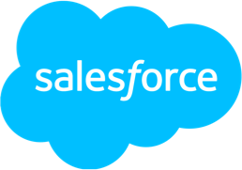
Thanks To Our Incredible Sponsors!

Slide 3
Agenda
Organizational Alignment
Pick a Use Case
Identity Success Metrics
Leverage the Customer 360 Data Model
Be Intentional (Action your Data)

Slide 4
Organizational Alignment Tip #1

Slide 5
Data Management is Complex
Amidst increasing customer data
Identity Data
Purchase Data
Case Data
Web and Mobile Data
Health Data
Engagement Data
100ZB of data
in the cloud by 2025
Notes:
ZB = a million tera bytes

Slide 6
Ensure Organizational Alignment
Avoid "shared responsibility" and break out of organizational silos
Executive Leadership Strategy, Decision Making, Facilitation, Communication
Digital / Marketing Team
Marketing Manager Marketing Specialist Project Manager
IT / Data Department
IT Manager Data Admin Data Specialists & Architects Web/Digital Resources
CoE
Center of Excellence
A Data Cloud will affect several departments in an organization, and while they all have to buy in and cooperate, you still need a single owner to drive successful adoption

Slide 7
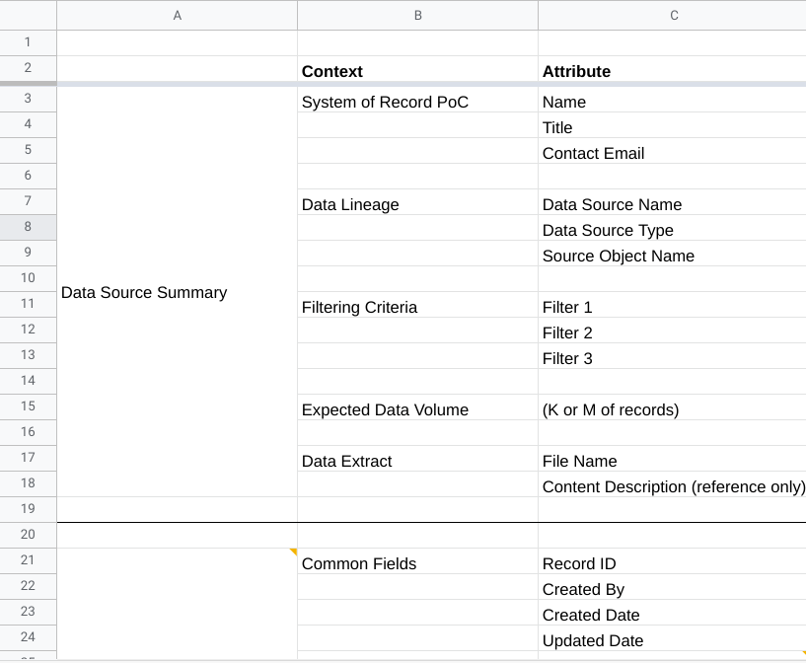
Before Ingesting your Data
Advice
Understand System of Record for each Data Source
Inventory Your Data Sources
Investigate quantity, quality and completeness of all data sources
Build out a Data Dictionary for each source being added to Data Cloud
Database Relationships: Primary and Foreign Keys & Nullable fields
Data Governance: Estimates of data quality, estimated volumes & described data flows
Source Data Overlap: Recognize shared data points & consider possible matching conditions
Determine Data Category
For each data stream (Profile vs Engagement vs Other)

Slide 8
Pick a Use Case
Tip #2

Slide 9
Pick a Use Case
Tip #2

Slide 10
Implementation Approach
Discovery And Design
Align on customer experiences that will be enabled and what business impact is driven through use cases
Explore available Data Sources, identify required feeds, existing data relationships or to be established as part of integration.
Derive necessary calculated insights that address segmentation and activation requirements for computed measures.
WHY and WHAT
DATA AUDIT
COMPUTATIONS
1
3
5
2
4
6
TAXONOMY
PROFILE
STRATEGY
VALUE
Collate necessary attributes required for the segmentation, align with Customer 360 Data Model and identify gaps, design extended data model.
Clarify all data points that need to be consolidated into the Unified Individual Profile, hierarchical order of resolution and reconciliation rules.
Clarify KPIs for use cases, establish operational reporting, provide recommendations for ROI measures and gaining audience insights

Slide 11
Discover
Use Cases across these main categories to drive value
Use Case Discovery
Unification & Harmonization
Insights & Analytics
Segmentation & Activation
Organizational Efficiency
Activate Across the
Customer Journey
Empower 1:1
Personalisation
Drive engagement outside
of your Owned channels
Target and Scale
Avoid Irrelevant
Messaging
Test, Learn & Optimize
Improve
Customer-Lifetime-Value
Segment More Precisely
Discover Customer’s
channel of choice
Consolidate Markets,
Systems & Data
Create a Unified Profile
Single Place For
Segmentation
Unified Web Data
Collection
Know Your Customer
Go Beyond Marketing Data
Enrich with External data
Discover new Segments

Slide 12
Identity Success Metrics
Tip #3

Slide 13
Typical Data Cloud Implementation Metrics
Data Integration & Quality
# Data Sources
Data Integrity
Data Latency
Engagement & Adoption
Adoption Rate
Training Time
Satisfaction Scores
Business KPIs
Customer LTV
Segmentation Effectiveness
Customer Retention Rate
Operational Efficiency
Query Time
System Uptime
Cost Savings
Marketing Metrics
Campaign ROI
Lead Conversion Rate
Engagement Metrics
Compliance & Security
Data Compliance Rate
Security Incidents

Slide 14
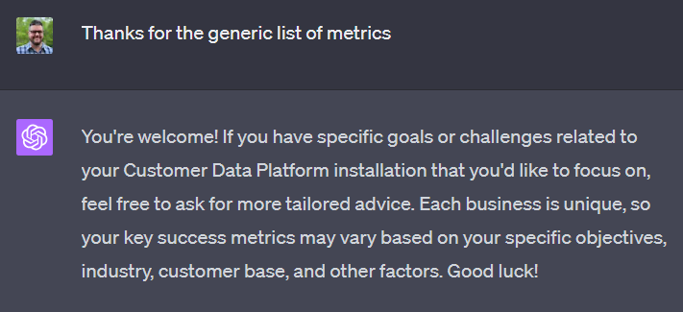

Slide 15
Use Case Success Metrics
How can you entice others
Something that matters to the team (Operational Efficiency)
Time saved no longer having to get data from multiple sources and create a report
Business KPIs
1- Customer LTV
2- Segmentation Effectiveness
3- Customer Retention Rate
Marketing Metrics
1- Campaign ROI
2- Lead Conversion Rate
3- Engagement Metrics

Slide 16
Leverage the Customer 360 Data Model
Tip #4

Slide 17
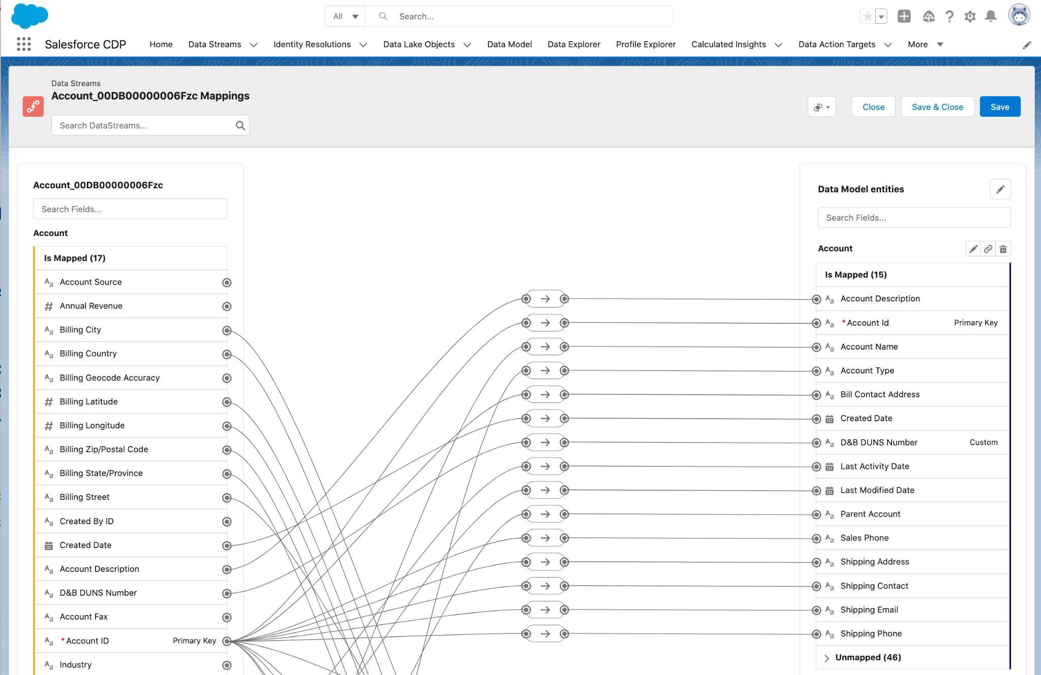
Mapping Data to the Data Model
Unlock the Value of Data by Harmonizing to the Right Data Model
Harmonize
Map all previously siloed data (left) onto the correct, logical objects (right) with clicks-not-code mapping
OOTB Mapping
Automatically map data from salesforce applications & easily map data from other sources
Custom Objects and Fields
Re-configure the Data Model or create your own objects, fields and relationships to create the Data Model that makes sense for your business.

Slide 18
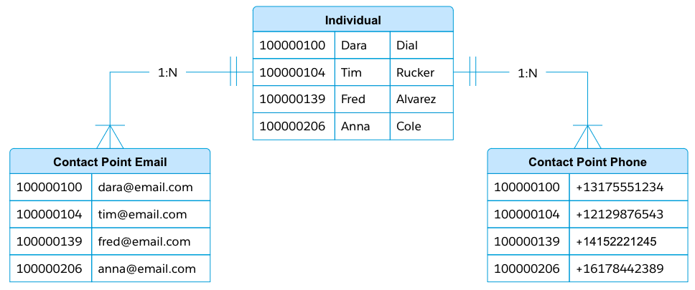
Take Your Time with this part
Do not rush into pushing
buttons in Data Cloud
Before Mapping Your Data
Align Your Data with the Customer 360 Data Model
Data Cloud Data Model is normalized
Data needs to be normalized before it can be mapped
Assess & establish
How to transform & map source data to the standard data model
Leverage Data Model Subject Areas (Party, Case, Engagement etc)
Determine Type of Data per Source System Object
Profile vs Engagement vs Other
“Map” Source and Destination Objects and Fields in a spreadsheet
Propose Extensions or Substitutions to Standard Data Model as needed (fields or objects)
Denormalized Data

Slide 19
Data Ingestion & Data Mapping Mapping are Distinct Steps
Did you know?
Source data varies greatly.
Data Cloud harmonizes them into a Standard Data Model
Different Data Sources
& Unique Data Models
Data Cloud Standard Data Model
S3 Object
(DLO)
Mapping
Data Cloud DMO
Identity Resolution
Segments
Marketing Cloud DE (DLO)
Other DMOs
Insights
Activation
Harmonization is the transformation of different data models into a common one.
CRM Objects (DLO)
Data Cloud Data Streams
Resulting Data Cloud Value

Slide 20
Be Intentional
(Action your Data)
Tip #5

Slide 21
Action Your Data
Be Sure to Align Your Choice to the Use Case
Analyze Data & Enhance Data with Insights
Calculated Insights
Tableau
Marketing Cloud Intelligence
Act On Your Data
Segmentation
Activation
Data Actions
Deliver Predictions
Einstein Studio -
Bring Your Own AI using Amazon Sagemaker

Slide 22
Data Actions (“Action” your data in real time)
Drive real time actions on your Data Cloud data
Did you know
Any object or Insight can be actioned in real time via
Data Actions
Data Cloud Object
Action Rules (optional)
Send Email
Mobile & Web SDK
Data Cloud Data or Insights
Chatter Post
In App - Mobile Notification
Insights
Desktop Notification
Data Action
Slack Message
Streaming Data
Log Custom Platform Event
Enrichment (optional)

Slide 23
Activation vs Data Action
Activation
Data Actions
Publishes Segments to Activation Targets (S3, SFTP, External Platforms, SFMC)
Focused on activating a Segment with relevant profile attributes and metrics
Translates Data Cloud IDs to activation targets with the right contact point, append attributes and insights etc.
Activation of large segments with millions of profiles
Typical user: Marketer
Sends alerts/events to Targets (Salesforce Core, Webhook) based on real time Data Changes or Insights
Event driven automations and data integration
Focused on near real time events and Insights at channel, product, account, service, individual etc.
No historical data or additional context
Typical users: Data aware specialist / architects and data engineers

Slide 24
1- Use Cases
Top 5 Tips Recap
Be Clear on what should & what should not be done in Data Cloud
2- Be Intentional
How to Action your Data / Relate to the use case
3- Organizational Alignment
Break out of Organizational Silos / Spend Time Auditing Source Data
4- Identity Success Metrics
Business KPIs / Operational Efficiency
Bonus Tip
Leverage the Experts
5- Customer 360 Data Model
Align your data to the Customer 360 Data Model - Take your time

Slide 25
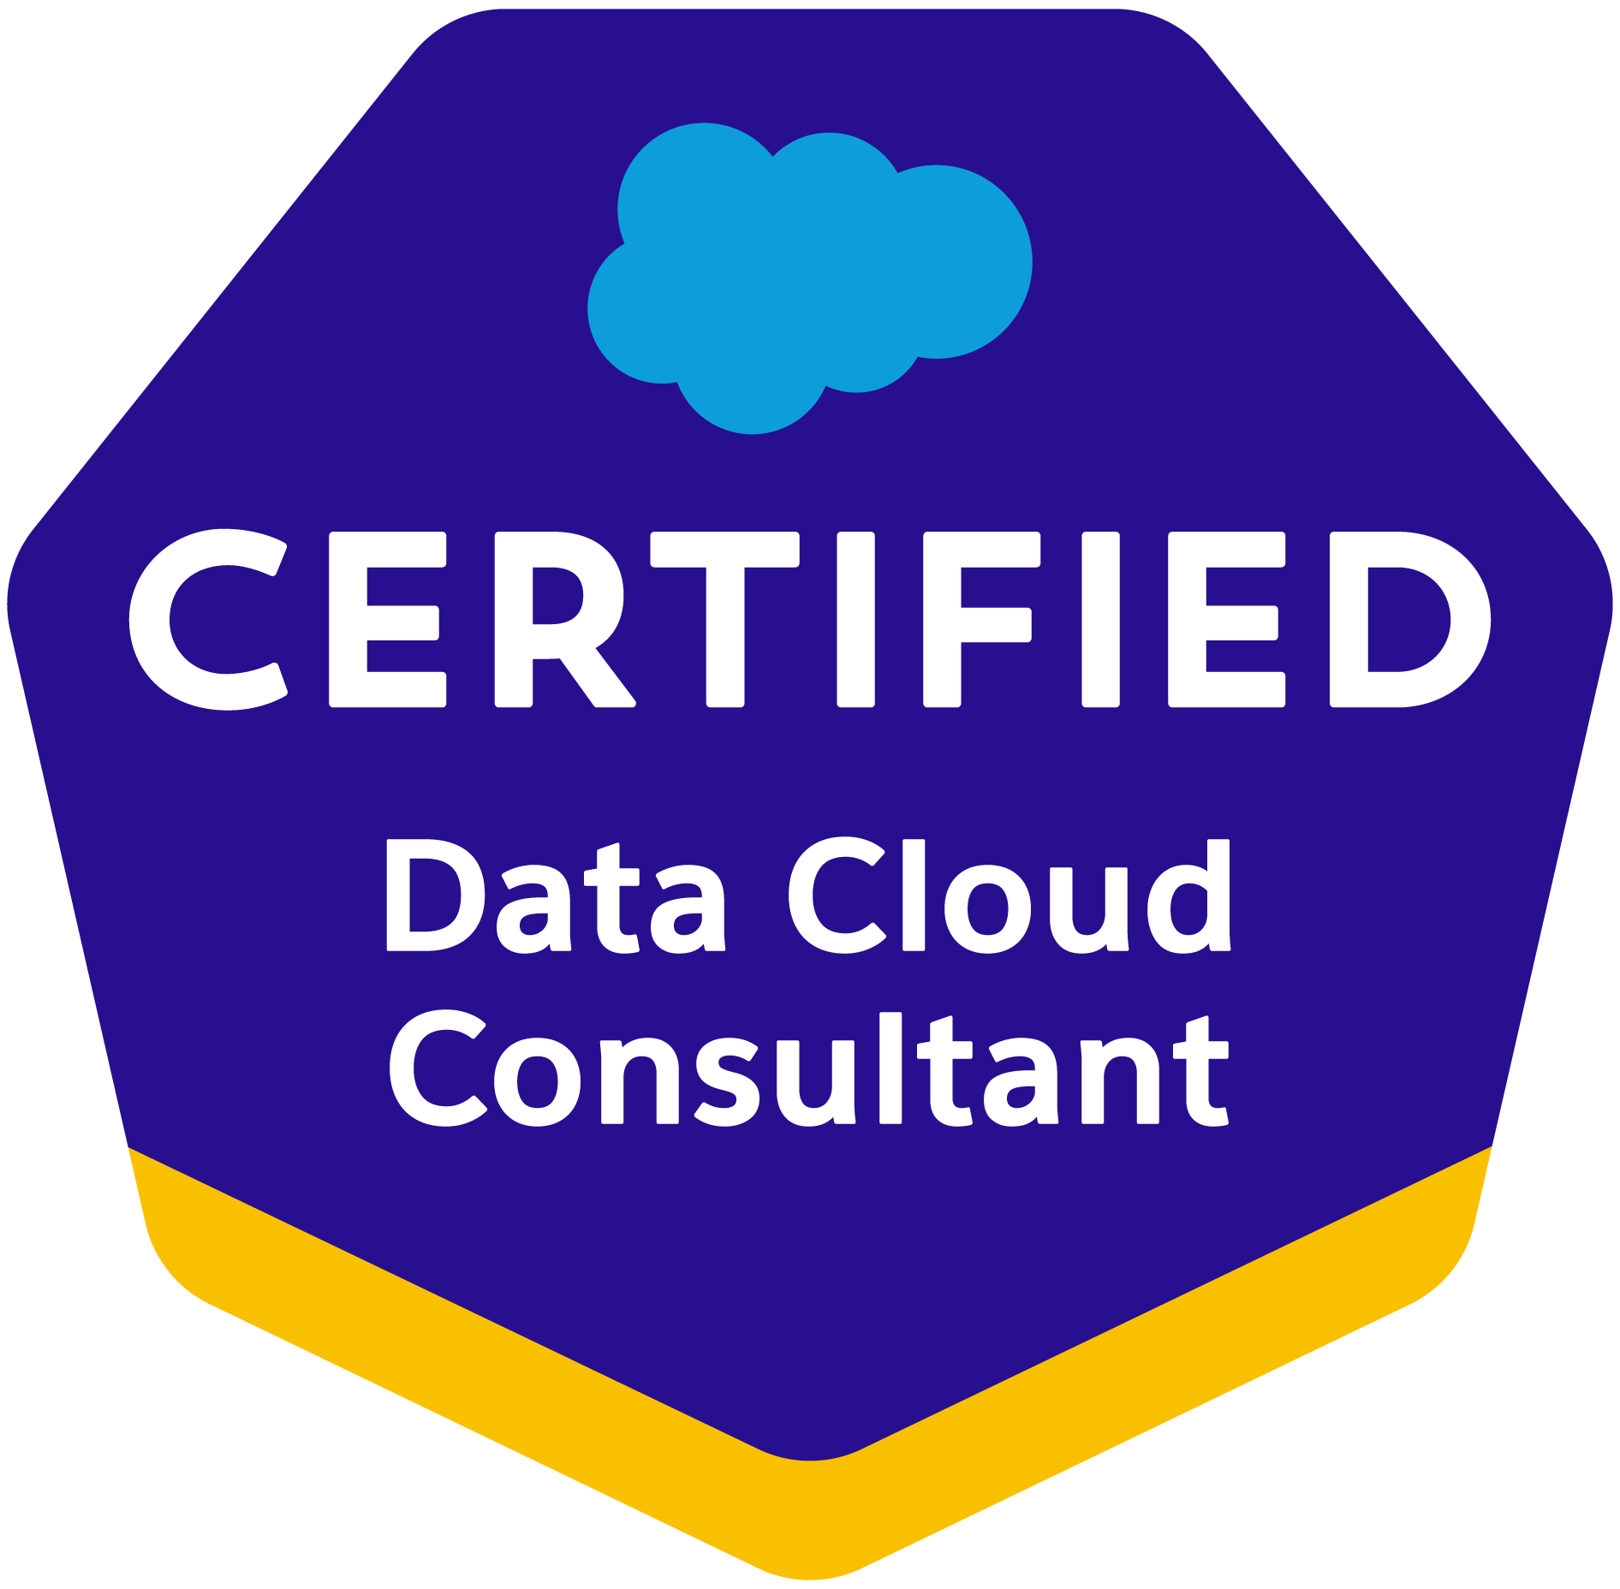
Tip 6 - Leverage the experts
Trail Map for Data Cloud
Self-learning
Partner with Implementation
Hands-on training
All stakeholders to access instance and get to know your instance in depth
Partner with Account Success
Success Review
Check-in on progress!
Planning for Success
Best practices for value and use case mapping
Partner alignment on implementation goals
Discuss your business value map and use case roadmap draft
Build and launch your use cases
Create first segments and activate them
Review your implementation
Confirm if existing implementation matches your use case plan or needs adjustments, or vice versa
Review your first results
Share initial learnings
Implementation Considerations Review the resources and the documentation available to you.
Optimize for Success
Best practices for use case optimization
Document Business requirements
- Identify Data sources and integrations
- Confirm requirements
- Define your audience segments strategy
Watch the Prepare for Implementation Video and go through the Trails on Trailhead
Continue Your Journey!
Check here for new feature announcements and release notes.

Slide 26
Data Cloud Trailblazer Path
TRAILHEAD | TRAILBLAZER COMMUNITY | EXPERT COACHING SESSIONS | ASK-AN-EXPERT OFFICE HOURS | ADDITIONAL RESOURCES
Learn new skills from anywhere. Build a Data Strategy for Data Cloud Prepare to use your data in a Data Cloud Ingestion and Modeling in Data Cloud Connect your data sources and define their relationship in Data Cloud.. Explore Salesforce Data Cloud Learn how to implement and use key features of Salesforce Data Cloud | Learn, connect, have fun, and give back together. Salesforce Data Cloud Connect with other Salesforce Data Cloud users. Marketing Cloud Connect with other Marketing Cloud users. | Targeted, outcome- based sessions. Expert Coaching Catalog See topical engagements on how to manage data once it’s in Data Cloud Getting Started: Data Cloud: Prepare for Implementation Get expert guidance as you prepare to use Data Cloud. Data Cloud: Best Practices Enhance your understanding and get the most out of Data Cloud Data Cloud: Mapping Fundamentals Intro to data storage and segmentation | Get real-time answers and ideas from experts and peers. Ask a Data Cloud Expert For best practice, strategy questions. | Ingest, harmonize, unify, and analyze streaming and batch data with Salesforce Data Cloud Resource hub for Data Cloud Data Cloud Implementation Guides PDF guides to set up, administer, and configure CDP. Professional Services Implementation, advisory, and more. Release Readiness Stay up to date on the latest and greatest product enhancements and innovations. Release Notes Explore product enhancements and new features.
Learn on Trailhead
Join the Community
View the Catalog
See Upcoming Sessions

Slide 27
Thank You!

