Slide 1
Maximizing B2B Campaigns: Integrating Offline Conversions With GA4
Sabuhi Yahyayev
CloudKettle, MA Practice Lead

Slide 2
Thanks To Our Incredible Sponsors!

Slide 3
Agenda
Understanding the data model of Google Analytics 4 (GA4)
Salesforce and GA4 Integration Framework
Configuring Account Engagement to Push Data to GA4 + Demo
Real-life use cases to integrate offline conversions

Slide 4
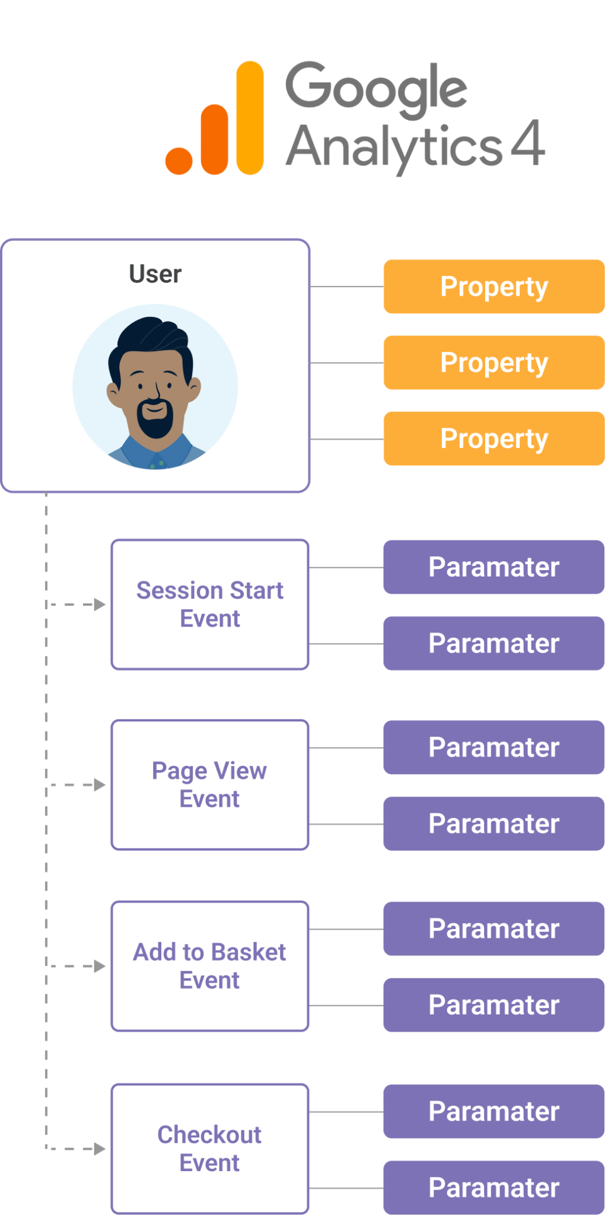
Google Analytics 4 (GA4) Data Model
GA4: A model driven by events, offering improved tracking flexibility.
GA4 Events: Includes both Default and Custom Events.
Instead of traditional dimensions and metrics, it uses parameters.
It improves cross-platform and device user tracking.

Slide 5
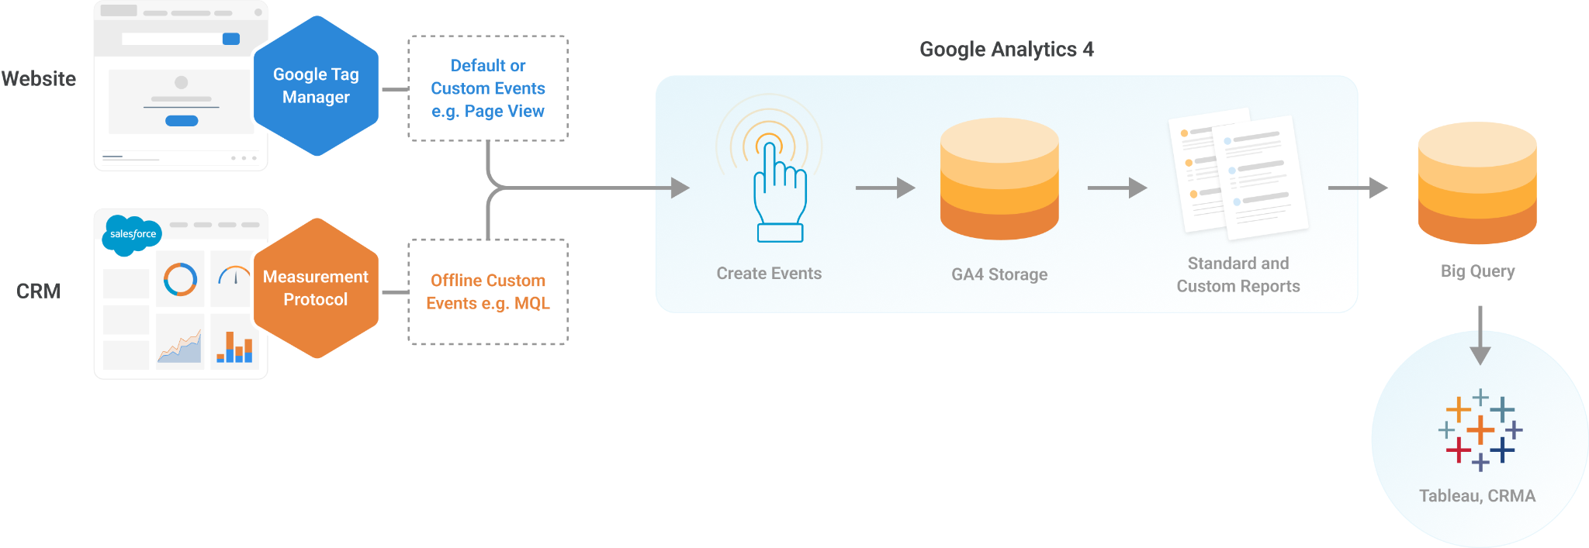
Google Analytics 4 (GA4) Data Model (cont.)

Slide 6
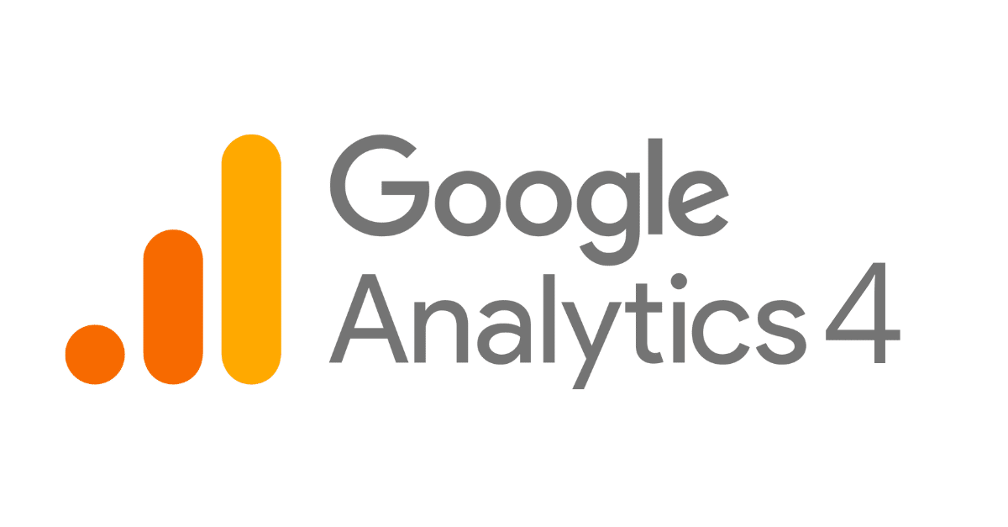
Salesforce and GA4 Integration Framework
Uses Account Engagement Forms to gather prospect data
Leverages Account Engagement Marketing App Extensions
Utilizes Engagement Studio to make external calls from Account Engagement
Feeds data to GA4 via the Measurement Protocol (MP)
+

Slide 7
Salesforce and GA4 Integration Framework

Slide 8
Preparing for Salesforce and GA4 Integration
Find GA4 Measurement ID and Measurement API Secret Key
Set up forms to capture Client ID, Session ID, and Timestamp
Install the Salesforce & GA4 Integration package
Set up a new Marketing App with a new External Action
FORM
WEBSITE
SALESFORCE
GA4

Slide 9
DEMO

Slide 10
Use cases to integrate offline conversions
Allocate the marketing budget using accurate and real conversion data.
Develop a comprehensive understanding of customer interactions and engagement.
Acquire deeper insights into complex customer behavior patterns and preferences.
Enhance the accuracy of attributing offline conversions to marketing efforts.

Slide 11
Thank You!

