Slide 1
Bringing an Architect Mindset to Your Marketing Tools
Vicki Moritz-Henry
Certified Instructor & Architect

Slide 2
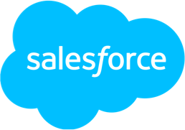
Thanks To Our Incredible Sponsors!

Slide 3
Agenda
What is the Well-Architected Framework?
Architecture Diagrams
Anti-Patterns / Scenarios to Avoid
Using Salesforce Solution Kits

Slide 4
Well-Architected Framework

Slide 5
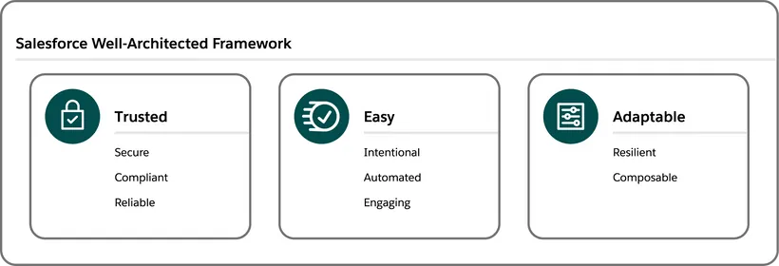
What is it?

Slide 6
Trusted

Slide 7
Secure
What type of data are you bringing into your marketing system?
Does it need to be there?
Be the guardians of your marketing data. Only bring data into the system that you need for marketing purposes.

Slide 8
Compliant
GDPR: Do you have a clear 360 degree view of your customer? Do you have contact delete processes in place to respect the right to erasure?
CAN-SPAM: Do you have clear team alignment around commercial vs. transactional messages? Do your opt-outs sync with any systems that may be sending emails?
Just to name a few…..
When in doubt, check with legal.

Slide 9
Reliable
GDPR: Do you have a clear 360 degree view of your customer? Do you have contact delete processes in place to respect the right to erasure?
CAN-SPAM: Do you have clear team alignment around commercial vs. transactional messages? Do your opt-outs sync with any systems that may be sending emails?
Just to name a few…..
When in doubt, check with legal.

Slide 10
Easy

Slide 11
Intentional
Have you gotten input from other teams who either may be effected or have some insight into your customers?
Is there a clear intent behind your marketing, messages and automation?
Use the description fields on your marketing assets to practice Intentional Marketing.

Slide 12
Automated
Search for manual processes and automate them!
Conversion points
Record updates
Internal notifications
The sky is the limit!

Slide 13
Engaging
Create engaging content!
Do you have all the engagement points mapped out?
Which system are they coming from?
Have you created a customer journey map?

Slide 14
Adaptable

Slide 15
Resilient
Do we have error handling built into the system?
Who gets error messages?
Do you have customer-facing processes in place for any issues encountered?
What happens if we have missing data points? Are we able to handle null values like First Name?
I HATE getting emails starting with
Hi ,
Buy my product!

Slide 16
Composable
Journey Builder: Are my journeys discrete journeys around a single goal or objective?
Email creation: (In MC) Am I creating reusable content blocks for any commonly used content? (In MCAE) Am I creating reusable pieces of dynamic content or using snippets?

Slide 17
Architect Diagrams:
Three Diagrams Architects Can’t Live Without

Slide 18
Your Logo Here
Slack
Sales
Service
Success
Business Capability Map
Marketing
Mulesoft
Learning
Commerce
Platform
Sustainability
This Level 1 Marketing, Strategy, and Sales diagram example details business drivers and capabilities that are a part of a company's transformational vision, and high-level product positioning required to make that vision a reality.
Analytics
Industries
Partners
Business Drivers
Website
Mobile App
Social
SMS
Chat
Email
Meet shoppers where they are
Drive awareness and acquisition
Realize revenue and employee success
Deliver superior customer service
Personalize the customer journey
Commerce
Experience
Sales
Service
Marketing
Site Merchandising
Shopper Experience
Pricing Management
Promotion Management
Order Capture
Order Fulfillment
Self Service
Content Management
Loyalty Management
Lead Management
Onboarding
Training
Cross-Channel Service
Knowledge Management
Predictive Service
Case Management
Returns Management
Order on Behalf
Audience Management
Campaign Management
Journey Management
Marketing Analytics
Privacy Management
Salesforce Customer 360
Content Management
ERP System

Slide 19
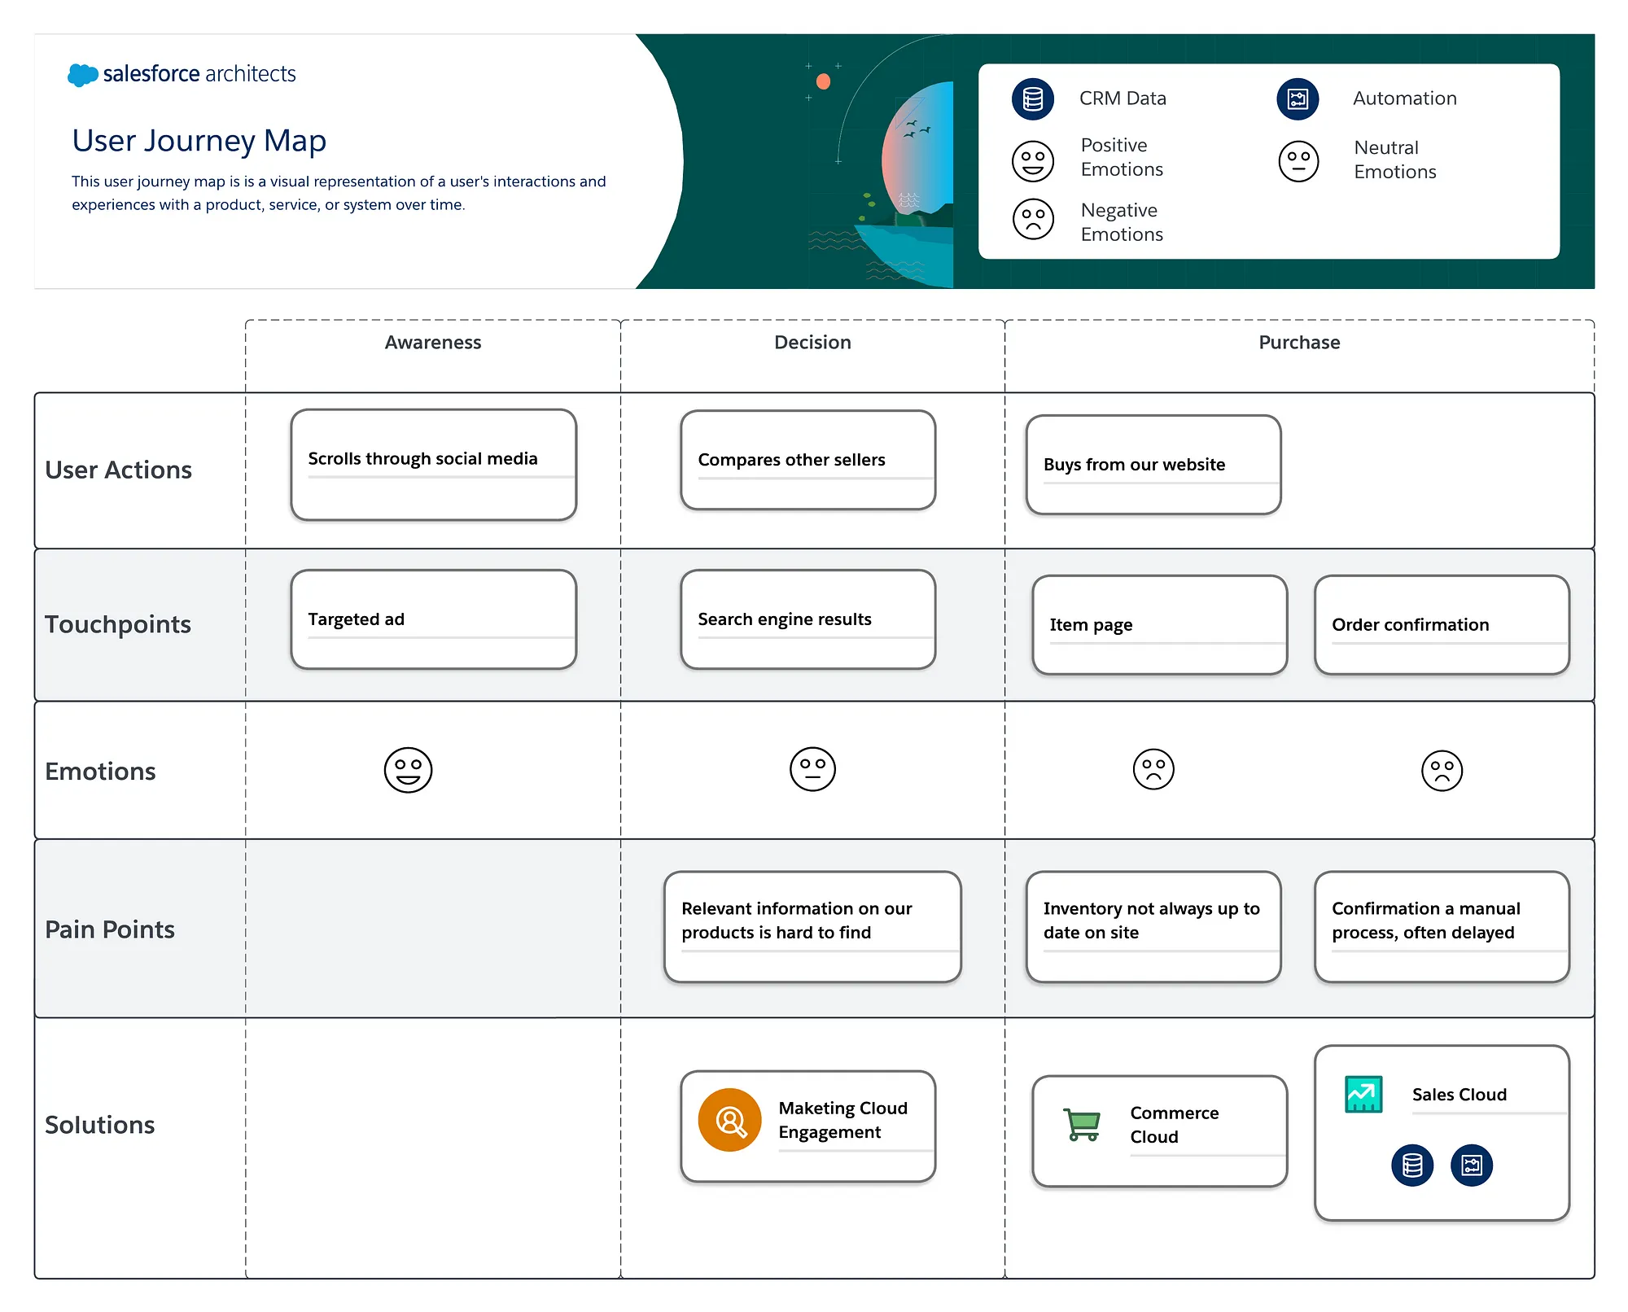

Slide 20
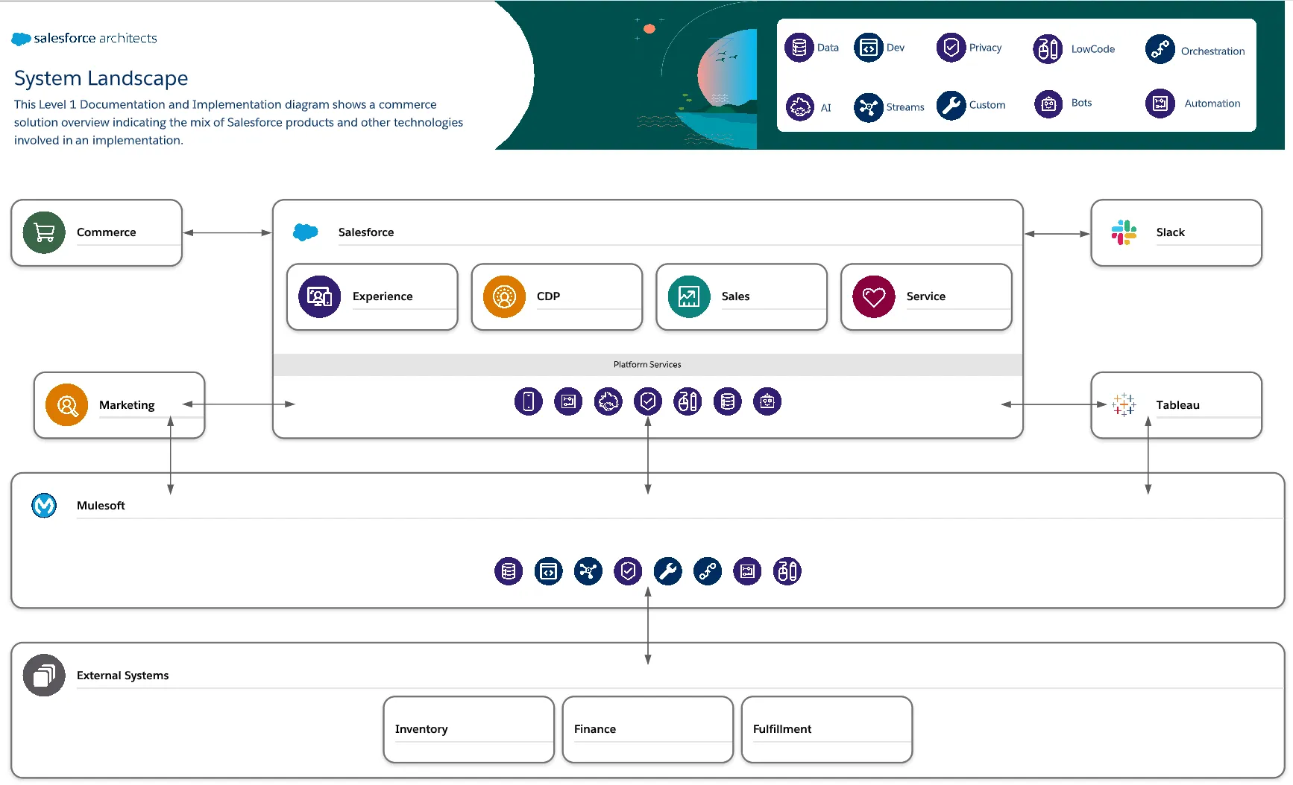

Slide 21
Let’s Talk Scenarios…

Slide 22
Know Where Marketing Fits In the System/Solution Landscape
What data do you need for your marketing? Where is that data coming from?
Do you have data being stored in your marketing tool that would be better off somewhere else?
What data needs to be synced back to other systems?
What is the ultimate business case behind using an marketing automation tool? What are you goals and KPIs?

Slide 23
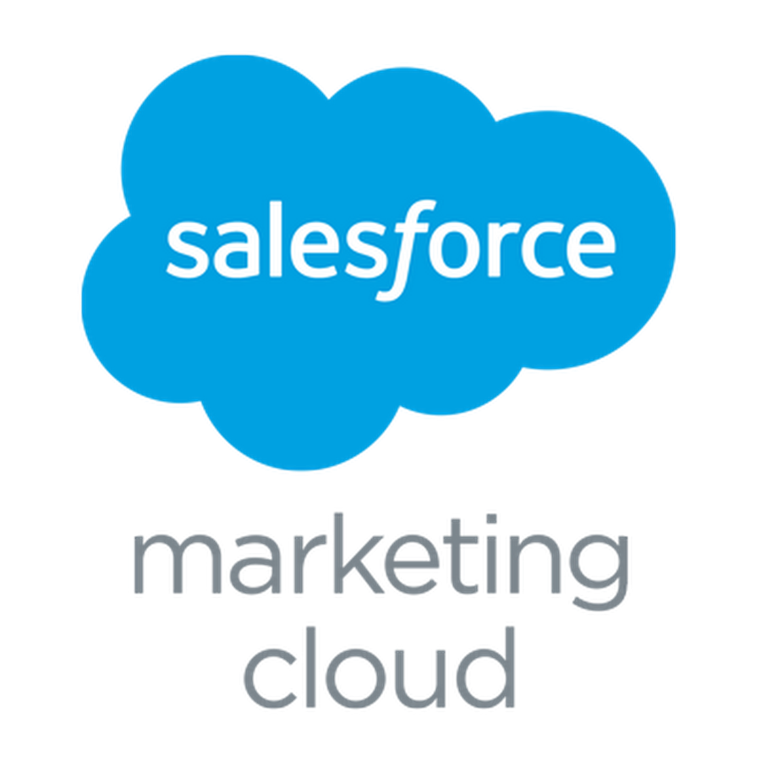
Anti-Pattern
Unclear data flow in system landscape.
Customer fills out a Marketing Cloud SmartCapture form on a CloudPage subscribing to communications.
Subscriber data captured in Data Extension.
Data Extension used to send 3 welcome emails in Journey Builder, then adds to the contact record to Salesforce via MCC.
Email address becomes Contact Key on send.
Contacts synchronized into MC from Sales Cloud with the Contact Record ID as the Contact Key.
Two billable contacts, no consistency in messaging or analytics.

Slide 24
Marketing Cloud Connect Example
Contact Key = Lead/Contact Record ID
Email
Lead record brought into a Synchronized Data Extension
Lead ID used as Contact Key
Astro fills out a Web-to-Lead form
Assigned a Lead ID in SF
Sales Cloud
Marketing Cloud
SMS
Paid Advertising

Slide 25
Know Where Marketing Fits In the Customer Journey
What are your campaign goals and strategies?
What are the various touchpoints?
What triggered communications do you have in your marketing automation? If a customer has a certain interaction with you, what sorts of communication will they receive?

Slide 26
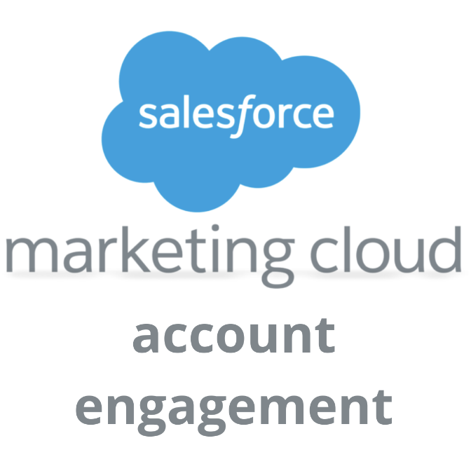
Anti-Pattern
Unclear documentation about what happens based off a customer touchpoint.
Customer fills out an Account Engagement landing page to access a demo.
Completion Action: Auto-responder email with a link to the demo & adding them to the Demo Interest List.
Engagement Program: Sends a series of emails to the Demo Interest list prompting them to sign up for a live demo and giving them the link to recording if no engagement.

Slide 27
Let’s Explore the Salesforce Solution Kits & the Customer 360 Guide…

Slide 28
Your Logo Here
Single Source of Truth
Streams
Customer 360 Audiences
Retail Storefront Solution Architecture
This Level 2 Marketing, Strategy, and Sales diagram example details the products and technology directly involved in a retail storefront solution.
Segments
Personalization
Salesforce
Commerce
Marketing
Preferences, clicks, email opens
Orders
Offers
Pricing
Catalog
Experience
Sales
Engagement
Campaigns
Intelligence
Interaction Streams
Affinity & Intent
Order on behalf
Order history
Seamless identity
Profile
Personalization
Self-Service
Accounts, Contacts
Orders
Reports & Dashboards
Distributed Marketing
Personalized Communications
Abandoned cart
Coupon redemption
Personalized marketing
Recommendations
Transactional emails
Service
Customer Data Platform
Social Customer Service
Contacts
Cases
Offers
Tableau
Mulesoft
Industry Data Sources
Supplier & Partner Ecosystem
Content Management
ERP System
Leads, Forecasts, Inventory, POS, etc.
External context

Slide 29
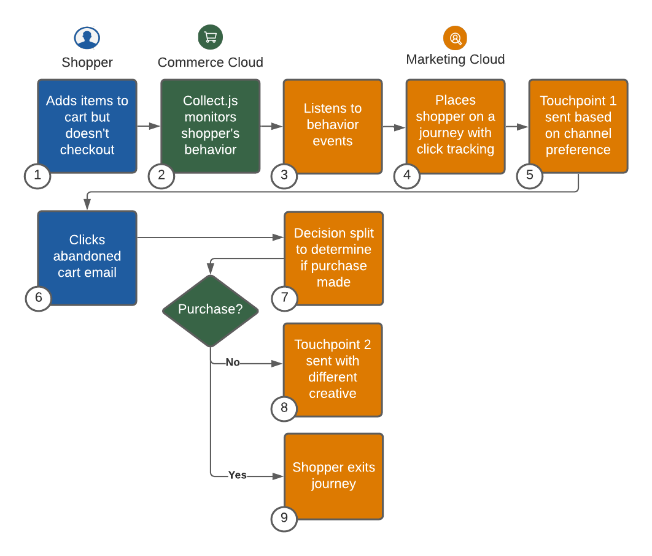
Abandoned Cart Solution Kit (Solution Kit for Retail)

Slide 30
Summary
Apply the Well-Architected Framework to every solution and to your day-to-day role.
Don’t forget to think high-level and how all of your marketing assets will fit together in the solution and the system landscape.
Take the time to make diagrams and document your work. Future “you” will thank you!

Slide 31
Resources
Salesforce Architect Website: https://architect.salesforce.com/
Customer 360 Guide for Retail: https://help.salesforce.com/s/articleView?id=sf.icx_b2c_intro_parent.htm&type=5
Trailhead: Salesforce Solution Kits: Quick Look: https://trailhead.salesforce.com/content/learn/modules/salesforce-solution-kits-quick-look
Salesforce Architect Blog: Three Diagrams Architects Can’t Live Without: https://medium.com/salesforce-architects/three-diagrams-architects-cant-live-without-2bce9aaacad0

Slide 32
Thank You!
Any questions?
Stay in touch on LinkedIn or Twitter.
LinkedIn: https://bit.ly/VickiMoritzHenry
Twitter: @VickiHenry63

